Slide 1
PHY 742 Quantum Mechanics II
1-1:50 AM MWF Olin 103
Plan for Lecture 11
Time dependent perturbation theory
Ref: Chapter 15
Introduction
Sudden approximation
Time harmonic perturbations

Slide 2
Topics for Quantum Mechanics II
Single particle analysis
Single particle interacting with electromagnetic fields – EC Chap. 9
Scattering of a particle from a spherical potential – EC Chap. 14
More time independent perturbation methods – EC Chap. 12, 13
Single electron states of a multi-well potential ➔ molecules and solids – EC Chap. 2,6
Time dependent perturbation methods – EC Chap. 15
Path integral formalism (Feynman) – EC Chap. 11.C
Relativistic effects and the Dirac Equation – EC Chap. 16
Multiple particle analysis
Quantization of the electromagnetic fields – EC Chap. 17
Photons and atoms – EC Chap. 18
Multi particle systems; Bose and Fermi particles – EC Chap. 10
Multi electron atoms and materials
Hartree-Fock approximation
Density functional approximation

Slide 3
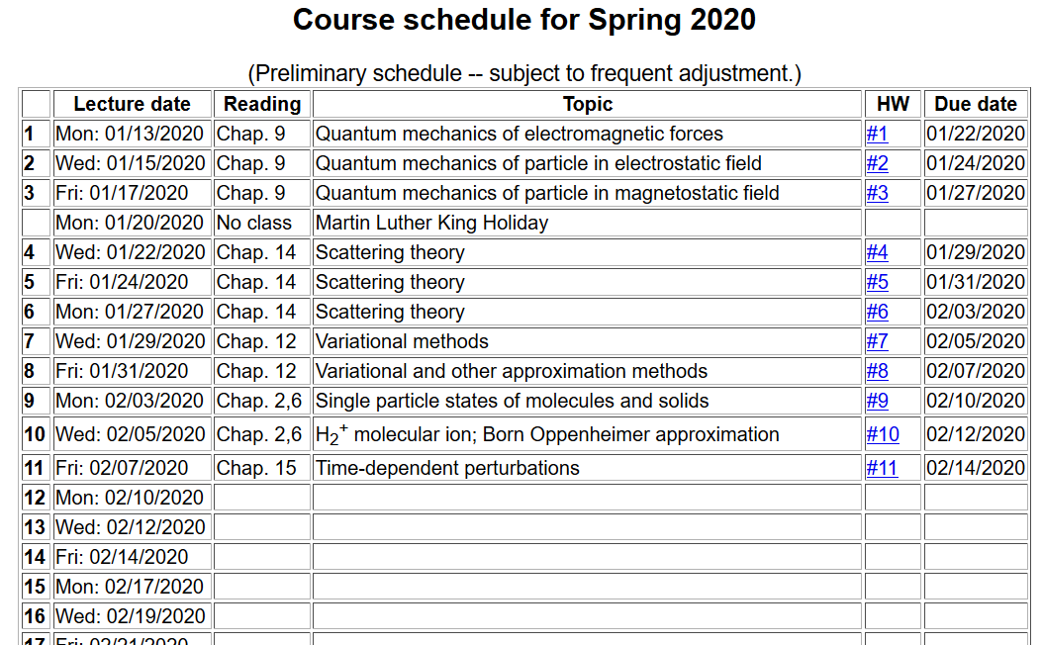

Slide 4
Time dependence in quantum mechanics

Slide 5
Sudden approximation
This method is useful when there is an abrupt change in the Hamiltonian of the system
This can happen when we have a nuclear process occur which is “sudden” for the electronic states. It is also a reasonable approximation for some X-ray absorption processes in which an electron is suddenly removed from the core of an atom.

Slide 6
Sudden approximation -- continued

Slide 7
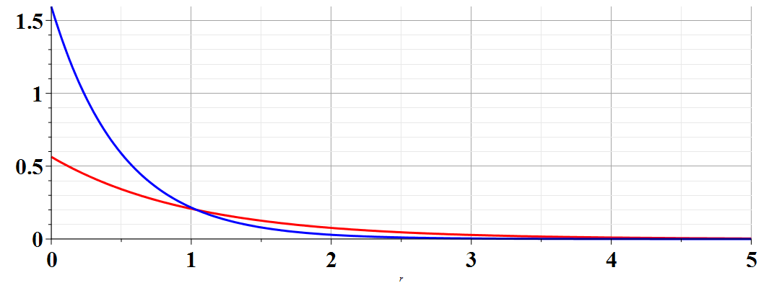
Example of a H-like ion initially with Z^{A}=2,
transforming to one with Z^{B}=1.
Similar to HW #11
A
Z^{A}=2
B
Z^{B}=1
➔Probability of H-like ion remaining in ground state:

Slide 8
Another example -- Harmonic oscillator with time varying frequency

Slide 9
Range of validity of sudden approximation

Slide 10
Treatment of time-dependent perturbations

Slide 11
Treatment of time-dependent perturbations -- continued

Slide 12
Treatment of time-dependent perturbations -- continued

Slide 13
Treatment of time-dependent perturbations -- continued

Slide 14
Treatment of time-dependent perturbations -- continued

Slide 16
Treatment of time-dependent perturbations -- continued
largest T
larger T
small T

Slide 17
Estimating the rate of transitions I → f
Fermi “Golden” rule

Slide 18
Example
H atom in presence of electric field

Slide 19
Example
H atom in presence of electric field

Slide 21
Summary of results for resonant transitions for H-like ion 1s→2p₀

Slide 22
Digression: Notion of oscillator strength for transition between states l→n:
sum rule for oscillator strength

Slide 23
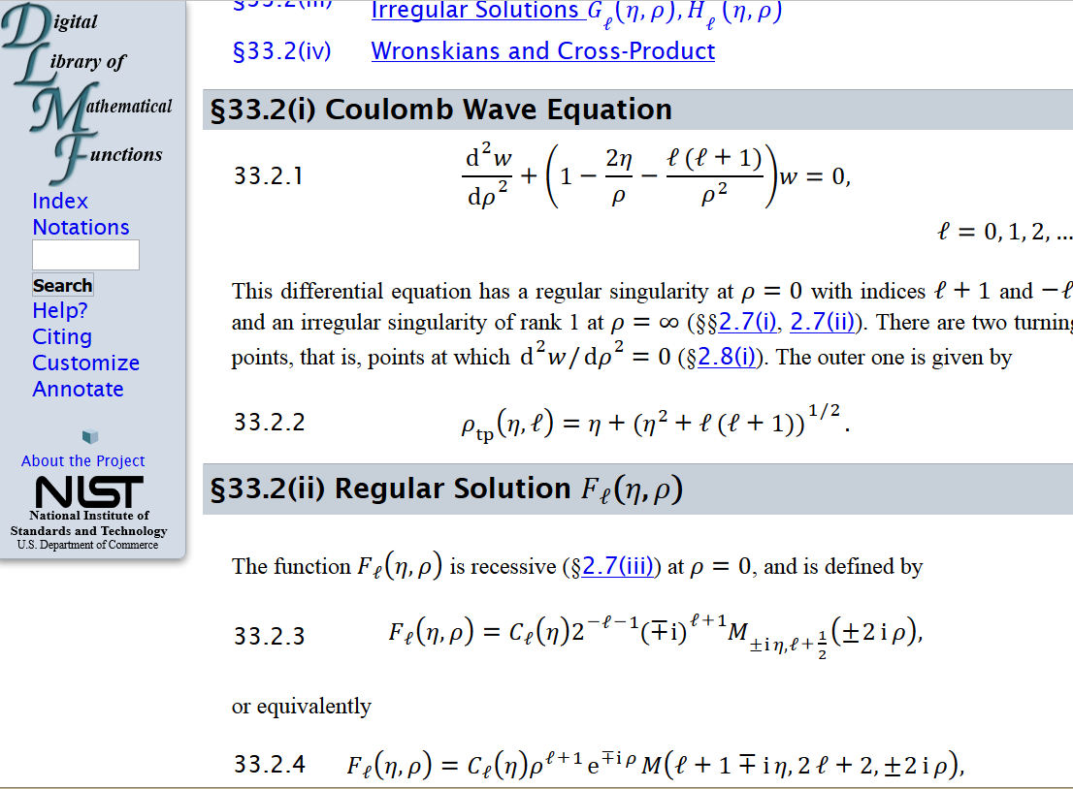
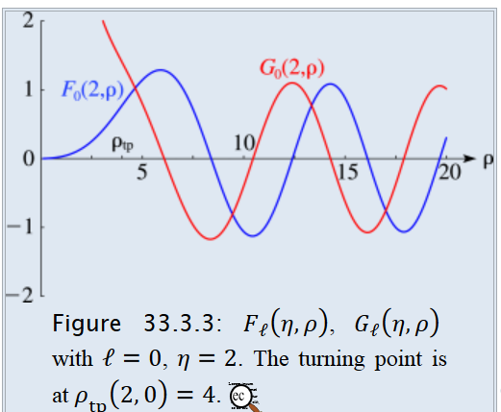
Absorption of radiation in the case of photo emission
From: http://dlmf.nist.gov/33.2

Slide 24
Absorption of radiation in the case of photo emission
approximating final state as a plane wave (Born approximation)
Note: In a more accurate treatment, one should modify the static electric field in order to account for electrodynamics …

Slide 25
For a H-like ion in a beam of photons with flux S, it is convenient to define a cross section:
(Details: Merzbacher, Quantum Mechanics, third ed. (1998)

