Slide 1
PHY 742 Quantum Mechanics II
1-1:50 AM MWF Olin 103
Plan for Lecture 12
Time dependent perturbation theory
Ref: Chapter 15
Time harmonic perturbations
Fermi Golden Rule
Oscillator strength

Slide 2
Topics for Quantum Mechanics II
Single particle analysis
Single particle interacting with electromagnetic fields – EC Chap. 9
Scattering of a particle from a spherical potential – EC Chap. 14
More time independent perturbation methods – EC Chap. 12, 13
Single electron states of a multi-well potential ➔ molecules and solids – EC Chap. 2,6
Time dependent perturbation methods – EC Chap. 15
Path integral formalism (Feynman) – EC Chap. 11.C
Relativistic effects and the Dirac Equation – EC Chap. 16
Multiple particle analysis
Quantization of the electromagnetic fields – EC Chap. 17
Photons and atoms – EC Chap. 18
Multi particle systems; Bose and Fermi particles – EC Chap. 10
Multi electron atoms and materials
Hartree-Fock approximation
Density functional approximation

Slide 3
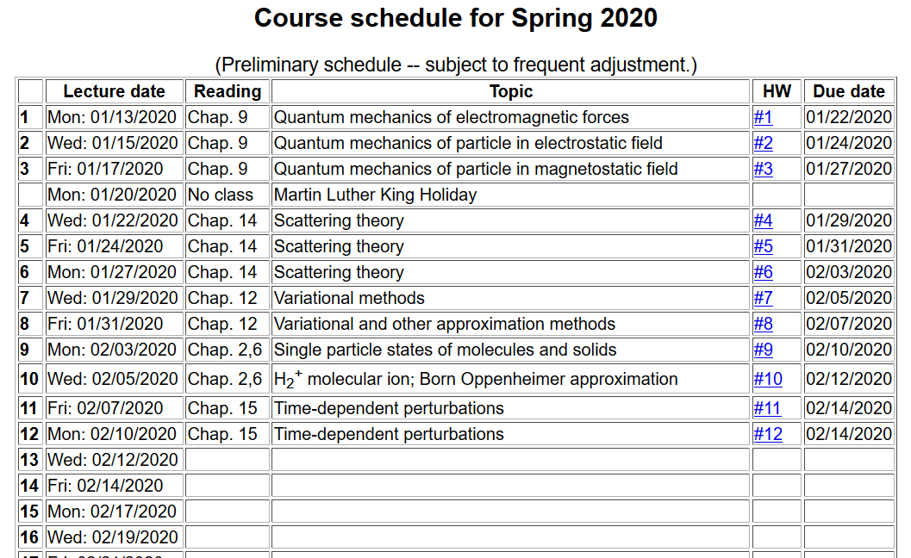

Slide 4
Review: Treatment of time-dependent perturbations

Slide 5
Treatment of time-dependent perturbations -- continued

Slide 6
Treatment of time-dependent perturbations -- continued

Slide 7
Treatment of time-dependent perturbations -- continued

Slide 8
Treatment of time-dependent perturbations -- continued

Slide 10
Treatment of time-dependent perturbations -- continued
largest T
larger T
small T

Slide 11
Estimating the rate of transitions I → f
Fermi “Golden” rule

Slide 12
Example – Zero order system in the presence of an electromagnetic field

Slide 13
Example – Zero order system in the presence of an electromagnetic field -- continued

Slide 14
Example – Zero order system in the presence of an electromagnetic field -- continued
(note slight cheat)

Slide 15
Example – Zero order system in the presence of an electromagnetic field -- continued

Slide 16
Example – Zero order system in the presence of an electromagnetic field -- continued
Fermi golden rule:

Slide 17
Example -- H-like atom in presence of electric field

Slide 19
Summary of results for resonant transitions for H-like ion 1s→2p₀

Slide 20
Digression: Notion of oscillator strength for transition between states l→n:
sum rule for oscillator strength

Slide 21
Digression – “selection rules” for transitions between spherically symmetric states in due to interaction with an electromagnetic field in the dipole approximation --

Slide 22
Example when the final state is in the continuum spectrum
Exact solutions for continuum states of H-like ions are related to confluent hypergeometric functions

Slide 23
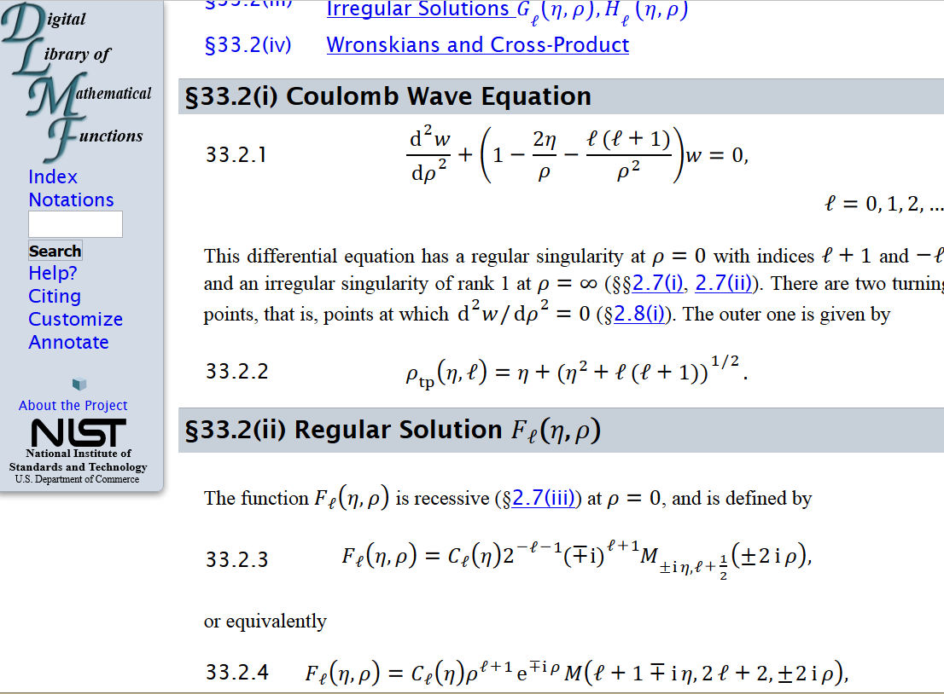
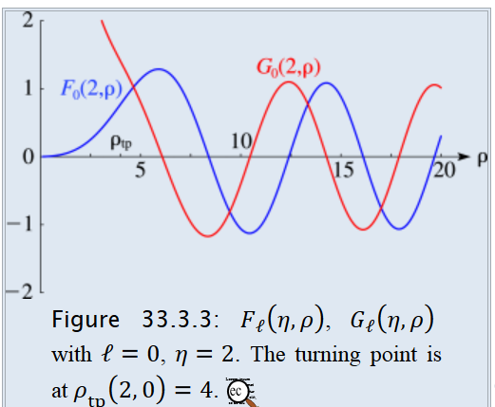
Absorption of radiation in the case of photo emission
From: http://dlmf.nist.gov/33.2

Slide 24
Absorption of radiation in the case of photo emission
approximating final state as a plane wave (Born approximation)
To be continued …

