Slide 1
PHY 742 Quantum Mechanics II
1-1:50 AM MWF Olin 103
Plan for Lecture 13
Time dependent perturbation theory
Ref: Chapter 15
Fermi Golden Rule for bound → continuum transition.

Slide 2
Topics for Quantum Mechanics II
Single particle analysis
Single particle interacting with electromagnetic fields – EC Chap. 9
Scattering of a particle from a spherical potential – EC Chap. 14
More time independent perturbation methods – EC Chap. 12, 13
Single electron states of a multi-well potential ➔ molecules and solids – EC Chap. 2,6
Time dependent perturbation methods – EC Chap. 15
Path integral formalism (Feynman) – EC Chap. 11.C
Relativistic effects and the Dirac Equation – EC Chap. 16
Multiple particle analysis
Quantization of the electromagnetic fields – EC Chap. 17
Photons and atoms – EC Chap. 18
Multi particle systems; Bose and Fermi particles – EC Chap. 10
Multi electron atoms and materials
Hartree-Fock approximation
Density functional approximation

Slide 3
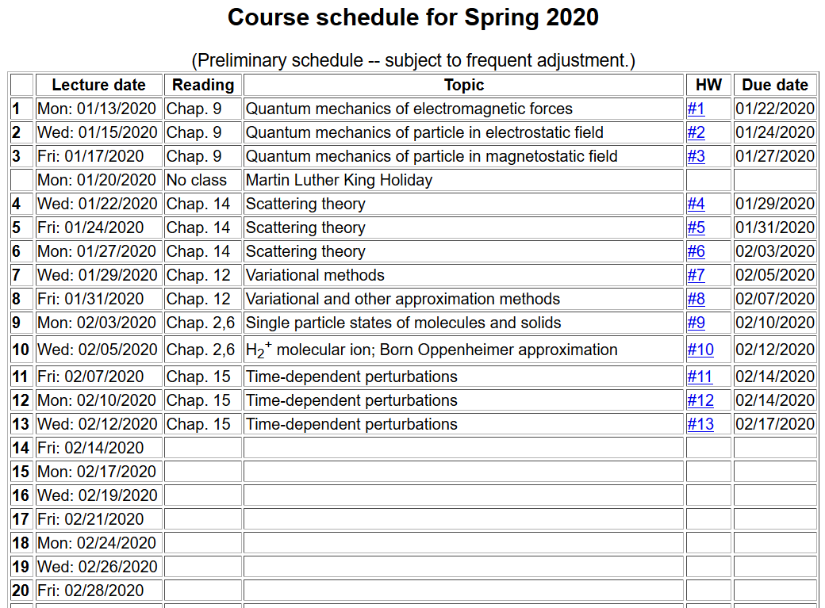

Slide 4
Summary of results of 1st order theory for a time harmonic perturbation of the form:
Fermi golden rule:
Treatment of the case when the initial state is bound and the final state is in the continuum spectrum --

Slide 5
Absorption of radiation in the case of photoemission of a H-like atom
It is convenient to approximate the final state as a plane wave (Born approximation)
Transition rate:

Slide 6
Convenient coordinate system --
z
F
k
r
y
x

Slide 7
Approximate photoemission -- continued
z
F
k
r
y
x

Slide 8
Approximate photoemission -- continued

Slide 9
Approximate photoemission -- continued
Digression – In general, the full transition rate is determined by averaging over all initial states and summing over all final states.
In our case, there is only one initial state, but a continuum of final states.

Slide 10
Approximate photoemission -- continued
Note that there are multiple values of k for each

Slide 11
Digression – how can we count the number of plane waves?
L
L
L

Slide 12
Approximate photoemission -- continued

Slide 13
Summary of results --
z
F
k
r
y
x

