Slide 1
PHY 742 Quantum Mechanics
1-1:50 AM MWF Olin 103
Plan for Lecture 15:
The Dirac equation
Chap. 16 in Professor Carlson’s textbook:
Dirac equation for a free particle
Dirac equation for a hydrogen atom

Slide 2
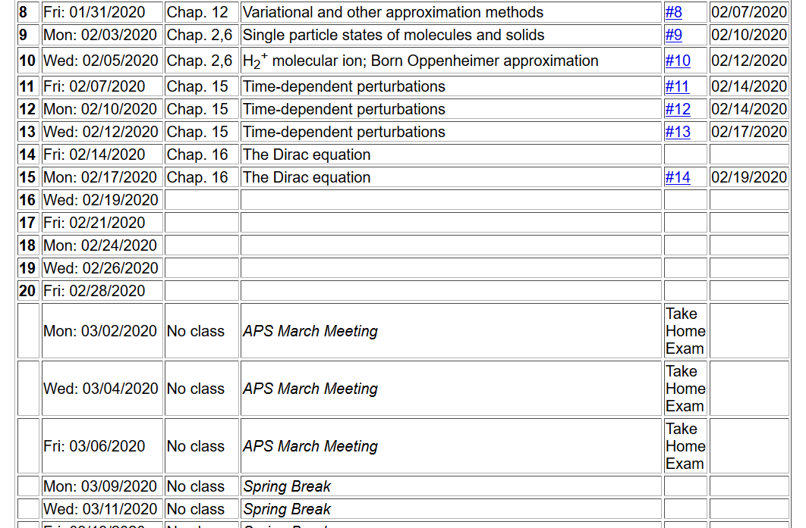

Slide 3
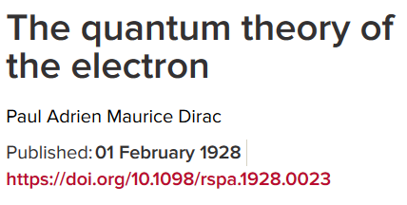
P. A. M Dirac 1902-1984
Won Nobel Prize in Physics in 1933
together with Erwin Schrödinger

Slide 4
Energy ⬅➔Momentum relationships in classical and quantum mechanics
Focusing on treatment of Fermi particles
Non-relativistic mechanics
Relativistic mechanics
Classical
Quantum

Slide 5
Relativistic relationships – continued
Ref: J. J. Sakurai, Advanced Quantum Mechanics

Slide 6
Relativistic relationships – continued
Ref: J. J. Sakurai, Advanced Quantum Mechanics

Slide 7
Relativistic relationships – continued

Slide 8
Four component wavefunction of free Fermi particle

Slide 11
What does this all mean?

Slide 12
Dirac equation for free particles – slightly more convenient notation
mc²
-mc²
For free particle, E>0 and E<0 solutions represent distinct physical situations.

Slide 13
Dirac equation for a free particle

Slide 14
Dirac equation for Fermi particle in a scalar potential field

Slide 15
Dirac equation for electron in the field of a H-like ion

Slide 16
Dirac equation for electron in the field of a H-like ion -- continued

Slide 17
Digression – useful identity for operator vectors A and B

Slide 18
Dirac equation for electron in the field of a H-like ion -- continued

Slide 19
Dirac equation for electron in the field of a H-like ion -- continued
We can
show that:

Slide 20
Dirac equation for electron in the field of a H-like ion -- continued

Slide 21
More relationships between the operators

Slide 22
Summary of allowed combinations of eigenvalues
Alternatively

Slide 23
Addition of angular momentum - orbital angular momentum and spin angular momentum

Slide 24
Another representation of the spin-angular function in terms of spherical harmonic functions and eigenvectors of σ_{z}

Slide 26
Question:
How do these results reduce to the Schroedinger equation in the non-relativistic limit
What new physics is contained more generally?

