Slide 1
PHY 742 Quantum Mechanics
1:00-1:50 AM MWF Olin 103
Plan for Lecture 17:
Dirac equation for hydrogen-like ions and other atoms
Chap. 16 in Carlson’s text – Supplemented with J. J. Sakurai, Advanced QM
Review of results for H-like ions
Generalization to approximate treatment of spherical atoms
Comparison with non-relativistic results

Slide 2
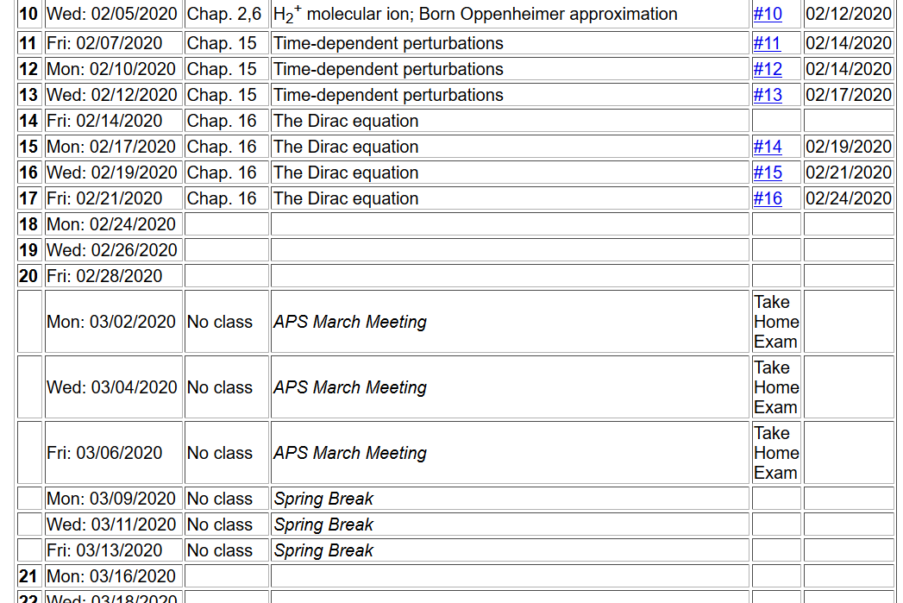

Slide 3
Dirac equation for electron in a scalar, spherically symmetric potential V(r)
We can
show that:

Slide 5
Summary of allowed combinations of eigenvalues
Alternatively

Slide 8
Dirac equation for electron in the field of a H-like ion
Comparison with Schrödinger equation --
Schematic diagram:
3d_{5/2}
κ=-3
3s,3p,3d
3p_{3/2},3d_{3/2}
κ= ± 2
3s_{1/2},3p_{1/2}
κ= ± 1
2s,2p
2p_{3/2}
κ=-2
2s_{1/2},2p_{1/2}
κ= ± 1
1s
1s_{1/2}
κ=-1

Slide 9
Physical differences due to Dirac equation on the H-like ions

Slide 10
Physical differences due to Dirac equation on the H-like ions

Slide 11
Some details

Slide 12
More details about ground state of H-like ion from Dirac equation

Slide 13
Practical solution of radial portions of Dirac equation

Slide 14
More general treatment of bound states of Fermi particle within spherical potential V(r) -- continued

Slide 15
More general treatment of bound states of Fermi particle within spherical potential V(r) -- continued

Slide 16
More general treatment of bound states of Fermi particle within spherical potential V(r) -- continued

Slide 18
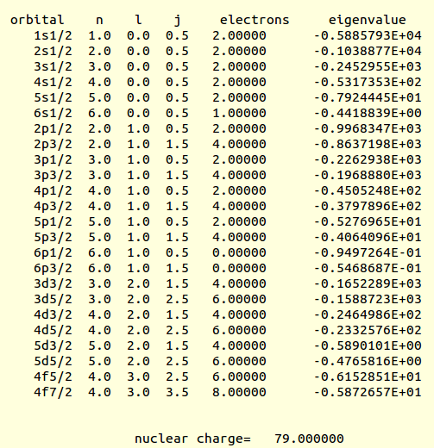
Example results for Au (from an old code)
(Ry units)

Slide 19
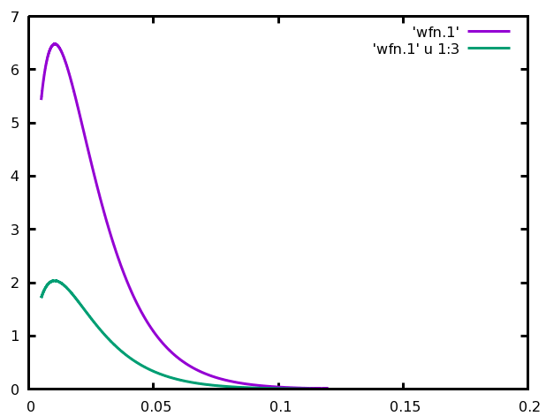
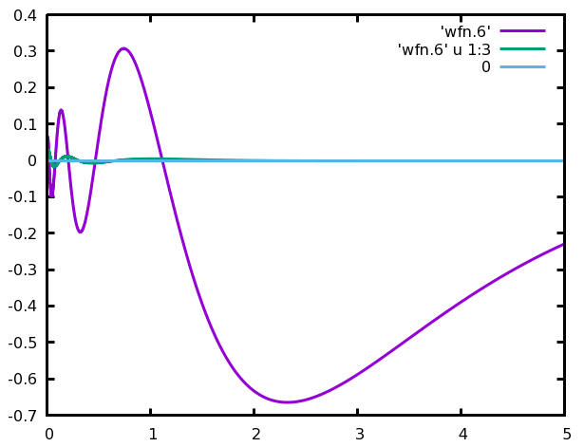
1s_{1/2}
G
For Au
F
6s_{1/2}
F
G

Slide 20
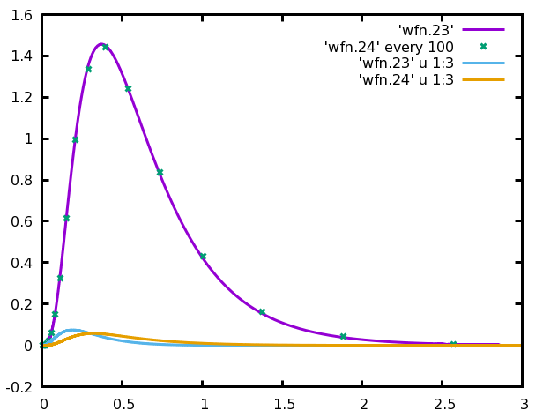
For Au
G_{4f5/2}
G_{4f7/2}
F_{4f5/2}
F_{4f7/2}

Slide 21
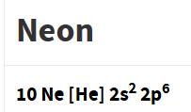
More general treatment of bound states of Fermi particle within spherical potential V(r) – continued
Some sample results within density functional theory
Ref. https://www.nist.gov/pml/data/results
Energy unit is “Hartree
1H= 27.21138602 eV
Non-relativistic
Relativistic
J=1/2
J=1/2
J=1/2
J=3/2
1s | -30.305855 |  | -30.314393
2s | -1.322809 |  | -1.326075
2p | -0.498034 |  | -0.500040 -0.496232

Slide 22
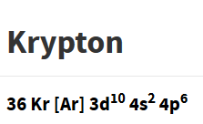
Non-relativistic
Relativistic
1s | -509.982989 |  | -517.456410
2s | -66.285953 |  | -68.209637
2p | -60.017328 |  | -61.753188 -59.789712
3s | -9.315192 |  | -9.639319
3p | -7.086634 |  | -7.347319 -7.057577
3d | -3.074109 |  | -3.032140 -2.984281
4s | -0.820574 |  | -0.851373
4p | -0.346340 |  | -0.361325 -0.33742
J=1/2
J=1/2
J=1/2
J=3/2
J=1/2
J=1/2
J=3/2
J=3/2
J=5/2
J=1/2
J=1/2
J=3/2

