Slide 1
PHY 742 Quantum Mechanics II
1-1:50 AM MWF Olin 103
Plan for Lecture 2
Quantum particle interacting with classical electromagnetic fields
Reading: Chapter 9 in Carlson’s textbook
Summary of basic equations
Examples based on electrostatic fields

Slide 2
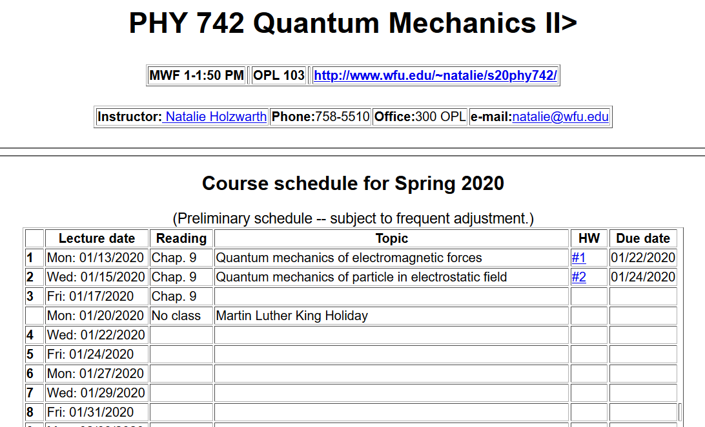

Slide 3
General formalism for the quantum mechanics of a particle of mass m and charge q interacting with a electromagnetic field with scalar potential U(r,t) and vector potential A(r,t) --
⬅differs only by phase factor

Slide 4
For electrostatic and/or magnetostatic fields, the time dependence of the fields becomes trivial, and we expect stationary state solutions to the Schrödinger equation

Slide 5
Example of particle interacting with an electromagnetic field
U(x)
E
Energy
x
a

Slide 6
One dimensional Schrödinger equation for charged particle in an electrostatic field – continued:
U(x)
E
Energy
x
a

Slide 7
Digression – library of solutions to differential equations
http://dlmf.nist.gov/

Slide 8
http://store.doverpublications.com/0486612724.html

Slide 9
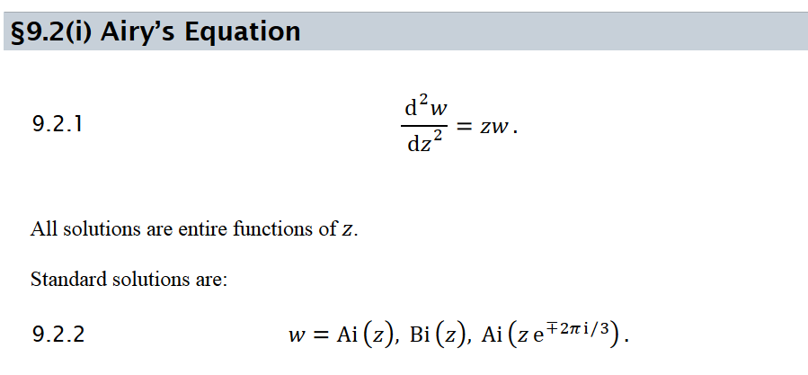

Slide 10
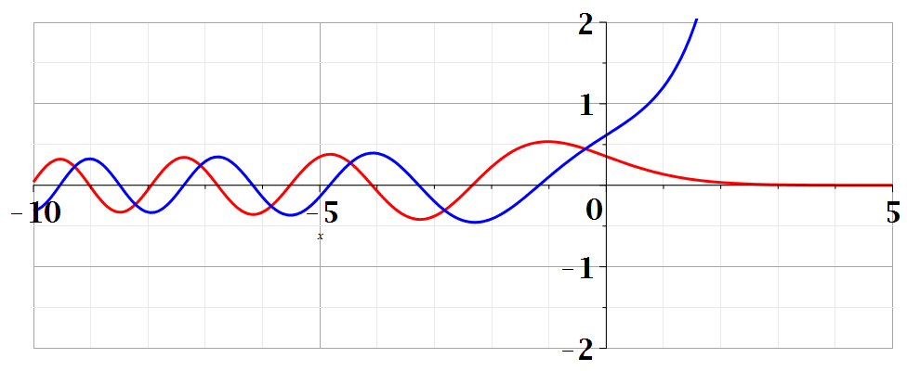
Bi(z)
Ai(z)

Slide 11
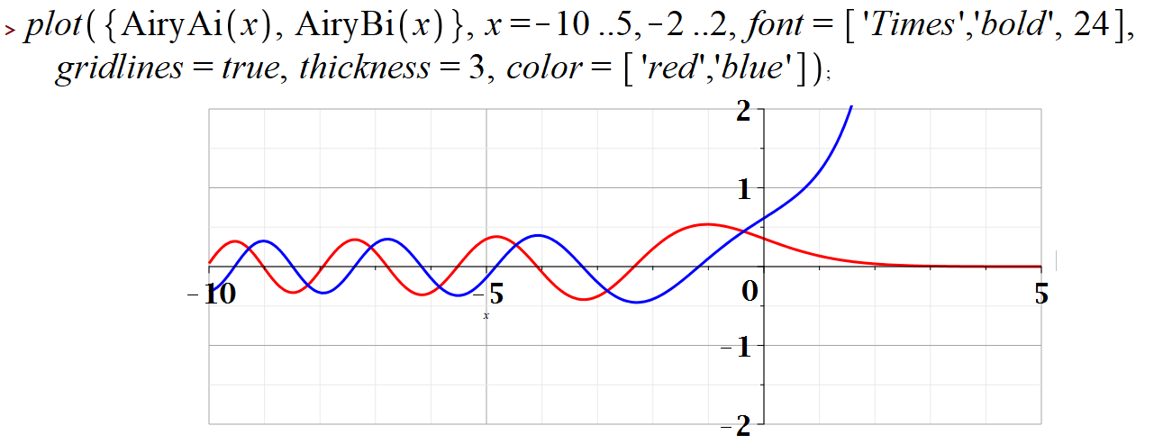
Example Maple input --

Slide 12
⬅normalization constant

Slide 13
Some properties of Airy functions –
Integral form:

Slide 14
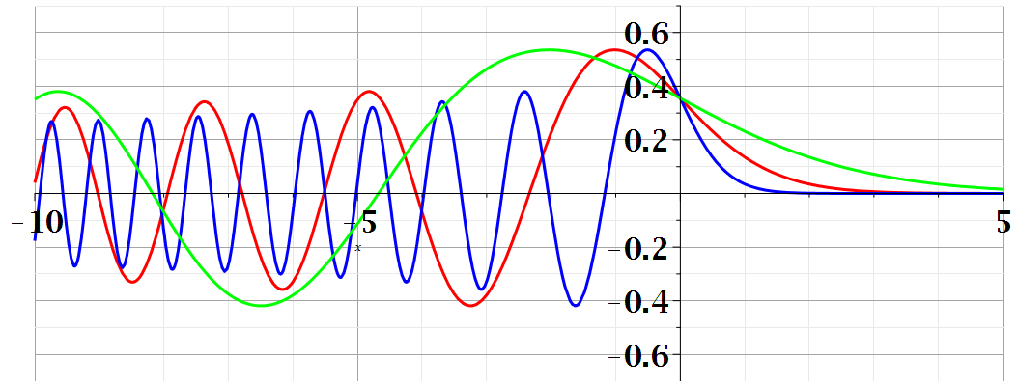
Summary of results
Note that in this case, physical solutions exist for all energies E; the wavefunction oscillates for
x<a+E/qF and decays for x>a+E/qF .

Slide 15
Related example with bound stationary state solutions --
Discrete energy levels
U(x)
x

