Slide 1
PHY 742 Quantum Mechanics II
1-1:50 AM MWF Olin 103
Plan for Lecture 20
Review of single-particle Quantum Mechanics

Slide 2
Topics for Quantum Mechanics II
Single particle analysis
Single particle interacting with electromagnetic fields – EC Chap. 9
Scattering of a particle from a spherical potential – EC Chap. 14
More time independent perturbation methods – EC Chap. 12, 13
Single electron states of a multi-well potential ➔ molecules and solids – EC Chap. 2,6
Time dependent perturbation methods – EC Chap. 15
Relativistic effects and the Dirac Equation – EC Chap. 16
Path integral formalism (Feynman) – EC Chap. 11.C
Multiple particle analysis
Quantization of the electromagnetic fields – EC Chap. 17
Photons and atoms – EC Chap. 18
Multi particle systems; Bose and Fermi particles – EC Chap. 10
Multi electron atoms and materials
Hartree-Fock approximation
Density functional approximation

Slide 3
Comment on exam
Three multipart problems
Be careful about units. Professor Carlson’s text is in SI units. Many graduate level texts are in cgs Gaussian units as are some of the PHY 742 lecture notes. It is often convenient/advisable to convert to dimensionless units.
In your spare time, think about your presentation topic

Slide 4
Interaction of a particle of mass m and charge q with an electromagnetic field:
Classical Hamiltonian in SI units:
Quantum Hamiltonian in SI units and in coordinate representation:
Relationship of scalar and vector potentials to electric and magnetic fields:

Slide 5
Summary of results --

Slide 6
Consideration of effects of a static magnetic field on quantum states of a charged free particle. First consider the spatial degrees of freedom (ignoring intrinsic spin).

Slide 9
Interaction of magnetostatic field B with a hydrogen atom (including contribution of intrinsic electron spin, omitting contribution of intrinsic proton spin).

Slide 10
Analysis of magnetostatic effects on atomic structure using perturbation theory, also including the effects of spin-orbit interation

Slide 11
Representation of scattering in terms of probability amplitude
Scattering geometry

Slide 12
What we want to show, is that the scattering phase shift is a measure of the quantum mechanical scattering cross section:

Slide 13
Representation of a free particle in quantum mechanics --
Continuum solutions of the time independent Schrödinger equation.
z
r
ö
y
x
Potential interaction due to spherical target for 0 ≤ r ≤ D

Slide 17
Variational methods --
Significance of this inequality --
The inequality motivates a class of estimation methods known as variational methods to converge to the ground state energy E₀ and the corresponding ground state probability amplitude.

Slide 18
Quantum states of H₂⁺
e
r_{B}
r_{A}
R_{AB}

Slide 19
Recall the eigenstates of a H atom --
n=5, n=4
n=3
n=2
n=1
Useful basis for representing states of H₂⁺ ion

Slide 20
e
r_{B}
r_{A}
R_{AB}

Slide 21
r_{B}
r_{A}
R_{AB}

Slide 23
Evaluation of matrix elements:

Slide 24
Evaluation of matrix elements – summary --

Slide 25
D

Slide 26
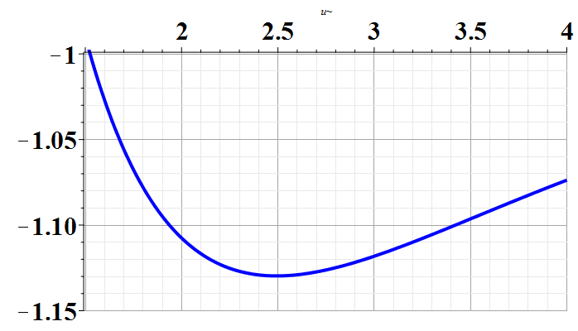
D
U₊(Ry)
Experimental bond length according to NIST:
~ 2 Bohr

Slide 27
Fermi Golden Rule
Resonant transition rate due to time harmonic perturbation --

Slide 28
Example – Zero order system in the presence of an electromagnetic field -- continued

Slide 29
Dirac equation for electron in the field of a H-like ion

Slide 31
cgs Gaussian units
SI units

