Slide 1
PHY 742 Quantum Mechanics II
1-1:50 AM MWF via video link:
https://wakeforest-university.zoom.us/my/natalie.holzwarth
Plan for Lecture 22
Quantization of the Electromagnetic fields
Read XVII. Quantizing Electromagnetic Fields.
Classical Hamiltonian for the electromagnetic fields
Quantum Hamiltonian for the electromagnetic fields
Notes:
Historically, the notion of quantized radiation in the form of photons came very early in the development of quantum theory. Our task is to see how this quantization can be derived from the classical equations of Electrodynamics.

Slide 2
Topics for Quantum Mechanics II
Single particle analysis
Single particle interacting with electromagnetic fields – EC Chap. 9
Scattering of a particle from a spherical potential – EC Chap. 14
More time independent perturbation methods – EC Chap. 12, 13
Single electron states of a multi-well potential ➔ molecules and solids – EC Chap. 2,6
Time dependent perturbation methods – EC Chap. 15
Relativistic effects and the Dirac Equation – EC Chap. 16
Path integral formalism (Feynman) – EC Chap. 11.C
Multiple particle analysis
Quantization of the electromagnetic fields – EC Chap. 17
Photons and atoms – EC Chap. 18
Multi particle systems; Bose and Fermi particles – EC Chap. 10
Multi electron atoms and materials
Hartree-Fock approximation
Density functional approximation
Notes:
This is the schedule that we have used from the beginning. Comments/suggestions are welcome.

Slide 3
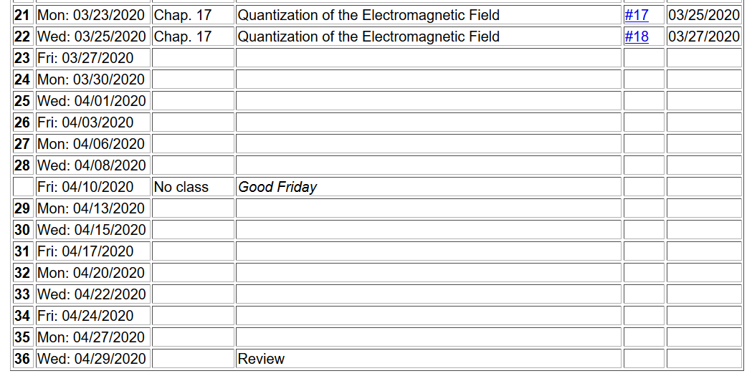
Notes:
This is the altered schedule. Note that there is one homework problem which hopefully you will be able to complete before the next lecture.

Slide 4
Notes:
The final equation here is expressed purely in terms of the vector potential.

Slide 5
Plane wave solutions to electromagnetic waves in terms of vector potentials
3 mutually perpendicular vectors
polarization unit vectors.
Notes:
From the equations for the vector potential, we find that there are two plane wave solutions with two different polarizations as indicated by the index σιγμα.

Slide 6
General form of vector potential as a superposition of plane waves:
Notes:
From the plane wave terms, we can simplify the form of the energy of the electromagnetic field.

Slide 7
Some details, with more care to use real functions --
Notes:
Here are some details of the derivation.

Slide 8
Big leap --
Notes:
Now consider how the EM field energy can be quantized, thinking in terms of the analogy of these equations to those of the Harmonic oscillator. We introduce a normalization factor and the creation and annihilation operators.

Slide 9
Uncontrolled energy shift
Notes:
Reviewing the commutation relations for the creation and annihilation operators. At the end, we do arrive at an expression that is very much like that of the Harmonic oscillator. However, in this case, the constant term causes trouble because it represents an uncontrolled energy. No problem. If it is unphysical it is strategically removed. Unfortunately, it will come back to bother us on occasion…

Slide 10
Creation and annihilation operators:
Note: We are assuming that the polarization vector is real.
Notes:
With these definitions of the vector potential amplitudes, we can now write an expression for the quantum mechanical form of the vector potential.

Slide 11
Notes:
From the vector potential, we can also write expressions for the electric and magnetic fields.

Slide 12
What is the expectation value of the E field for a pure eigenstate |n> of the electromagnetic Hamiltonian?
A complex (non zero) number
Zero
Infinity
What is the expectation value of the B field for a pure eigenstate |n> of the electromagnetic Hamiltonian?
A complex (non zero) number
Zero
Infinity
Notes:
What do you think is going to happen?

Slide 13
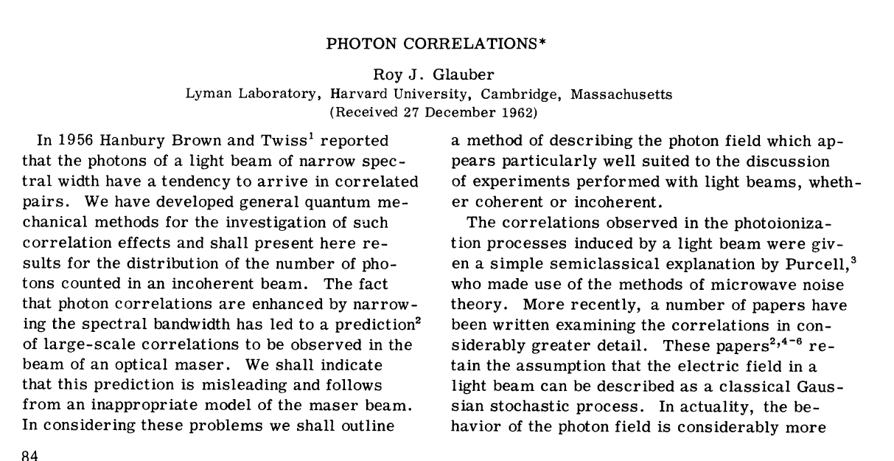
How does a quantum mechanical E or B field exist? Consider a linear combination of pure photon states --
Notes:
In this paper, the notion of a “coherent” state was introduced. As we will see, the expectation values of the electric and magnetic fields are non-zero for a system in a coherent state.

Slide 14
Notes:
It is possible to prove these identities (for HW #18).

