Slide 1
PHY 742 Quantum Mechanics II
1-1:50 AM MWF via video link:
https://wakeforest-university.zoom.us/my/natalie.holzwarth
Plan for Lecture 23
Quantization of the Electromagnetic fields
Complete the reading of XVII. Quantizing Electromagnetic Fields.
Quantum Hamiltonian for the electromagnetic fields
Eigenstates of the electromagnetic Hamiltonian
Quantum expressions for the electromagnetic fields
Variance of measurable properties of the electromagnetic fields
Properties of a single mode coherent state
Notes:
Please finish reading Chapter 17 of Professor Carlson’s textbook.

Slide 2
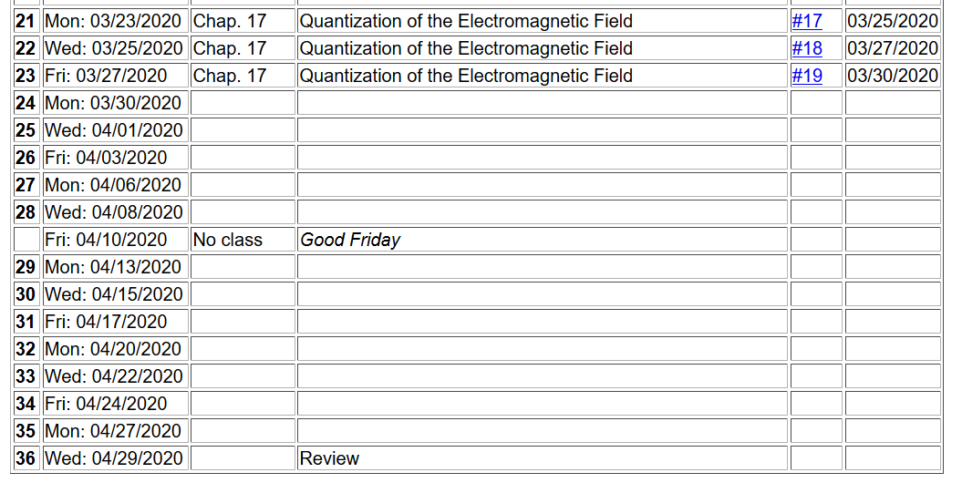
Notes:
The assigned homework for today’s lecture involves verifying some of the equations discussed in this lecture.

Slide 3
Summary of previous results for the electromagnetic Hamiltonian
Notes:
The is a review of equations discussed in Lecture 22.

Slide 4
Properties of the creation and annihilation operators:
Note: We are assuming that the polarization vector is real.
Notes:
Continuing review of previous results.

Slide 5
Notes:
From the quantum expression of the vector potential, we can also write expressions for the electric and magnetic fields.

Slide 6
Notes:
Consider evaluating the expectation values of these fields for a pure photon eigenstate. Embarrassingly, they are 0.

Slide 7
Digression -- Commutator formalism in quantum mechanics
Notes:
In order to understand how the previous results can be true, we need to review the notion of variance in quantum mechanics. In particular, the variance often is controlled by non-trivial commutation relations. In this slide and the following, the relationship between variance and commutators is reviewed.

Slide 8
Proof --

Slide 10
Notes:
Wrapping up the commutator discussion with the example of the uncertainty principle applied to position and momentum.

Slide 11
What does this have to do with quantum EM fields?
infinite
infinite
Notes:
For the E and B fields themselves, the variance is not a result of non trivial commutation relations. Here we calculate the variances for pure photon states.

Slide 12
It is also possible to show that components of the E and B field have nontrivial commutation relations, indicating that in general it is not possible to simultaneously determine E and B at the same point in space to arbitrary accuracy.
Effects of the phase of each mode.
In deriving these equations, we neglected the phase of each mode. A more careful treatment of photon number and phase show that these also have nontrivial commutation relations.
How is this quantum treatment of the electromagnetic fields consistent with the classical picture?
There is no need for consistency.?
There should be consistency in certain ranges of the parameters.?
Notes:
Summary of what we have learned so far. What do you think about how the quantum equations could be related to the classical picture?

Slide 13
Notes:
Here we introduce the single mode coherent state as a particular linear combination of eigenstates of the electromagnetic Hamiltonian.

Slide 14
Single mode coherent state continued
This means that variance of the E field for the coherent state is independent of the amplitude E₀. Therefore, for large E₀ the variance is small in comparison.
Notes:
For these coherent states, we can evaluate the variance of the quantum mechanical electric field. You should verify these equations for your homework.

Slide 15
Single mode coherent state continued
Notes:
Again using the coherent states, we can evaluate the variance of the photon number. What do you think is the significance of these results?

Slide 16
Interpretation of a single mode coherent state
Notes:
Here we see that the coherent state is related to a Poisson distribution, important in statistical analysis.

Slide 17
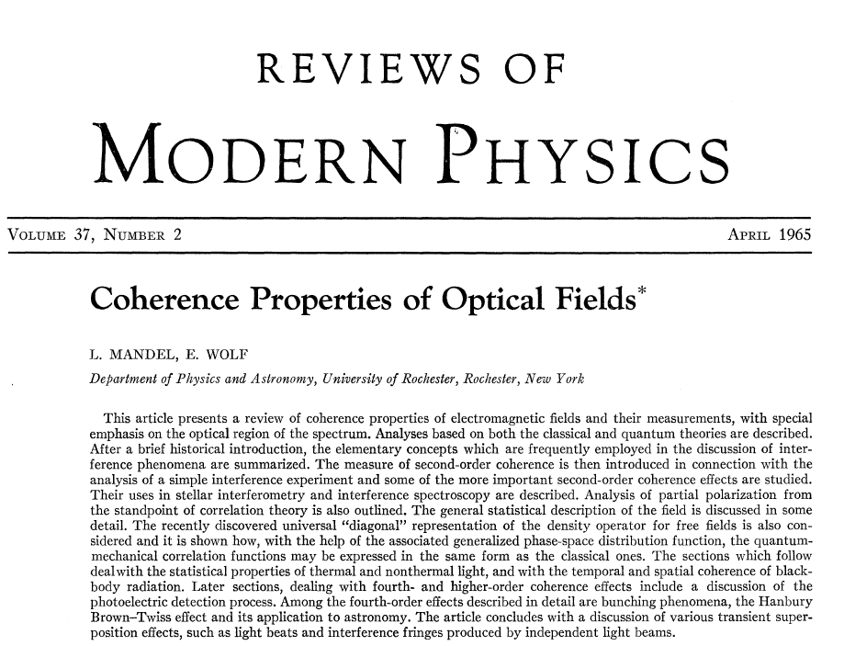
More reading -- page 231
Notes:
There are many more interesting aspects of the statistical properties of quantum electromagnetic fields. Here is an example of an interesting review article.

