Slide 1
PHY 742 Quantum Mechanics II
1-1:50 AM MWF via video link:
https://wakeforest-university.zoom.us/my/natalie.holzwarth
Plan for Lecture 26
Quantum mechanics of multiple particle systems
Continue reading Professor Carlson’s textbook: Chapter X. Multiple particles (Sec. A&B)
Non-interacting particles
Second quantized formalism for Bose particles
Second quantized formalism for Fermi particles
Notes:
In this lecture, we will continue our consideration of multiple particle systems which is discussed in Chapter 10 of your textbook. We continue to consider the ideal situation in which the multiple particles do not interact with each other.

Slide 2
Topics for Quantum Mechanics II
Single particle analysis
Single particle interacting with electromagnetic fields – EC Chap. 9
Scattering of a particle from a spherical potential – EC Chap. 14
More time independent perturbation methods – EC Chap. 12, 13
Single electron states of a multi-well potential ➔ molecules and solids – EC Chap. 2,6
Time dependent perturbation methods – EC Chap. 15
Relativistic effects and the Dirac Equation – EC Chap. 16
Path integral formalism (Feynman) – EC Chap. 11.C
Multiple particle analysis
Quantization of the electromagnetic fields – EC Chap. 17
Photons and atoms – EC Chap. 18
Multi particle systems; Bose and Fermi particles – EC Chap. 10
Multi electron atoms and materials
Hartree-Fock approximation
Density functional approximation
Notes:
Here is the course outline that we have been following.

Slide 3
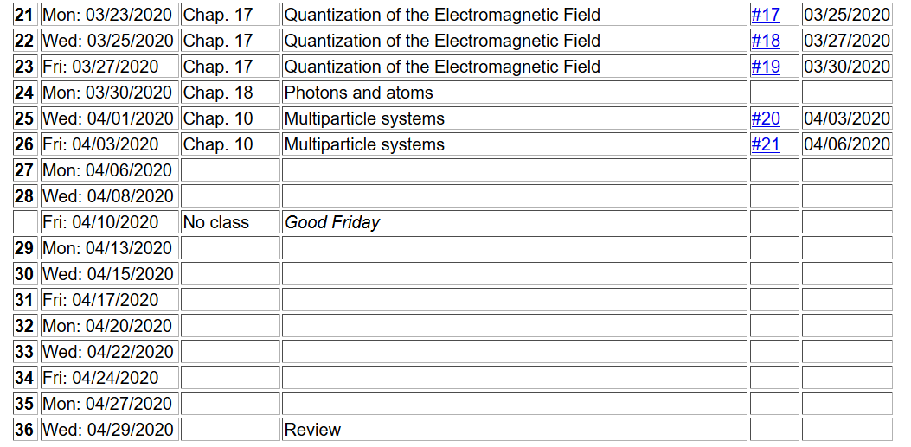
Notes:
Homework #21 involves examining the derivations and results of Slide 12 of this lecture.

Slide 4
Quantum mechanical treatment of multiparticle systems
z
1
2
5
4
3
y
x
Notes:
This diagram illustrates a general system to be considered where N particles are described by N different coordinates. The lower case “h” is used to emphasize a single particle Hamiltonian.

Slide 5
Quantum mechanical treatment of multiparticle systems
Does not take into account particle symmetry.
Notes:
Here we summarize the equations from Lecture 25. The non-interacting total Hamiltonian can be written as a sum of single particle Hamiltonian terms.

Slide 6
Refinement of the results for treatment of distinguishable or indistinguishable particles
P=permutation operator
Notes:
Here we summarize the particle permutation properties of Fermi and Bose particles. Using the permutation operator.

Slide 7
Treating multiparticle systems using “second” quantization formalism
Notes:
Defining the basis eigenstates from the single particle Hamiltonian.

Slide 8
Treating multiparticle systems using “second” quantization formalism -- continued
Notes:
Introducing the notion of “second” quantization.

Slide 9
In general, the number operator can be expressed in terms of a product of two operators. For the case of Bose particles, these operators are very similar to the raising and lowering operators of the harmonic oscillator.
Notes:
Considering first the case of Bose particles.

Slide 10
Second quantization for Bose particles, continued
Notes:
For Bose particles, we can use the same relationships found for harmonic oscillators and for the quantized electromagnetic fields.

Slide 11
Second quantization for Fermi particles
Notes:
Now consider the case for Fermi particles.

Slide 12
These results follow from the anti commutator relations of the operators.
Notes:
These results follow from the anti-commutation relations. Your homework for this lecture is to verify these relationships.

Slide 13
Note that the symmetry of the wavefunction is built into the formalism for Bose particles
Note that the antisymmetry of the wavefunction is built into the formalism for Fermi particles
Notes:
What do you think are the advantages/disadvantages of this second quantized formalism?

Slide 14
More general treatment of multiparticle system
interparticle interaction
Notes:
Next time, we will start to think about what happens when the particles interact.

