Slide 1
PHY 742 Quantum Mechanics II
1-1:50 AM MWF via video link:
https://wakeforest-university.zoom.us/my/natalie.holzwarth
Plan for Lecture 17
Quantum mechanics of a multi electron atom
Continue reading Professor Carlson’s textbook: Chapter X. Multiple particles (Sec. F)
He atom
Accounting for spin.
Ground state.
Excited states.
Notes:
In this lecture, we will consider what we learned about Fermi particles and apply it to Fermi particles in multielectron atoms, starting with He.

Slide 2
Topics for Quantum Mechanics II
Single particle analysis
Single particle interacting with electromagnetic fields – EC Chap. 9
Scattering of a particle from a spherical potential – EC Chap. 14
More time independent perturbation methods – EC Chap. 12, 13
Single electron states of a multi-well potential ➔ molecules and solids – EC Chap. 2,6
Time dependent perturbation methods – EC Chap. 15
Relativistic effects and the Dirac Equation – EC Chap. 16
Path integral formalism (Feynman) – EC Chap. 11.C
Multiple particle analysis
Quantization of the electromagnetic fields – EC Chap. 17
Photons and atoms – EC Chap. 18
Multi particle systems; Bose and Fermi particles – EC Chap. 10
Multi electron atoms and materials
Hartree-Fock approximation
Density functional approximation
Notes:
Here is the course outline that we have been following.

Slide 3
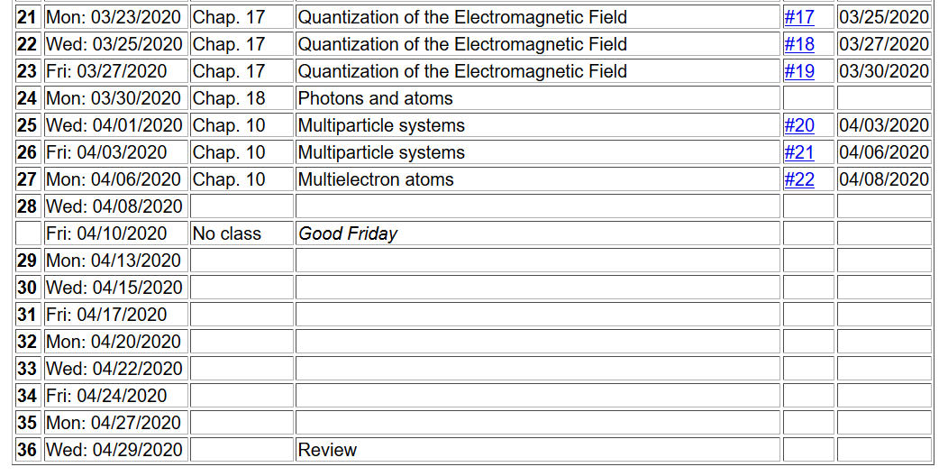
Notes:
Homework #22 involves rederiving the results shown on the lecture slides and evaluating the expectation value of the energy of a He atom.

Slide 4
In the past lectures, we have considered how to represent the quantum mechanics of identical particles. For treating a many electron atom, the focus is on representing the Fermi properties of the electrons. For example, in a basis with state labels a,b,c…. the second quantization operators work as follows.
Second quantization for Fermi particles
Notes:
Review of Fermi creation and annihilation operators.

Slide 5
These results follow from the anti commutator relations of the operators.
Notes:
These results follow from the anti-commutation relations

Slide 6
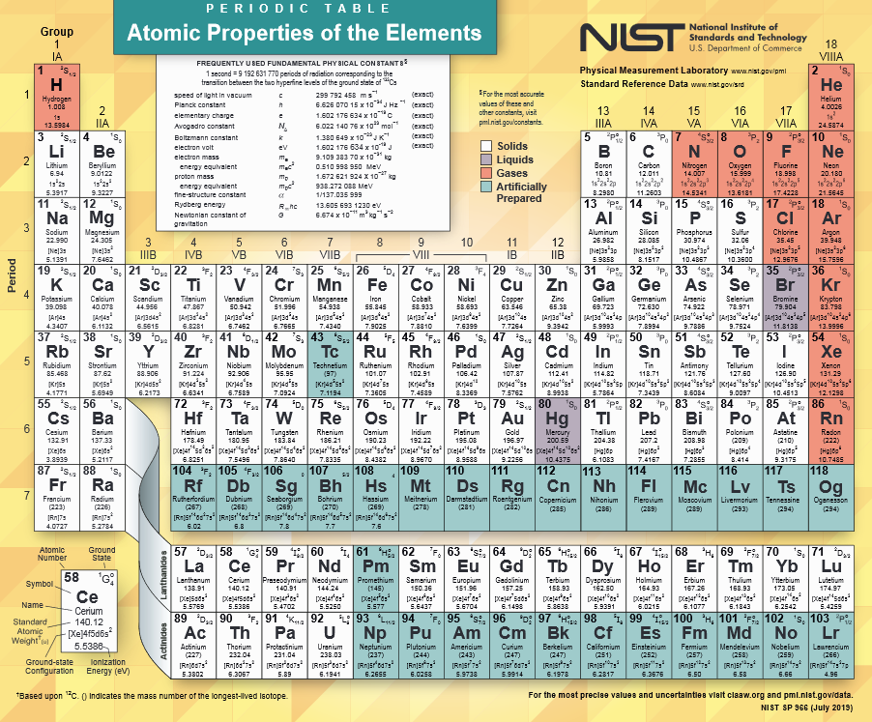
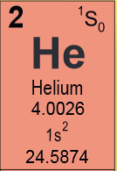
https://www.nist.gov/system/files/documents/2019/12/10/nist_periodictable_july2019_crop.pdf
Notes:
You probably know this notation. If not, please pose questions.

Slide 7
Notes:
What is missing from this analysis?

Slide 8
What is missing?
Electron spin.
Electron spin does not appear in this Hamiltonian and therefore cannot effect the analysis?
Electron spin does not appear in this Hamiltonian but can have a profound effect on the analysis?
Notes:
Various alternative notations.

Slide 9
Notes:
Defining single particle and two particle interaction terms. Do you notice something odd on this slide?

Slide 10
Spectrum of single particle states for He atom (schematic)
.
.
.
Notes:
Non-interacting particle energy diagram

Slide 11
Ground state configuration for He atom
.
.
.
Notes:
Consider first the lowest energy state of this system.

Slide 12
Expectation value of Hamiltonian for ground state of He atom
Notes:
Evaluating the expectation value in terms of the creation and annihilation operators.

Slide 13
Expectation value of Hamiltonian for ground state of He atom
Notes:
Here we make use of the fact that the energy does not depend on spin.

Slide 14
Now consider the interaction term
Notes:
Evaluating the two particle interaction terms, specializing to the choices of k and l that give nontrivial results.

Slide 15
Expectation value of Hamiltonian for ground state of He atom

Slide 16
Evaluation of two particle term, continued
Notes:
Why is v_{ijji}=0?

Slide 17
Summary of results
Notes:
What is the total electron spin of this He atom?

