Slide 1
PHY 742 Quantum Mechanics II
1-1:50 AM MWF via video link:
https://wakeforest-university.zoom.us/my/natalie.holzwarth
Plan for Lecture 28
Quantum mechanics of a multi electron atom
Continue reading Professor Carlson’s textbook: Chapter X. Multiple particles (Sec. F) Also review Chapter VIII. Spin and Adding Angular Momentum (Sec. C)
Digression on atomic term analysis
Excited states of the He atom
Notes:
In this lecture, we will consider what we learned about Fermi particles and apply it to Fermi particles in multielectron atoms, starting with He.

Slide 2
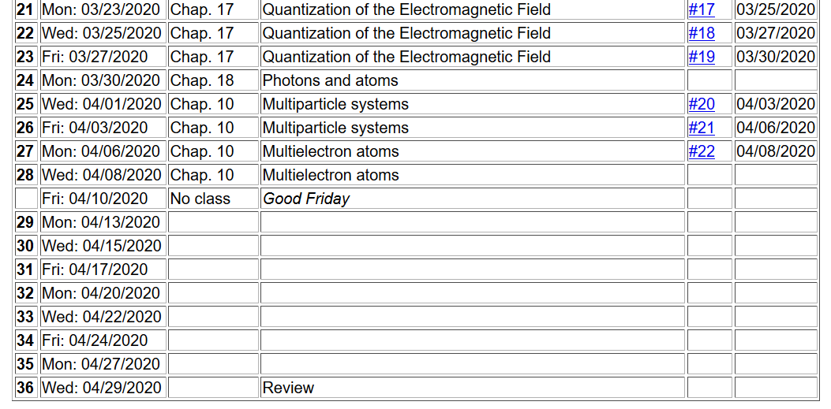
Notes:
No new homework assignment. Time for completing any “outstanding” homework and planning for projects.

Slide 3
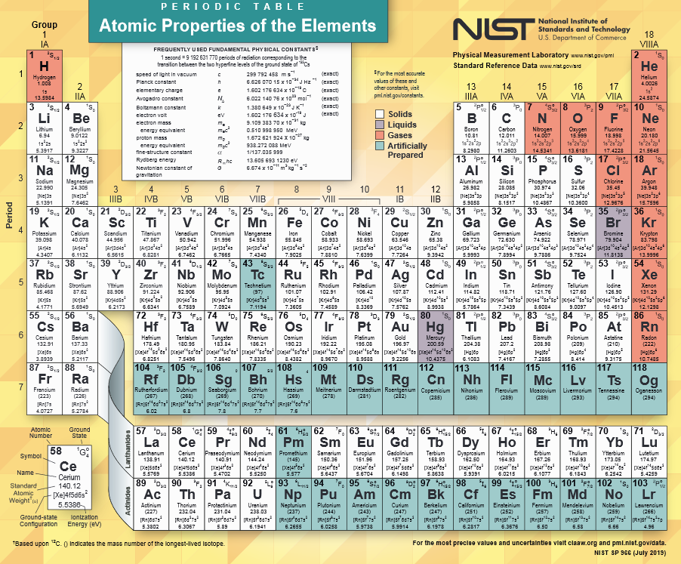
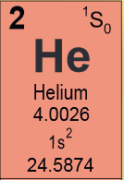
https://www.nist.gov/system/files/documents/2019/12/10/nist_periodictable_july2019_crop.pdf
Notes:
In principle, we can calculate the electronic structure for any atom in the periodic table. Last time we considered the ground state of the He atom.

Slide 4
Notes:
Setting up the basis for the problem. In fact the analysis is equivalent to a first order perturbation theory for the interaction term v.

Slide 5
Notes:
Defining single particle and two particle interaction terms within the second quantization formalism.

Slide 6
Ground state configuration for He atom
.
.
.
Notes:
Consider first the lowest energy state of this system.

Slide 7
Summary of results
Notes:
What is the total electron spin of this He atom?

Slide 8
While the ground state of the He atom is a very simple case, it illustrates the general properties of many electron atoms in a spherical environments. Because of the spherical symmetry, total angular moment of the system is conserved. If we assume that spin-orbit interactions are negligible, then total spin angular momentum and total orbital angular momentum are each separately conserved. Please review Chapter 8 of your textbook to know how to “add” angular momentum using Clebsch-Gordan coefficients.

Slide 9
Note, for practical calculations of Clebsch-Gordan coefficients, a good source is NIST’s DLMF -- https://dlmf.nist.gov/34.1
Professor Carlson also has a working maple script on his website.
For the spherical atom without spin-orbit coupling, the total spin angular momentum S and the total orbital angular momentum L are both conserved. The atomic term notation is

Slide 10
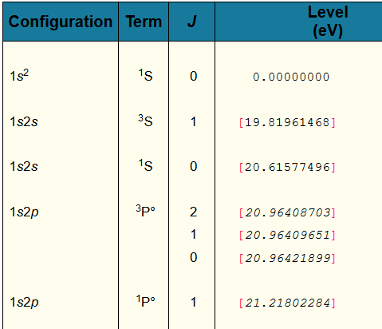
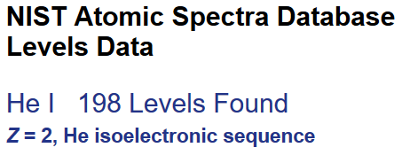
Example from NIST
Notes:
The atomic spectra of all of the elements have been well studied over the years and NIST has collected the data in the form of a table of atomic energy levels such as shown here for He. The ground state of each atom is chosen as the zero of energy. In this case, the lowest energy excitations are at higher energy by at approximately 20 eV or more.

Slide 11
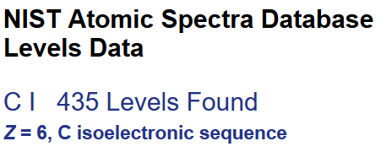
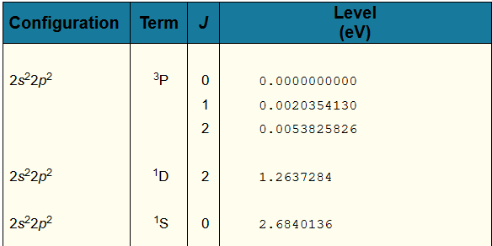
Example from NIST
Notes:
The atomic levels of C are very interesting. For the ground state configuration of 1s^2 2s^2 2p^2, we see that there are different arrangements leading to 3 different atomic terms. The lowest term has the designation ^3P while the highest term has the designation ^1S, having an energy 2.84 eV higher.

Slide 12
Back to the discussion of He
Ground state:
.
.
.
Notes:
This slide summarizes the analysis of the ground state wavefunction.

Slide 13
Digression -- How do we know that the total spin of this state is S=0?
Clearly M_{S}=0 -- but do we really know that S=0?
Notes:
What do you think?

Slide 14
Back to the discussion of He
A possible excited state:
.
.
.
Notes:
Now consider a possible excited state. Notice that the spin degeneracy is specified as 3, while only one spin configuration is mentioned. What can explain this?

Slide 15
Energy estimate of the ³S excited state of He
Notes:
This follows the analysis we discussed in Lecture 27.

Slide 16
Notes:
Writing the spatial parts of the matrix elements in a way that we can evaluate them.

Slide 17
Notes:
Explicit formulas for He evaluated using Maple.

Slide 18
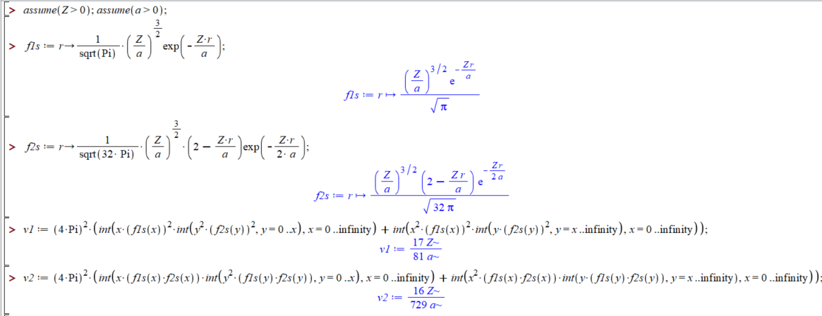
Maple script for evaluating integrals --
Notes:
Maple script for this case.

Slide 19
Summary of results for excited state:
.
.
.
Notes:
Summary of the results just analyzed.

Slide 20
Consider another excited state of He
While these two states are orthogonal to each other, they are mixed by the Hamiltonian, so we must consider them together
.
.
.
.
.
.
Notes:
Now consider a different excited state configuration, this time with total spin projection M_{S}=0. In this case, there are two configurations that we need to consider together.

Slide 21
Consider another excited state of He -- continued
Notes:
Evaluating the Hamiltonian in the A and B basis.

Slide 22
Consider another excited state of He – continued
Since the two states are mixed by the Hamiltonian, we need to consider their linear combination:
Notes:
Summary of results.

Slide 23
Consider another excited state of He – continued
One solution:
Another solution:
Notes:
How do we really understand how to separate out the singlet and triplet state for this case?

Slide 24
Summary of analysis of ground state and lowest excited states of He atom
Single particle states
Two particle states
(first order perturbation)
Energies
Calc. (eV) NIST (eV)
19.4 20.6
17.0 19.8
0.00 0.00
Notes:
Summary of the numerical results. Do you call this success? How could the calculation be improved?

