Slide 1
PHY 742 Quantum Mechanics II
1-1:50 AM MWF via video link:
https://wakeforest-university.zoom.us/my/natalie.holzwarth
Plan for Lecture 29
Hartree-Fock approximation; specifically applied to the analysis of a multi electron atom
This material is not explicitly treated in your textbook, but does build on what we learned in Chapter 10.
    Review and motivation
    The Hartree-Fock analysis
    Hartree-Fock analysis specifically for an atom
Notes:
This topic is not explicitly covered in your textbook. There are quite a few sources on the internet and I will try to suggest a few as well. The Hartree-Fock method is a venerable method for reasonably accurate modeling of real materials.

Slide 2
Topics for Quantum Mechanics II
Single particle analysis
  Single particle interacting with electromagnetic fields – EC Chap. 9
  Scattering of a particle from a spherical potential – EC Chap. 14
  More time independent perturbation methods – EC Chap. 12, 13
  Single electron states of a multi-well potential ➔ molecules and solids – EC Chap. 2,6
  Time dependent perturbation methods – EC Chap. 15
  Relativistic effects and the Dirac Equation – EC Chap. 16
  Path integral formalism (Feynman) – EC Chap. 11.C
Multiple particle analysis
  Quantization of the electromagnetic fields – EC Chap. 17
  Photons and atoms – EC Chap. 18
  Multi particle systems; Bose and Fermi particles – EC Chap. 10
  Multi electron atoms and materials -- various internet sources
    Hartree-Fock approximation & density functional treatment of atoms
    Hartree-Fock approximation & density functional treatment of molecules and solids
Notes:
In these first lectures, we will focus on treatment of an atom.

Slide 3
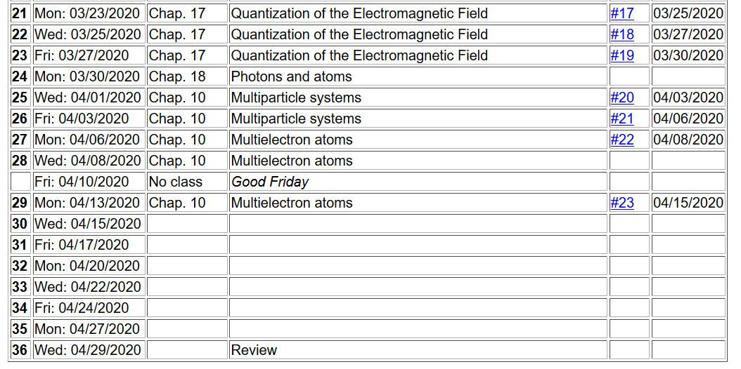
Notes:
The homework problem for this lecture involves evaluating some of the integrals we have been discussiong

Slide 4
Review and motivation
  General considerations in the study of multiple electron systems
    The wave function for the multiple electron system should take into account the properties of indistinguishable Fermi particles
    The particular systems that we would like to model (atoms, molecules, solids…) also generally have both electronic coordinates as well as nuclear coordinates. For the moment, we will neglect the nuclear coordinates and just focus on the electron behaviors
    Special tricks have been developed for the treatments of atoms, diatomic molecules, more complicated molecules, and extended systems (solids). In general, simple systems can treated in greater detail/accuracy than can more complicated systems. For example, consider the detailed atomic spectroscopy studied for all of the atoms in the periodic table

Slide 5
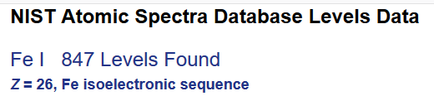
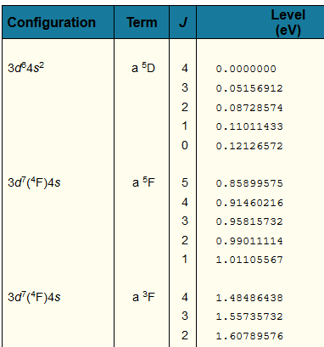
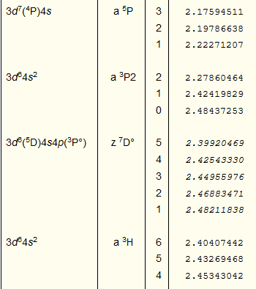
Example from the NIST website
Notes:
Last week, we introduced the NIST Atomic Spectra Database. Here is another example – Fe which shows some of the complexity involved with transition metal materials.

Slide 6
Why is this important?
  It is not really ..
  It could be useful for testing experiment/theory
  It could be useful for certain types of measurements
  It may be important for atom lovers, but means nothing to the study of molecules and solids
Plan –
  Discuss the general equations for multielectron systems
  Discuss the Hartree-Fock treatment
  Set up the particular equations for atoms
  How to analyze systems beyond the Hartree-Fock approximation
Notes:
Discussion points

Slide 7
General equations for multi electron systems
Notes:
Review of the properties of identical Fermi particles.

Slide 8
Notes:
Identification of one-electron and two-electron terms.

Slide 9
Notes:
Second quantization formulation.

Slide 10
Notes:
In this case, the basis functions are not necessarily eigenfunctions of the single particle Hamiltonian.

Slide 11
How can we estimate the ground state of our multi electron Hamiltonian?
variational approach --
Notes:
Review of the variational principle.

Slide 12
Significance of this inequality --
The inequality motivates a class of estimation methods known as variational methods to converge to the ground state energy E₀ and the corresponding ground state probability amplitude.
Notes:
Review continued.

Slide 13
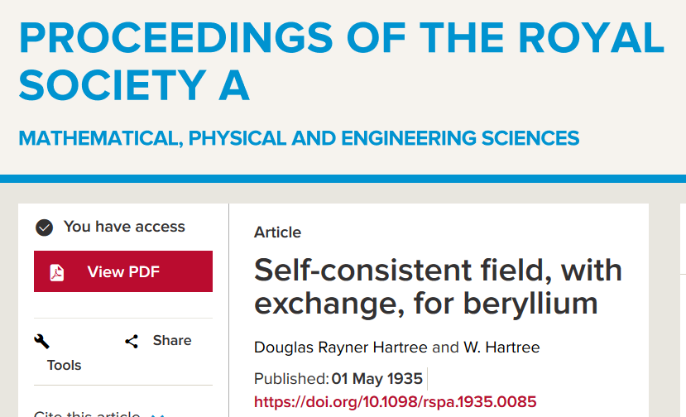
Hartree-Fock approximation
Notes:
Reverence to the historical paper by Hartree and Hartree

Slide 14
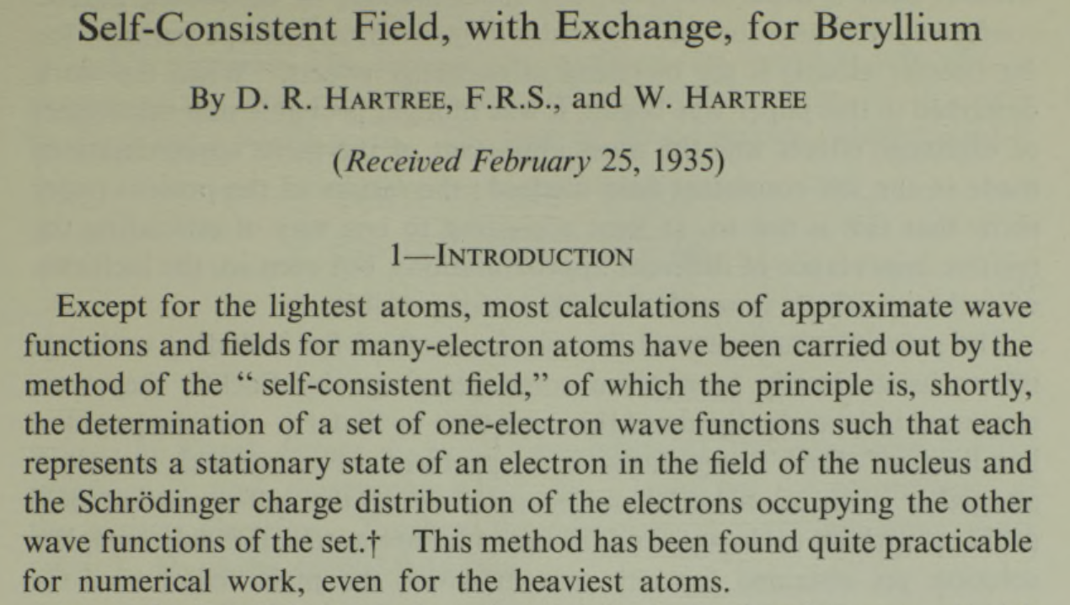

Slide 15
Note that the i=j contribution cancels out.
Notes:
Second quantization formulation

Slide 16
Matrix elements
Constrained optimization
Notes:
Writing out the integrals.

Slide 17
Constrained optimization
Lagrange multiplier
Notes:
Equations resulting from orbital optimization.

Slide 18
Hartree-Fock equations to solve
Notes:
Simplified structure of equations.

Slide 19
Self-consistent solution of the Hartree-Fock equations
Continue self-consistent
Iterations
Self-consistent cycles converged
Notes:
Iteration process in order to achieve self-consistency.

Slide 20
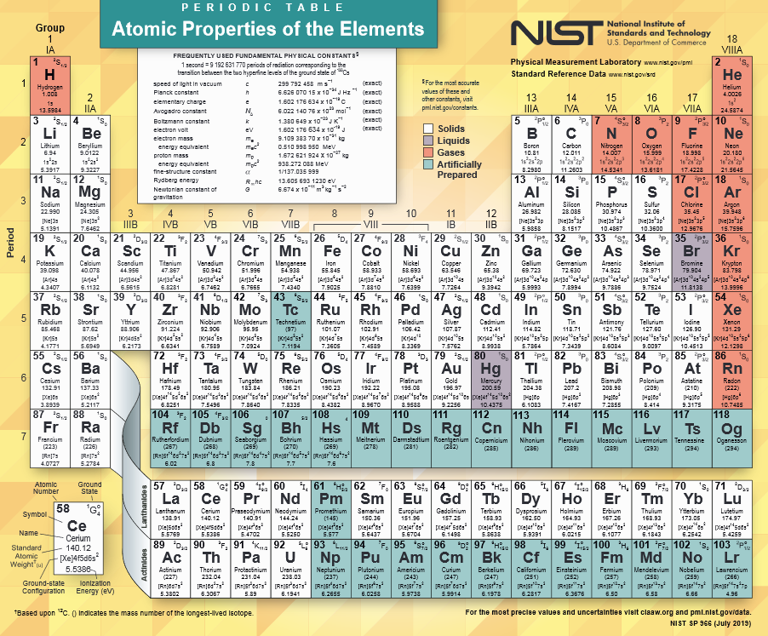
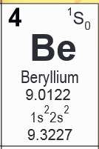
https://www.nist.gov/system/files/documents/2019/12/10/nist_periodictable_july2019_crop.pdf
Details discussed in paper by Hartree and Hartree.
Notes:
Example studied by Hartree and Hartree.

Slide 21
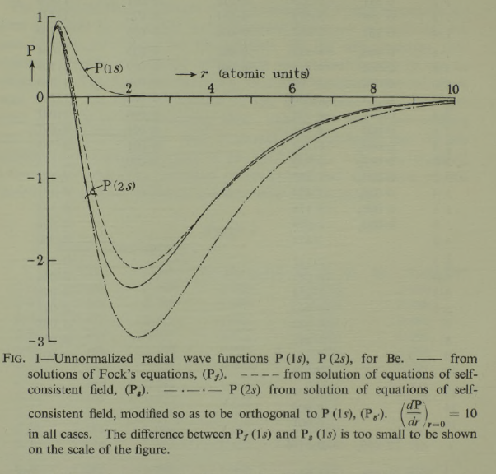
Notes:
Plot of radial wave functions from paper.

Slide 22
Other methods of solving the Hartree Fock equations
Rather than solve the coupled integral-differential radial equations, it is popular in quantum chemical contexts to represent the single particle functions as a sum of particular (fixed) basis functions. The variational parameters are then the linear coefficients of the basis functions
Notes:
Alternative method for carrying out Hartre-Fock analysis.

