Slide 1
PHY 742 Quantum Mechanics II
1-1:50 AM MWF Olin 103
Plan for Lecture 3
Quantum particle interacting with classical electromagnetic fields
Reading: Chapter 9 in Carlson’s textbook
Example of charged particle in a magnetostatic field
Example of a hydrogen atom in a magnetostatic field

Slide 2
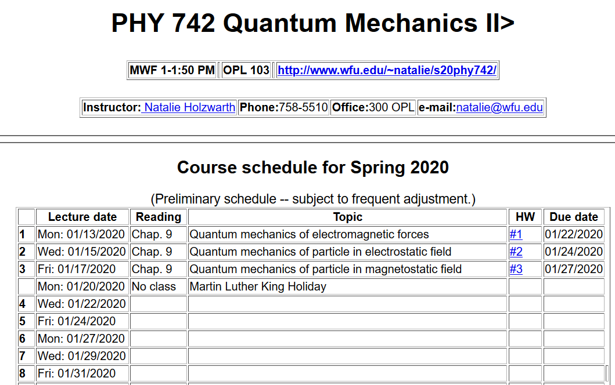

Slide 3
For electrostatic and/or magnetostatic fields, the time dependence of the fields becomes trivial, and we expect stationary state solutions to the Schrödinger equation

Slide 4
Consideration of effects of a static magnetic field on quantum states of a charged free particle. First consider the spatial degrees of freedom (ignoring intrinsic spin).

Slide 8
Hermite polynomial

Slide 9
Notion of density of states

Slide 10
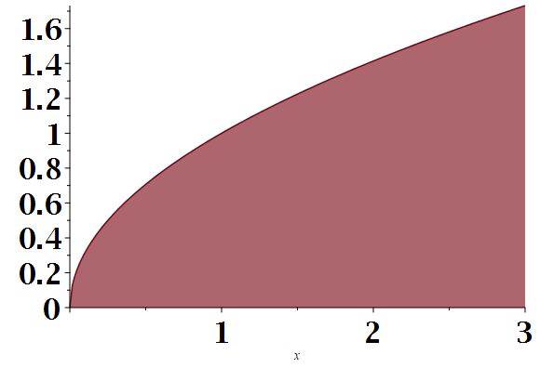
DOS plots –
Discrete spectrum
ε
Continuous spectrum for a free particle in three dimensions
ε

Slide 11
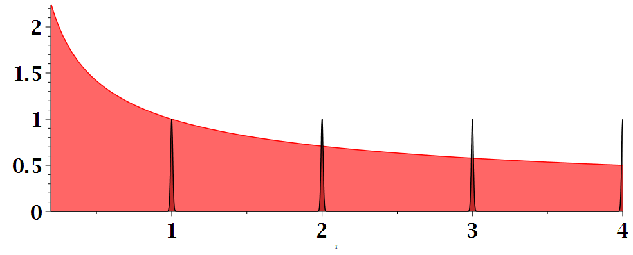
Note that this is an approximate model of an ideal metal in a magnetic field which results in oscillatory resistivity for example.
DOS plot for magnetostatic acting on charged particle
Placement of discrete levels depends on magnetic field strength
ε

Slide 12
Treating the same problem with a different Gauge:

Slide 13
Eigenvalues in cylindrical coordinates
Note that (with a non-trivial proof) it can be shown that this spectrum is equivalent to Cartesian gauge; full solution includes intrinsic spin
Full solution including eigenfunctions are worked out in Landau and Lifshitz. It is shown that the eigenstates are related to harmonic oscillator eigenstates.

Slide 14
Effects of magnetostatic fields on particles’ intrinsic magnetic moment.

Slide 15
Interaction of magnetostatic field B with a hydrogen atom (including contribution of intrinsic electron spin, omitting contribution of intrinsic proton spin).

Slide 16
Analysis of magnetostatic effects on atomic structure using perturbation theory, also including the effects of spin-orbit interation

Slide 17
Perturbation theory treatment of uniform and constant magnetic fields on atomic states -- continued

Slide 18
l=0
l=1

Slide 21
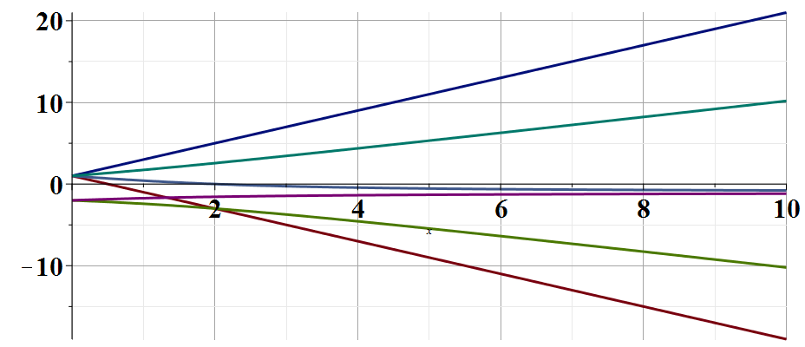
E/γ
β/γ
Paschen-Backb effect
Zeeman effect

