Slide 1
PHY 742 Quantum Mechanics II
1-1:50 AM MWF via video link:
https://wakeforest-university.zoom.us/my/natalie.holzwarth
Plan for Lecture 30
Hartree-Fock approximation and other formalisms for treating
multi electron systems
Summary of Hartree-Fock analysis
Other mean field treatments – density functional theory
Note that equations will be written for an atom, but can be extended to molecules and solids.
Notes:
We will summarize and review the Hartree-Fock method and then talk about extensions

Slide 2
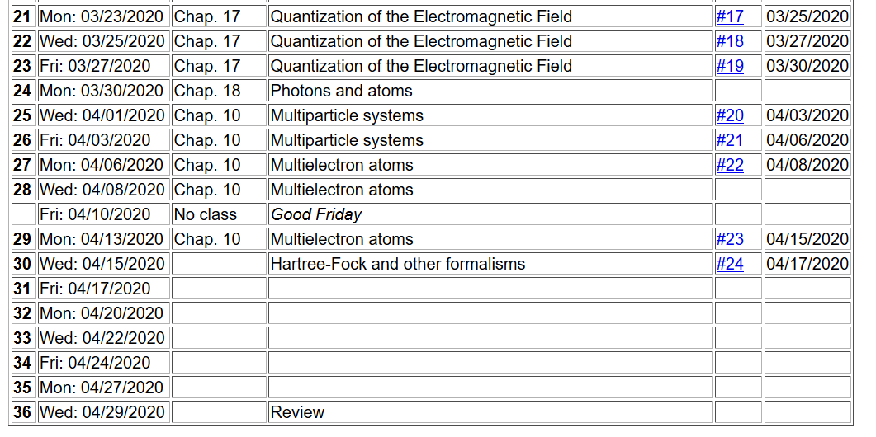
Notes:
This is the last homework assignment for the semester. It involves evaluating the exchange integral for a continuum of plane waves.

Slide 3
General equations for multi electron systems
Notes:
Review of the properties of identical Fermi particles.

Slide 4
Notes:
Identification of one-electron and two-electron terms.

Slide 5
Notes:
Review of second quantization formalism

Slide 6
In order to estimate the lowest energy state (ground state) of our system, we can use the variational principle to optimize a trial wave function which minimizes the expectation value
Notes:
Variational approximation.

Slide 7
Note that the i=j contribution cancels out.
Notes:
Hartree-Fock approximation

Slide 8
Matrix elements
Constrained optimization
Notes:
Writing out the integrals.

Slide 9
Coupled Hartree-Fock equations to solve
Notes:
Form of coupled equations

Slide 10
Self-consistent solution of the Hartree-Fock equations
Continue self-consistent
Iterations
Self-consistent cycles converged
Notes:
Iteration process in order to achieve self-consistency.

Slide 11
Problem with Hartree-Fock approach
Solutions do not have correlation effects.
Solutions are slightly painful (integral-differential equations are painful)
Chemists are happier than physicists
Density functional theory
Attempts to solve #1
Reduces the pain of #2
Physicists are happier than chemists
Notes:
Perspective on the state of the formalism.

Slide 12
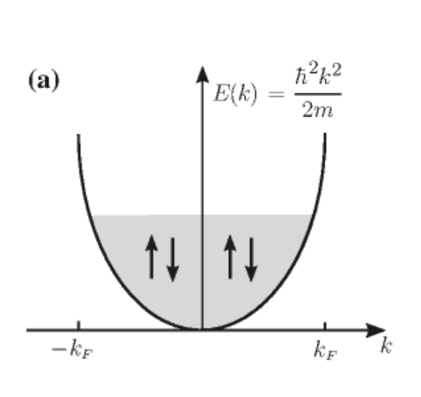
Evaluation of the Hartree-Fock equations for the jellium model – homogeneous electron gas
Prelude to DFT --
Notes:
Preparing to evaluate the exchange interaction for a convenient analytical case -- jellium

Slide 13
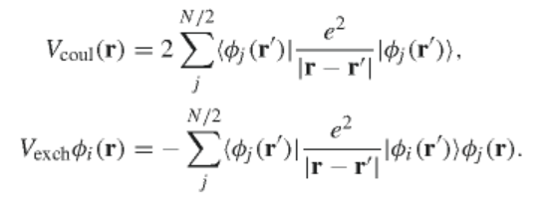
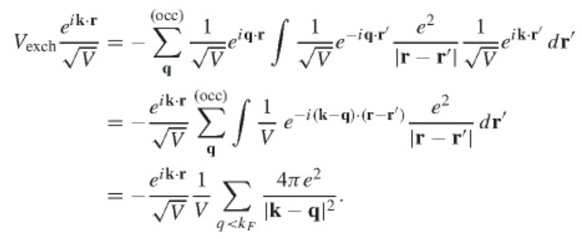
Hartree-Fock Equations
Notes:
Some details

Slide 14
Some details --
Notes:
More details.

Slide 15
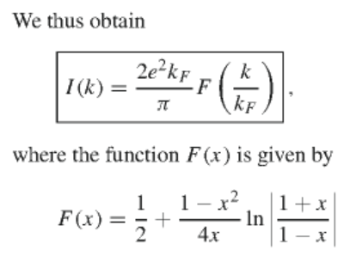
More details
Notes:
Not totally trivial.

Slide 16
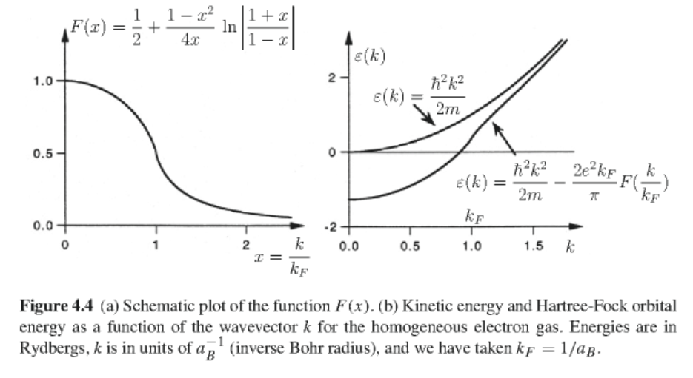
Eigenvalues of the plane wave orbitals:
Notes:
Plots of results.

Slide 17
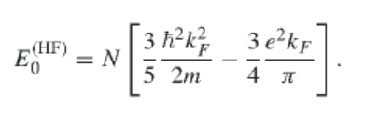
Total electronic energy of homogeneous electron gas in Hartree-Fock approximation
Some details:
Notes:
Some details.

Slide 18
Some ideas –
John Slater suggested that the average exchange potential of the homogeneous electron gas could be used to estimate the exchange interaction of a material
Notes:
More details

Slide 19
Kohn-Sham’s approximate exchange
Kohn & Sham argued that the effective exchange potential should be determined from the density derivative:
Notes:
This slide is the focus of HW #24.

Slide 20
Comment on the spatial dependence of these approximations
Notes:
Cheating.

