Slide 1
PHY 742 Quantum Mechanics II
1-1:50 AM MWF via video link:
https://wakeforest-university.zoom.us/my/natalie.holzwarth
Plan for Lecture 31
Density functional formalism for treating
multi electron systems
General theorem
Practical calculation schemes
Examples
Notes:
We will discuss the density functional theorem and its proof.

Slide 2
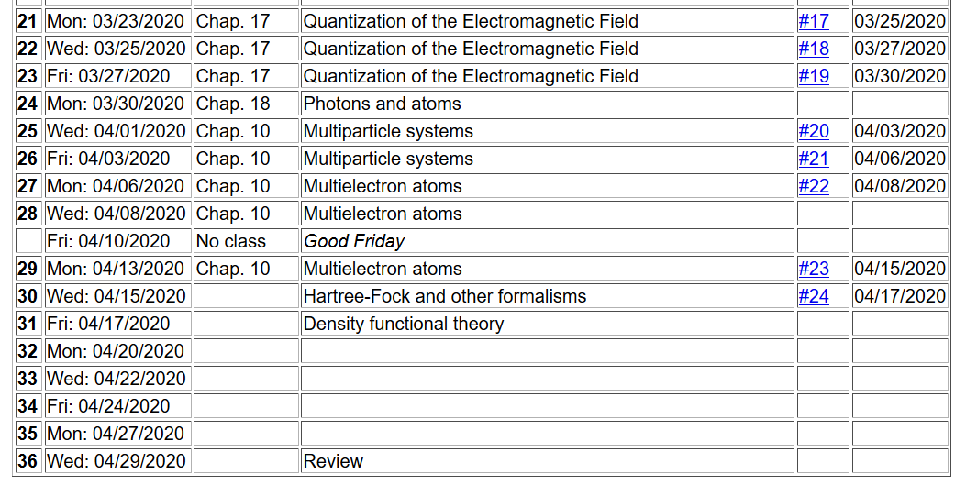
Notes:
Ongoing schedule

Slide 3
Density functional theory
Describes the relationship between the many electron problem and independent electron treatments.
Proof of theorem behind density functional theory
Estimates of F[n].
Notes:
Overview

Slide 4
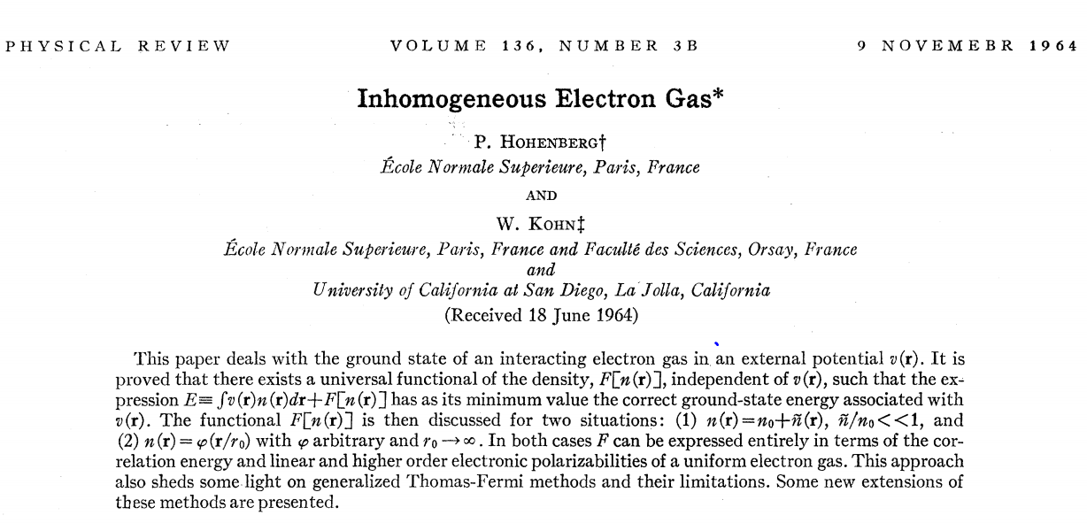
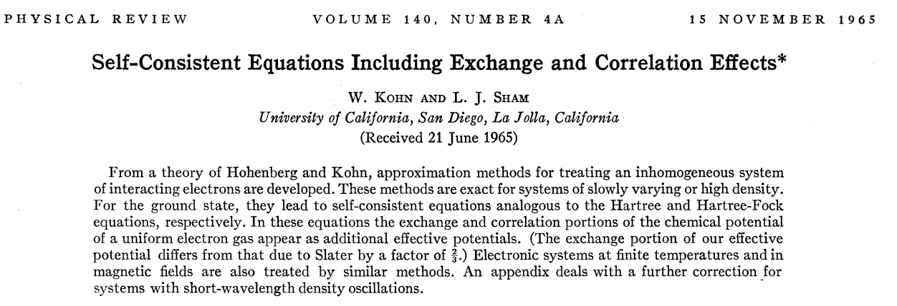
Density functional theory -- continued
Notes:
Original papers

Slide 5
Notes:
Nobel prize for Walter Kohn

Slide 6
Hohenberg and Kohn: formal proof of basic theorem
Kinetic energy
External potential
Coulomb interaction
Notes:
Setting up the problem.

Slide 7
Theorem: The density n(r) of the ground state of the system is a unique functional of the external potential v(r).
Proof: Consider two Hamiltonians H and H’ differing only by external potentials v and v’.
Suppose n(r) is the same for H and H’.
Notes:
Proof of theorem

Slide 8
We can also show:
Notes:
Continued

Slide 9
Notes:
Punch line

Slide 10
The theorem implies that the ground state energy E can be considered as a functional of the density n(r)
Thus, the determination of the ground state energy E is transformed into a minimization of the functional with respect to the density n(r), transforming a many particle minimization into a single particle minimization.
In practice, the functional form of F[n] is not known, but if it were, we could use optimization methods to determine the ground state energy E_{v}[n].
Notes:
Significance of theorm

Slide 11
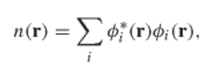
Kohn-Sham scheme to find ground state energy E_{v}[n]
Assume that the electron density can be expressed in terms of N independent electron orbitals
For a given external potential v_{ext}(r) the ground state energy is given by
E
E_{H}[n]=
Notes:
Kohn Sham equations

Slide 12
Kohn-Sham equations
where
Notes:
Kohn Sham equations

Slide 13
Estimate of the exchange-correlation contribution
Notes:
Practical implementations

Slide 14
Digression on spatially varying electron density
i
j
k
l
Notes:
How to cheat position dependence.

Slide 15
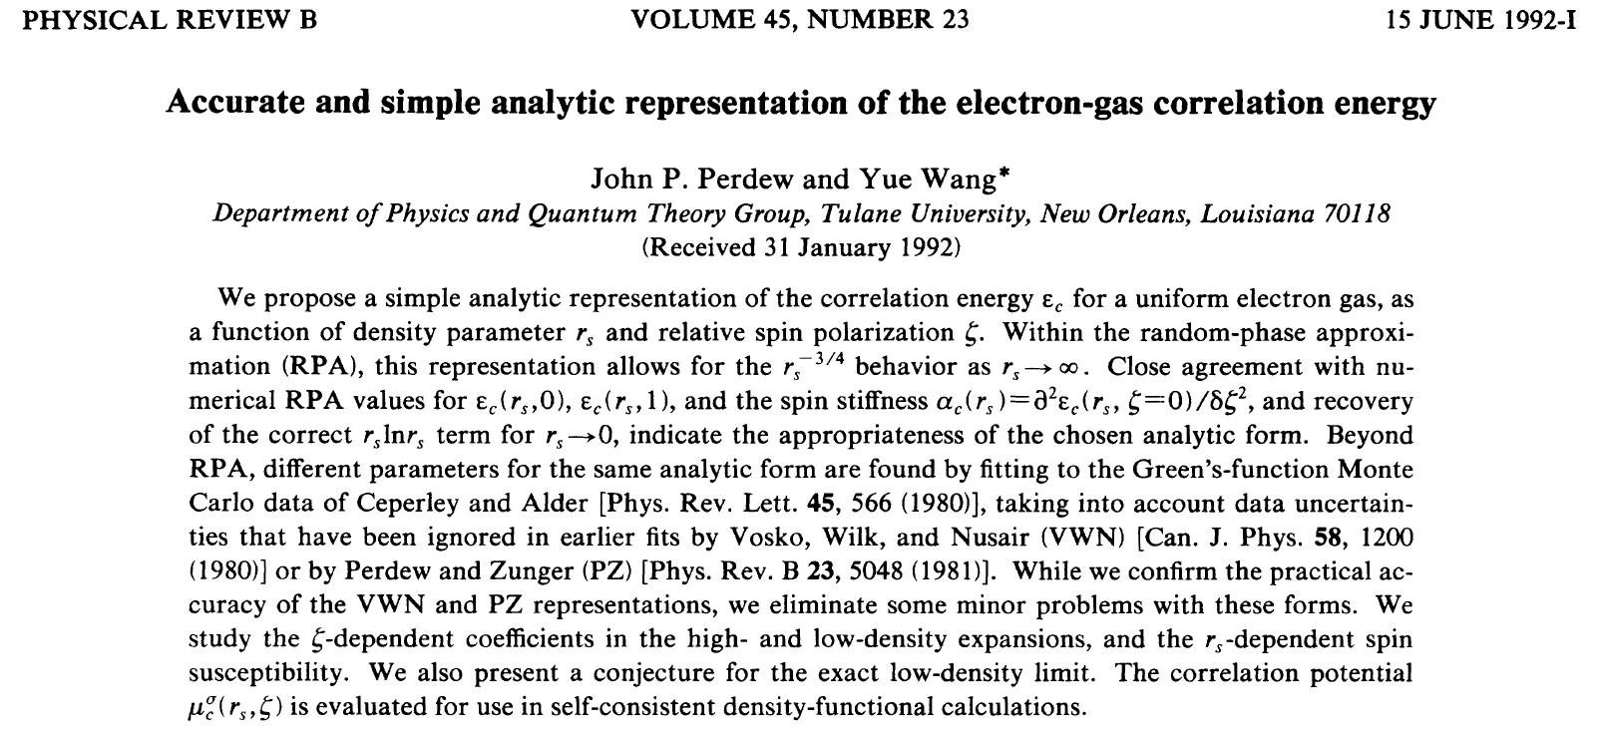
Correlation functionals
Local density approximation (LDA)
Notes:
Correlations affecta

Slide 16
Interpolation function for LDA:
E_{c}[n]=
Notes:
Some details

Slide 17
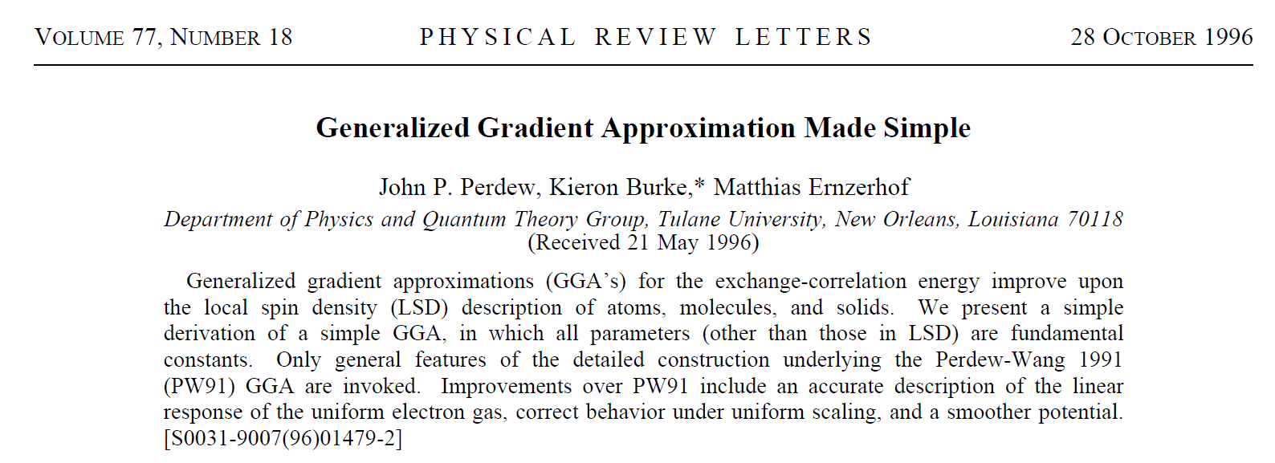
More complicated exchange-correlation functionals
Notes:
More complication

Slide 18
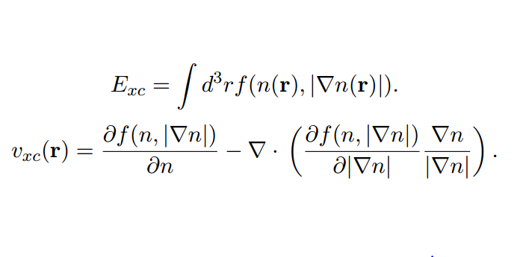
Some details of the Generalized Gradient Approximation
Notes:
Necessary details.

Slide 19
Summary: Kohn-Sham formulation of density functional theory
Notes:
Practical implementation

Slide 20
Self-consistent solution
Notes:
Iteration scheme.

Slide 21
Kohn-Sham formulation of density functional theory
Results of self-consistent calculations
Some remaining issues
Theory for E_{exc}[n] still underdevelopment
This formalism does not access excited states
Strongly correlated electron systems are not well approximated
Notes:
Perspective.

