Slide 1
PHY 742 Quantum Mechanics II
1-1:50 AM MWF via video link:
https://wakeforest-university.zoom.us/my/natalie.holzwarth
Plan for Lecture 32
Density functional formalism for treating
multi electron systems
General theorem
Practical calculation schemes
Examples
Notes:
We will illustrate the details of density functional theory for atoms.

Slide 2
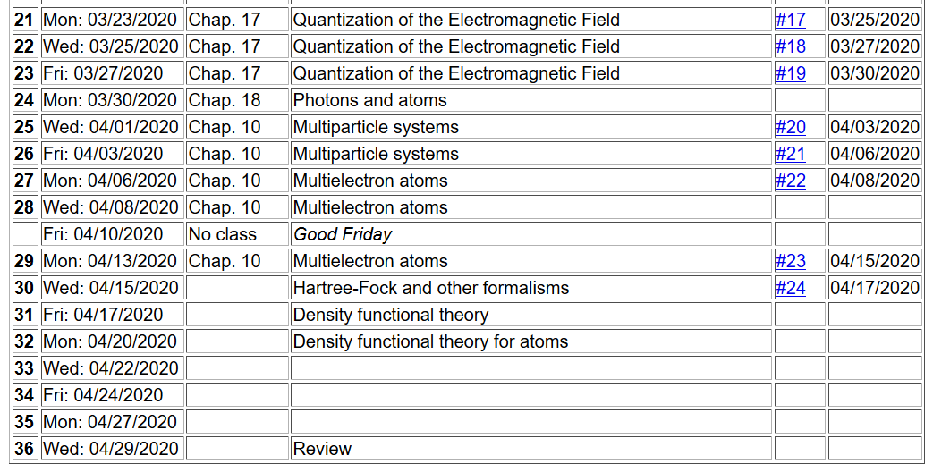
Notes:
Ongoing schedule

Slide 3
Summary of results for density functional theory –
For a system with a given one-electron potential v(r), there is a unique density n(r) which describes the system in its ground state. Although the density n(r) is a collective property of the system, it can be described by a single particle function and it implies that the task of finding the electronic ground state of the multi electron system can be mapped to a process of solving a related single particle problem self-consistently.
Kinetic energy
Single particle interaction
Electron-electron repulsion
Exchange-correlation
energy
Notes:
Summary of the theorem and of the various energy contributions.

Slide 4
Kohn-Sham scheme supposes that we can represent the density as a sum over one-electron orbitals
Here we are sweeping some details like spin under the rug….
Notes:
Here are the formulas for the various contributions

Slide 5
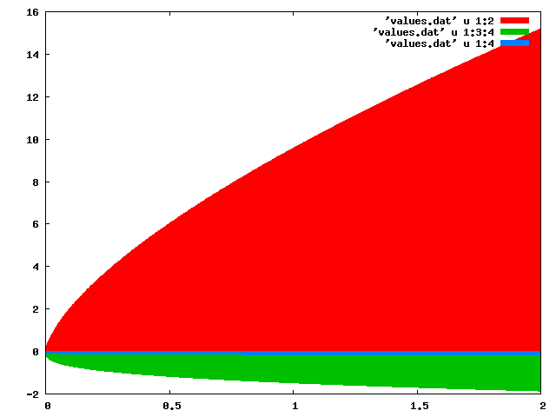
Digression: Jellium energies
E (Ryd) →
T[n]
E_{c}[n]
E_{x}[n]
n (bohr)⁻³ →
Notes:
This gives an idea of the order of magnitude of the terms as a function of density for the jellium model

Slide 6
Notes:
Various potential terms.

Slide 7
Numerical methods for solving the Kohn-Sham equations
Self-consistent solution
Notes:
Iteration scheme

Slide 8
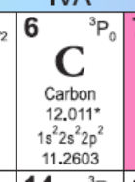
Numerical methods for solving the Kohn-Sham equations –
Consider the case of a single atom, choosing the coordinate system at the center of the nucleus. We will further assume that the atom is spherically symmetric, averaging over the multiplet configurations.
Notes:
Example of Carbon atom

Slide 9
Kohn-Sham equations for spherical atom
Notes:
Detailed equations

Slide 10
Kohn-Sham equations for spherical atom -- continued
Notes:
Simplifying the differential equation and choosing convenient units.

Slide 11
Kohn-Sham equations for spherical atom -- continued
Notes:
Some detailed equations

Slide 12
Kohn-Sham equations for spherical atom -- continued
Notes on numerical integration of differential equations
Notes:
Please read numerov.pdf and then continue with this power point.

Slide 13
Digression on numerical integration
Numerical results from second-order approximation:
 | N=4 | N=8 | Exact
ν=1 | 9.54915028 | 9.7697954 | 9.869604404
ν=2 | 34.54915031 | 37.9008002 | 39.47841762
Numerical results from Numerov approximation:
 | N=4 | Exact
ν=1 | 9.863097625 | 9.869604404
ν=2 | 39.04581620 | 39.47841762
Notes:
Some details about numerical integration

Slide 14
Some details:
Set up matrix problem for (N-1) unknown values;
s²E_{v} are matrix eigenvalues
Notes:
Details of the setup

Slide 15
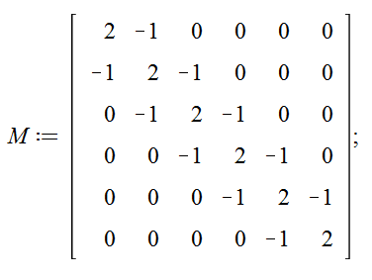
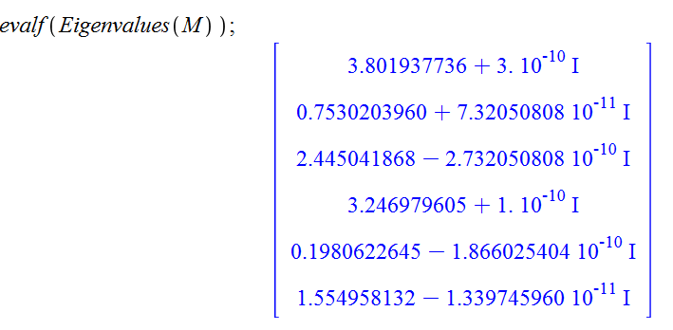
Example for N=7:
Notes:
Results using Maple

Slide 16
Example for N=7: -- continue
ν | λ | λ/s² | E_{v}
1 | 0.1980622645 | 9.7050509605 | 9.869604401
2 | 0.7530203960 | 36.897999404 | 39.47841760
3 | 1.554958132 | 76.192948468 | 88.82643960
4 | 2.445041868 | 119.80705153 | 157.9136704
5 | 3.246979605 | 159.10200064 | 246.7401100
6 | 3.801937736 | 186.29494906 | 355.3057584
Notes:
Summary. Notice that lowest eigenvalues are estimated the best.

