Slide 1
PHY 742 Quantum Mechanics II
1-1:50 AM MWF via video link:
https://wakeforest-university.zoom.us/my/natalie.holzwarth
Plan for Lecture 33
Some Practical Realizations of Density functional Theory
Electronic structure of atoms
Frozen core approximation
Extension of formalism to multi-center analysis
Notes:
We will illustrate the practical use of density functional for studying “real” materials.

Slide 2
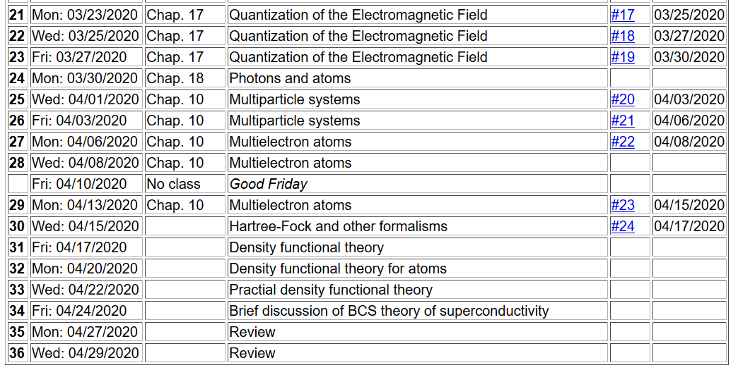
Notes:
Ongoing schedule

Slide 3
Kohn-Sham equations for spherical atom
Notes:
Particular equations for atoms.

Slide 4
Numerical methods for solving the Kohn-Sham equations
Self-consistent solution
Notes:
Self consistent procedure

Slide 5
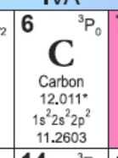
Example for carbon
Notes:
Example for C atom

Slide 6
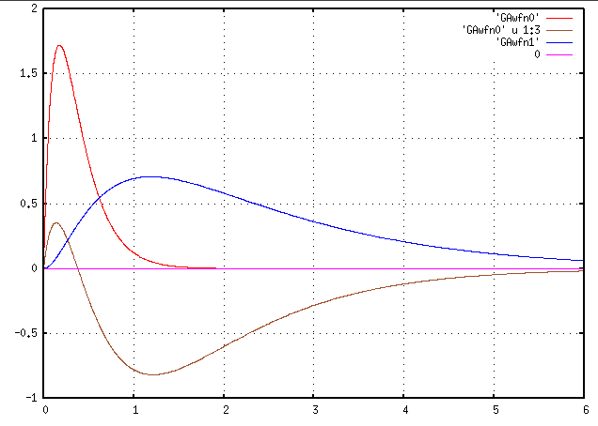
Results for carbon
Lagrange multipliers
1s
P_{nl}(r)
-0.4 Ry
2p
2p
-1.0 Ry
2s
r (Bohr)
2s
-20.0 Ry
1s
Notes:
Plot of self-consistent results for one electron orbitals and their Lagrange multipliers. Is there any physical significance to the Lagrange multipliers?

Slide 7
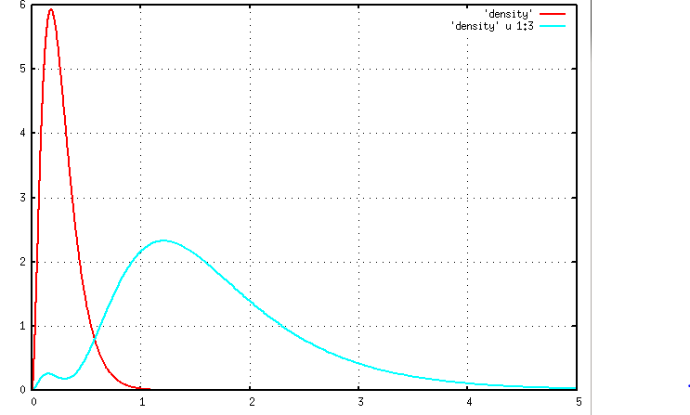
Electron density
n_{core}(r)
n r²/4p
n_{val}(r)
r (Bohr)
Notes:
Here is a plot of the electron density, separating the core and valence contributions.

Slide 8
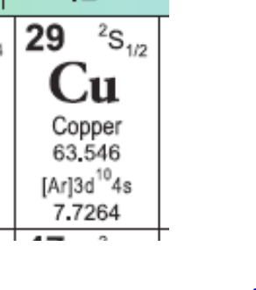
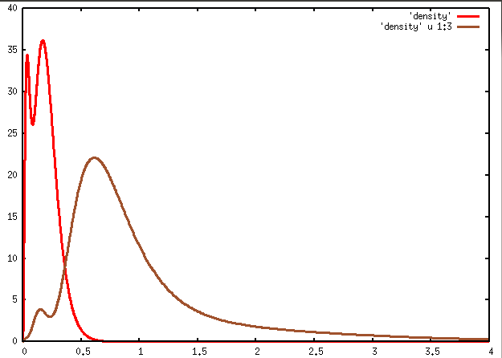
Example for Cu
1s²2s²2p⁶3s²3p⁶3d¹⁰4s¹
n_{core}(r)
n r²/4p
n_{vale}(r)
r (Bohr)
Notes:
The separation of core and valence density contributions is more obvious/important for Cu

Slide 9
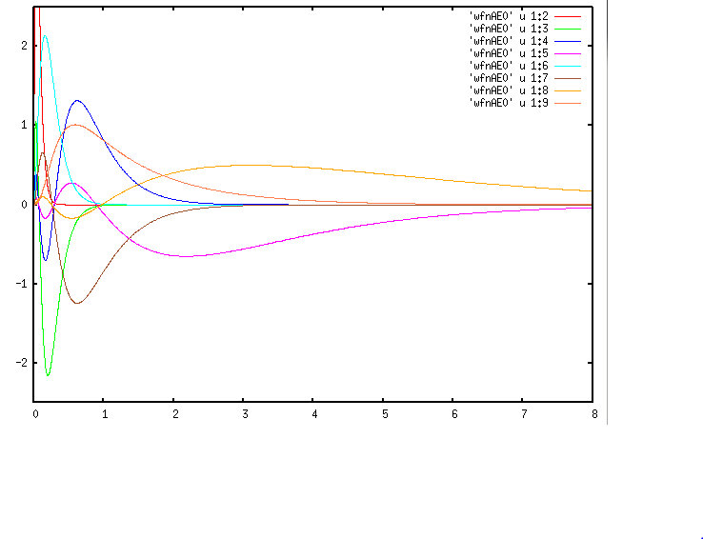
Results for Copper
3s
3d
4p
P_{nl}(r)
4s
3p
r (Bohr)
Notes:
Plot of all of the radial orbitals.

Slide 10
Frozen core approximation
Example for Cu
1s²2s²2p⁶3s²3p⁶3d¹⁰4s¹
n_{core}(r)
n r²/4π
n_{vale}(r)
r (Bohr)
Notes:
It is convenient to make the so-called “frozen” core approximation

Slide 11
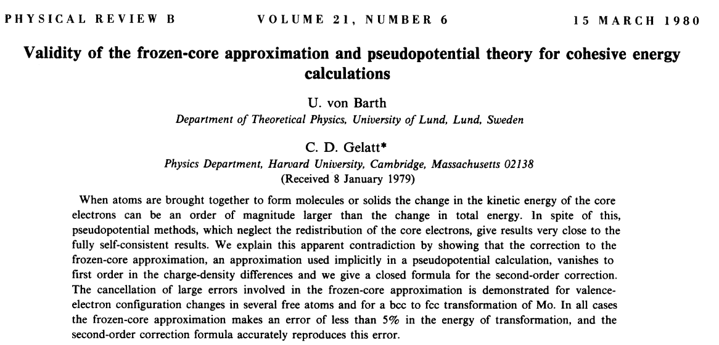
Systematic study of frozen core approximation in DFT
http://journals.aps.org/prb/abstract/10.1103/PhysRevB.21.2222
Notes:
This paper studied the numerical properties of the frozen core approximation.

Slide 12
Variational relations for DFT in frozencore approximation (Kohn-Sham formulation)
Notes:
Partitioning of the Hamiltonian terms.

Slide 13
Practical solution to Kohn-Sham equations for single particle orbitals:
Notes:
On top of the approximations made so far, we need to be able to solve the equations numerically.

Slide 14
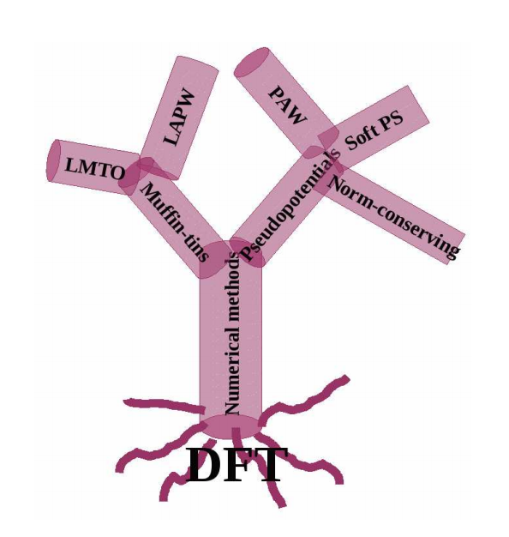
Practical solution of Kohn-Sham equations in solids
Notes:
Many methods have evolved to solve the numerical problems. Here are illustrated two main branches.

Slide 15
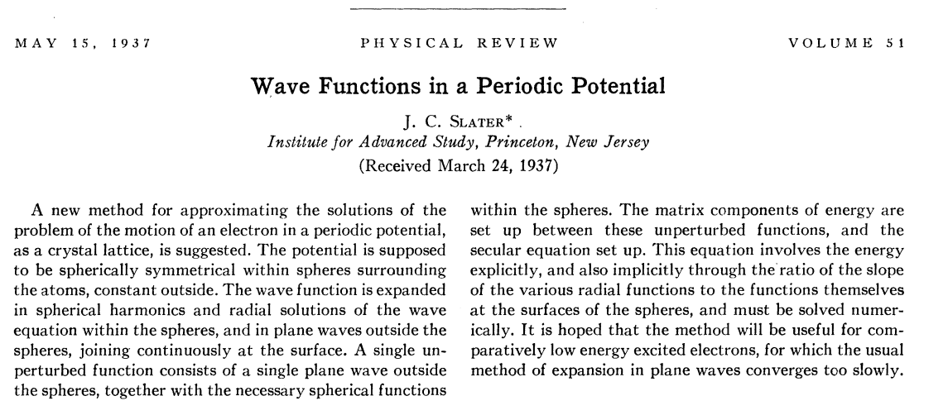
Muffin tin potential construction
http://journals.aps.org/pr/abstract/10.1103/PhysRev.51.846
Augmented Plane Wave (APW) approximation
Notes:
The muffin tin approach was developed by John Slater in the 1930’s.

Slide 16
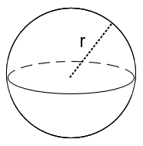
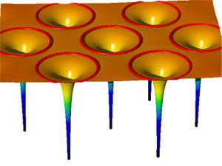
Muffin tin potential construction
http://www.jara.org/de/research/jara-hpc/forschung/details/simlab-ai/performance-modeling-for-linear-algebra-in-fleur/
Notes:
Some visualizations of the muffin tins.

Slide 17
Muffin tin model continued:
Problems with APW and KKR Green’s function schemes
Difficult numerically to find Kohn-Sham energies ε_{i}
Potential form unrealistic especially for covalent materials
➔Linearized equations – O. K. Andersen
http://journals.aps.org/prb/abstract/10.1103/PhysRevB.12.3060
Notes:
Some details

Slide 18
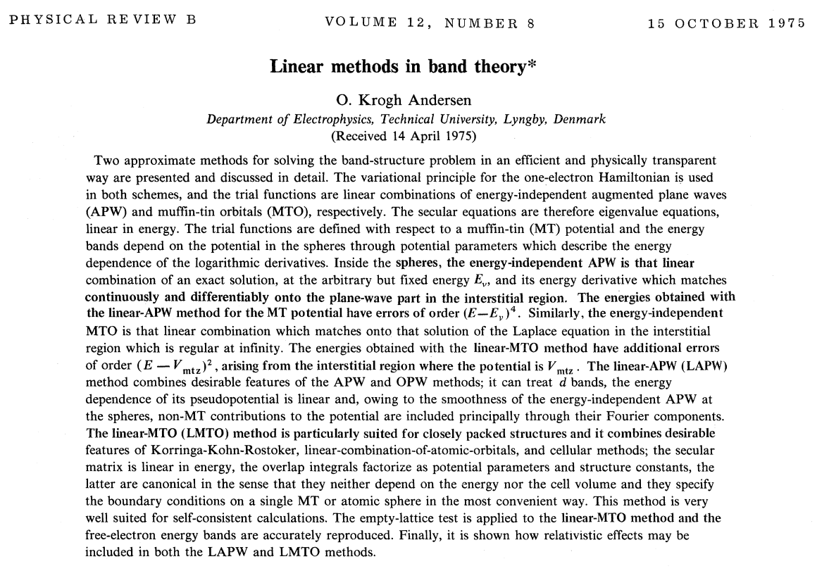
Notes:
The original method of Slater was not very efficient. O. K. Andersen showed how to make the numerical work morel efficient by linearizing the equations. Later authors improved the physics as well (relaxed the restrictions) of the muffin tin.

Slide 19
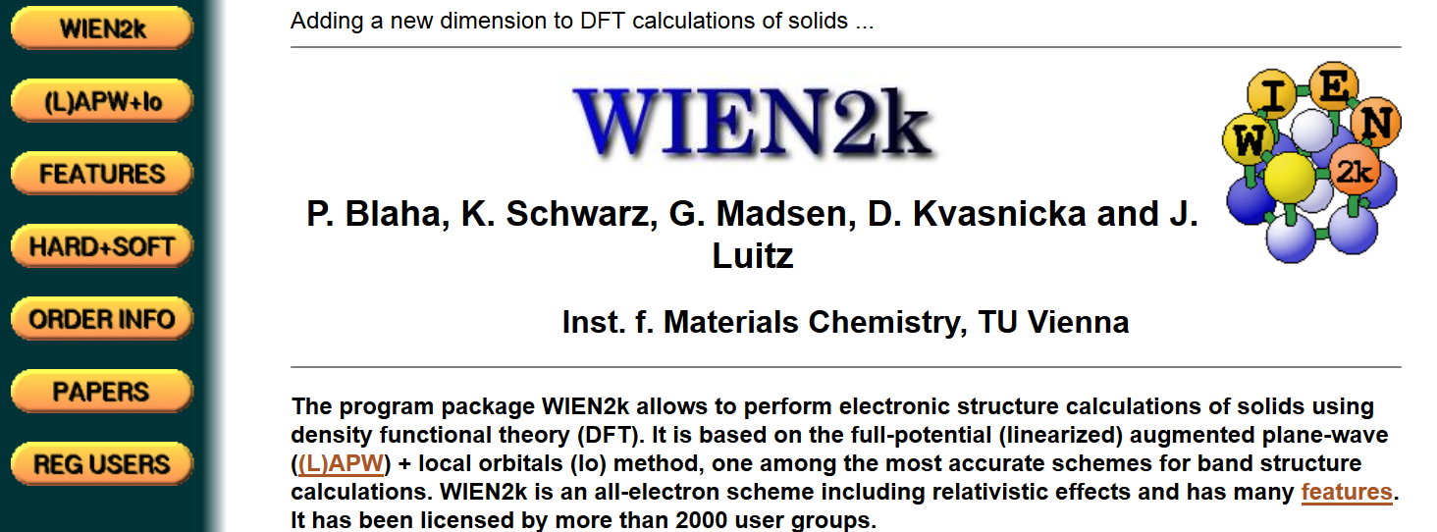
Modern software based on LAPW method --
http://www.wien2k.at/
Notes:
A modern code package using this method.

Slide 20
http://elk.sourceforge.net/
http://exciting-code.org/
Notes:
More LAPW codes.

Slide 21
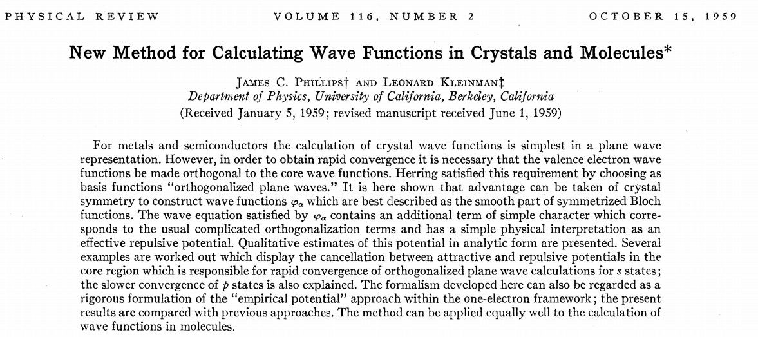
Motivation/justification for pseudopotential formalism
Notes:
Another approach was the pseudopotential approach initiated by Phillips and Kleinman.

Slide 22
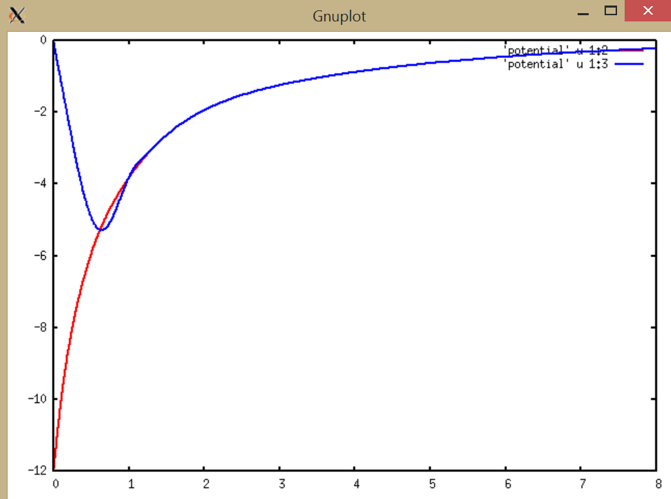
Local pseudopotential for C
rV(r) (Bohr * Ry
Self-consistent full potential for C
r (Bohr)
Notes:
The pseudopotential replaces the all-electron potential with a spacially smother one while maintaining the correct physics in the mathematics.

Slide 23
Kohn-Sham equations (assuming “local” pseudo potential)
Convergent representation for pseudopotentials
Ideally, the pseudopotential will represent the same physics as the “real” potential --
Notes:
With the pseudopotential, the Kohn-Sham equations can be solved with plane wave expansions over all space.

