Slide 1
PHY 742 Quantum Mechanics II
1-1:50 AM MWF via video link:
https://wakeforest-university.zoom.us/my/natalie.holzwarth
Plan for Lecture 34
A short introduction to the quantum theory of superconductivity
Bardeen, Cooper, Scrieffer, Phys. Rev. 108, 1175 (1957)
Cooper pairs
Gap equation
Estimate of T_{c}
Some of the slides contain materials from the textbook, Solid State Physics; Second Edition by Giuseppe Grosso and Giuseppe Pastori Parravicini (Academic Press, 2014)
Notes:
We will go over some of the concepts of this famous paper.

Slide 2
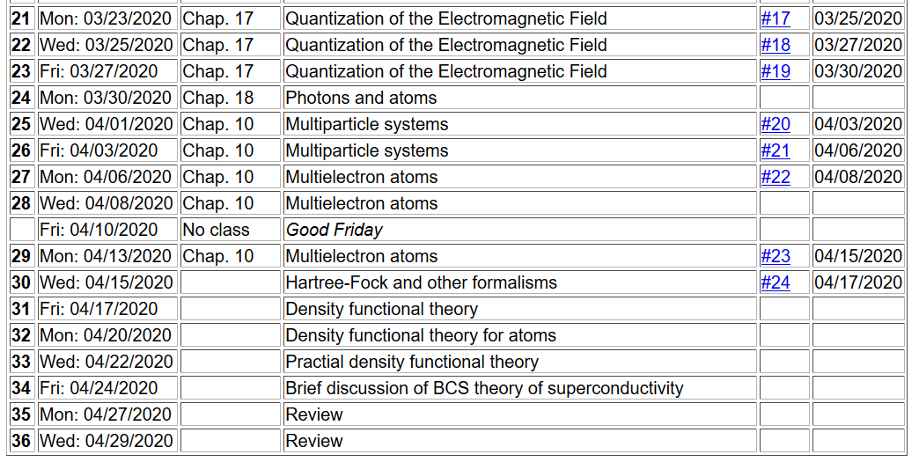
Notes:
Ongoing schedule

Slide 3
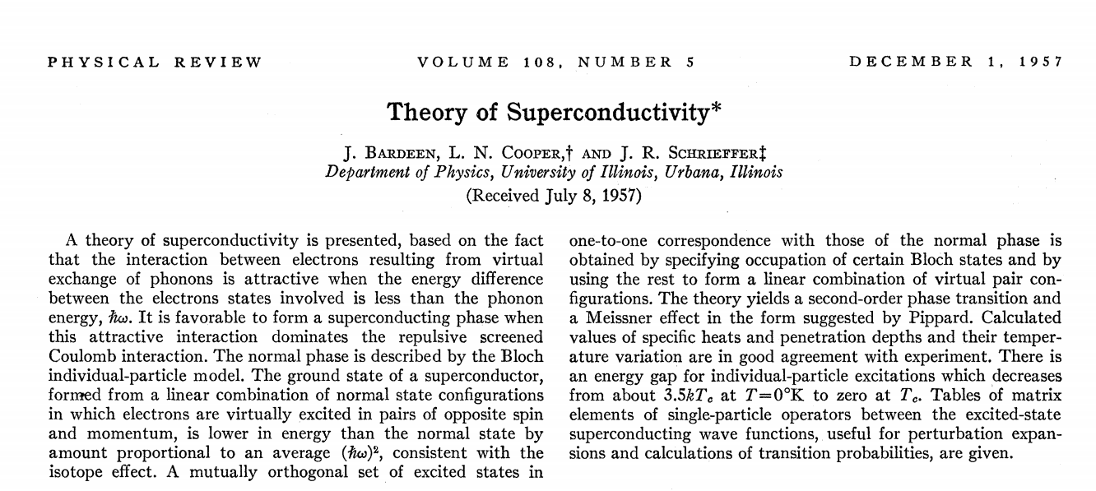

Slide 5
Notion of a Cooper pair
Starting with a material with all the states filled up to the Fermi level, we focus attention on a pair of states which have a net attractive interaction U(r₁,r₂):
The thinking is that the interaction is related to lattice vibrations and had an energy

Slide 6
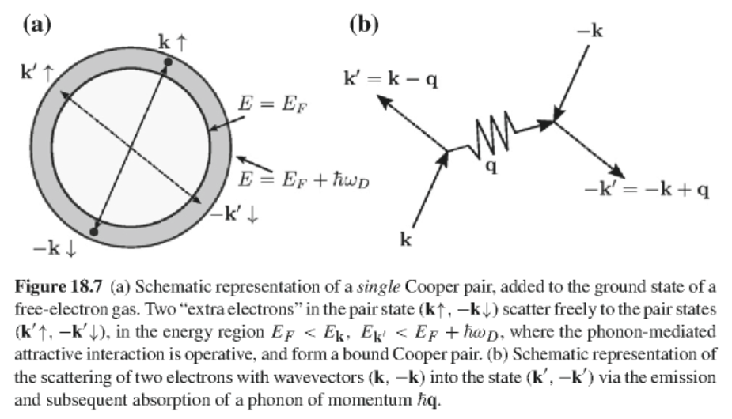
Notes:
Not sure that this helps… The thinking is that the pair of states are very close to the Fermi level.

Slide 7
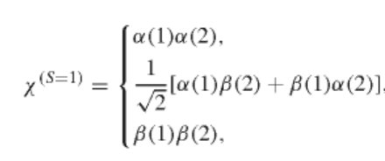
Properties of pair wavefunction
Spin part:
or
Notes:
The pair of electrons can have total spin 0 or 1 which determines the spatial symmetry to be symmetric or antisymmetric, respectively.

Slide 8
Properties of pair wavefunction – continued
Assume that the electron pair can be represented by a linear combination of plane wave states of wavevectors k and -k:
Notes:
It will be convenient to express the spatial part in terms of the Fourier representation.

Slide 9
Define Fourier transform of interaction potential:
Equation satisfied by pair amplitude functions:
Notes:
Here is the equation that the unknow amplitude g(k) must satisfy. The initial states are below the Fermi level and scattered states are above the Fermi level.

Slide 10
Cooper pair equations -- continued
Simplified model for interaction:
Notes:
Simplifying the interaction term to a constant. Why must Cooper pair states have singlet spin?

Slide 11
Cooper pair equations -- continued
Non-trivial solution for singlet state:
E_{pair}
Equation to determine eigenstate energy:
n
Density of states (one electron basis)
Notes:
How does the derivation of the eigenstate energy equation work?

Slide 12
Cooper pair equations -- continued
Shows that a singlet Cooper pair is more stable than the independent particle system even for small U_{0.}
Notes:
Why do we conclude that the Cooper pair is more stable?

Slide 13
Variational determination of the ground-state wavefunction in the BCS model
Second quantization
Note that the Cooper pair singlet state can be written
Notes:
It is convenient to use second quantization

Slide 14
Variational determination of the ground-state wavefunction in the BCS model -- continued
independent particle states
Cooper-pair interaction
Consider a ground state wavefunction of the form
probability amplitude for forming Cooper pair
Notes:
Hamiltonian of the BCS model. The parameters u and v will be determined variationally.

Slide 15
Variational determination of the ground-state wavefunction in the BCS model -- continued
Need to minimize the expectation value:
After some algebra:
Notes:
Writing out the energy to be determined variationally.

Slide 16
Variational determination of the ground-state wavefunction in the BCS model -- continued
Convenient transformation:
Define:
Notes:
Clever tricks and notations.

Slide 17
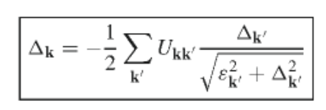
Variational determination of the ground-state wavefunction in the BCS model -- continued
In terms of the “gap parameter” the variational equations become:
Notes:
In the end, we have an integral equation for the gap parameter.

Slide 18
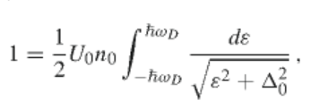
Variational determination of the ground-state wavefunction in the BCS model -- continued
Simplified model
Using DOS:
Notes:
Make a simplified model for the interaction term in order to solve the equation.

Slide 19
Variational determination of the ground-state wavefunction in the BCS model -- continued
Solving for the gap parameter:
Estimating the ground state energy of the superconducting state:

Slide 20
Estimating the ground state energy of the superconducting state – continued
Using the variational solution and integrating the DOS:
Notes:
Here we assume that the gap parameter is smaller that the phonon energy.

Slide 21
Effects of temperature:
Thermal average of Cooper pair operator:
Define
average
fluctuations
Notes:
Now we need to consider how temperature affects the analysis.

Slide 22
Modified Gap relationship
Fermi-Dirac distribution
Modified Gap equation
Notes:
Introducing the Fermi-Dirac distribution

Slide 23
Simplified model
Notes:
Evaluating expressions for simplified model

Slide 24
Evaluation of the integral
Notes:
Some arithmetic…

Slide 25
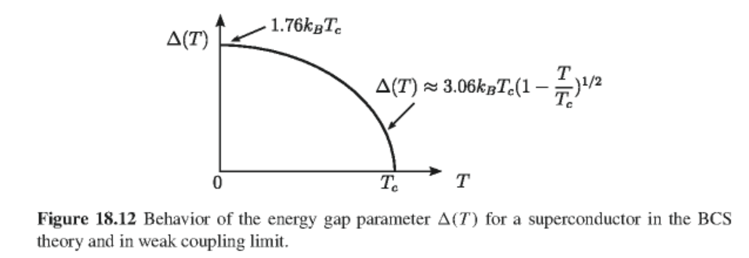
Numerical evaluation of integral:
Notes:
At the critical temperature, the gap is 0. Graph shows qualitative temperature dependence.

Slide 26
Estimation of critical magnetic field (BCS paper)
Free energy of normal state
Free energy of superconducting state
After some approximations, etc.:
Notes:
Relationship to critical field.

Slide 27
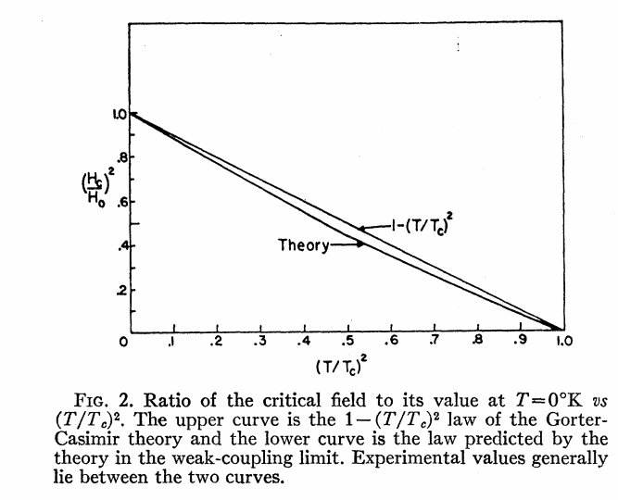
Notes:
Figure from BCS theory showing agreement with experiment.

