Slide 1
PHY 742 Quantum Mechanics II
1-1:50 AM MWF Olin 103
Plan for Lecture 4
Summary of Chapter 9 – Quantum particle interacting with classical electromagnetic fields
Begin reading Chapter 14 – Analysis of scattering phenomena
  Partial wave expansion of probability amplitude
  Formulation of differential cross section in terms of scattering phase shifts

Slide 2
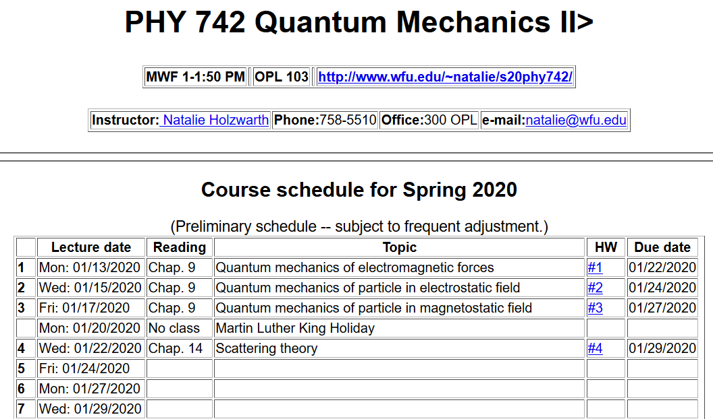

Slide 3
Summary of results for the quantum mechanical treatment of interaction of particle of mass m and charge q with classical electromagnetic fields in terms of scalar and vector potentials U(r,t) and A(r,t):

Slide 4
Summary – continued -- Effects of the electromagnetic field on the particle current operator.

Slide 5
Example – A(r,t)=0 and U(r,t)=F(x-a)
U(x)
E
Energy
x
a

Slide 6
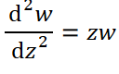
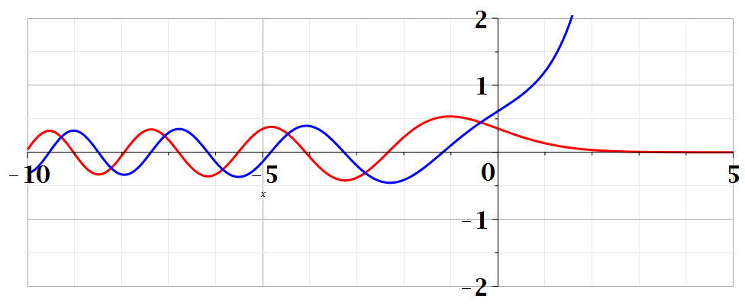
Airy functions --
Bi(z)
Ai(z)

Slide 7
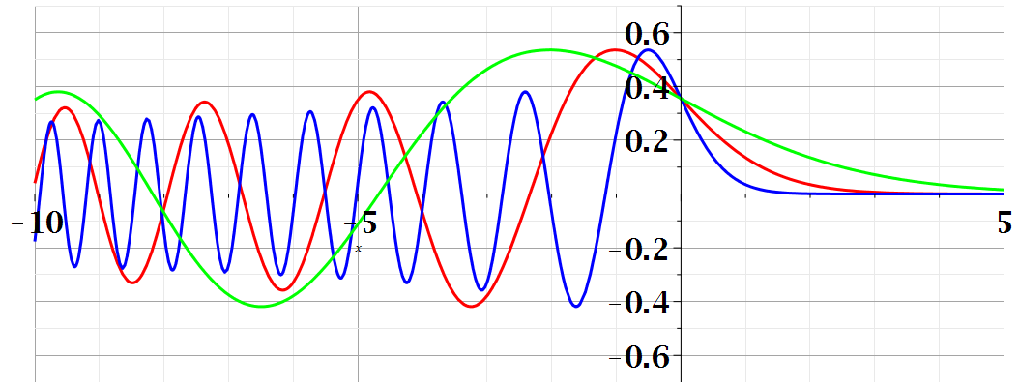
Summary of results
Note that in this case, physical solutions exist for all energies E; the wavefunction oscillates for
x<a+E/qF and decays for x>a+E/qF .

Slide 8
Example – Particle in a magnetostatic field

Slide 10
Hermite polynomial

Slide 11
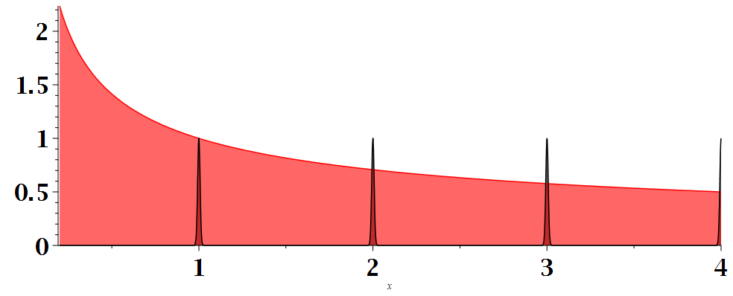
Note that this is an approximate model of an ideal metal in a magnetic field which results in oscillatory resistivity for example.
DOS plot for magnetostatic acting on charged particle
Placement of discrete levels depends on magnetic field strength
ε

Slide 12
Effects of magnetostatic fields on particles’ intrinsic magnetic moment.

Slide 13
Interaction of magnetostatic field B with a hydrogen atom (including contribution of intrinsic electron spin, omitting contribution of intrinsic proton spin).

Slide 14
Analysis of magnetostatic effects on atomic structure using perturbation theory, also including the effects of spin-orbit interation

Slide 15
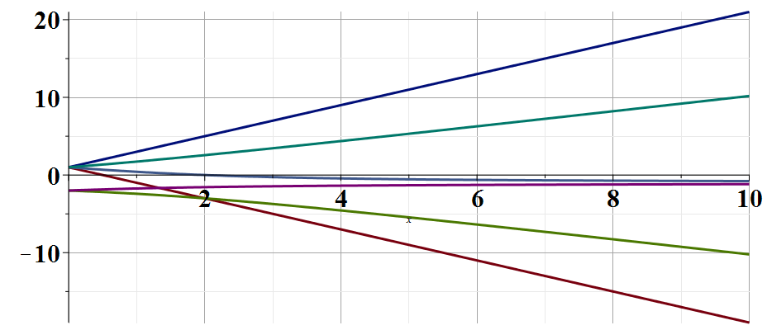
First order perturbation theory analysis for n=2 levels of H atom
E/γ
β/γ
Paschen-Back effect
Zeeman effect

Slide 16
Aharonov-Bohm effect – an interference phenomenon concerning a particle interacting with a vector potential
Reference: End of Chap. 9 in Professor Carlson’s text
Online sources -- http://mafija.fmf.uni-lj.si/seminar/files/2010_2011/seminar_aharonov.pdf

Slide 17
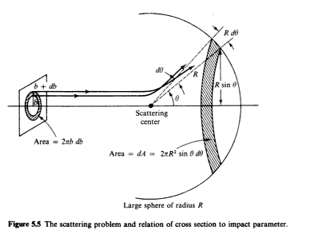
Introduction to scattering theory for quantum particles -- Chap. 14 of textbook; also see Merzbacher’s textbook
detector
Geometry of ideal scattering measurement

Slide 18
In classical mechanics, for an isotropic target, it is possible to calculate the cross section in terms of the impact parameter b:
In quantum mechanics, the same phenomenon is formulated in terms of the probability amplitudes. We will specifically focus on free particles scattering from a spherically symmetric target.

Slide 19
Representation of a free particle in quantum mechanics --
Continuum solutions of the time independent Schrödinger equation.
z
r
ö
y
x

Slide 21
Free particle partial waves -- continued

Slide 22
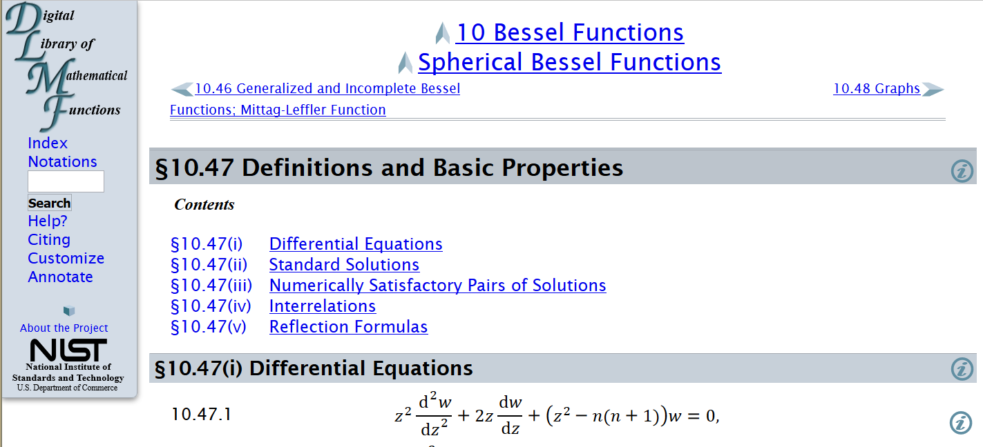
Properties of spherical Bessel functions
http://dlmf.nist.gov/10.47

Slide 23
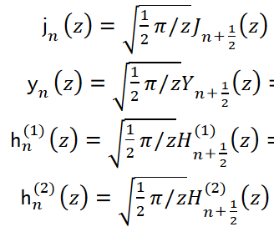
Spherical Bessel functions of order n
Cylindrical Bessel functions of order n+1/2

Slide 24
Forms of spherical Bessel and Hankel functions:

Slide 25
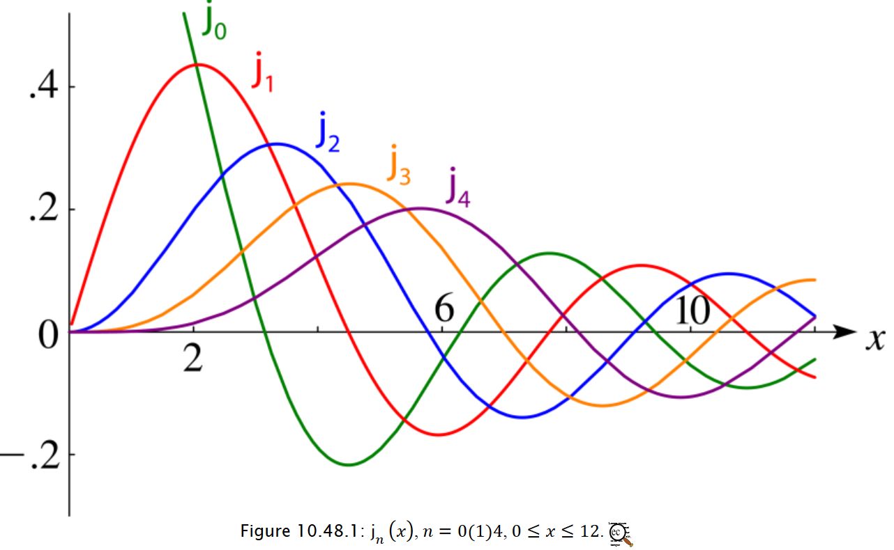

Slide 26
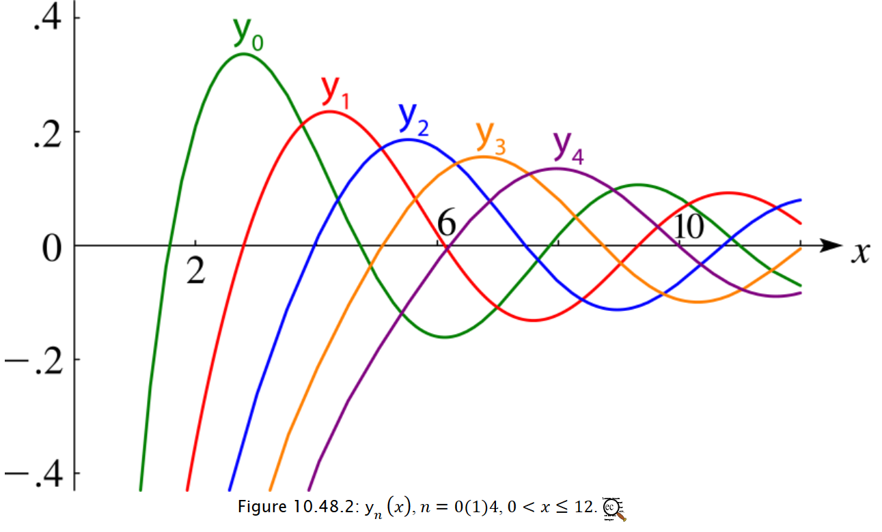

Slide 29
What we will show next time, is that the scattering phase shift is a measure of the quantum mechanical scattering cross section:

