Slide 1
PHY 742 Quantum Mechanics II
1-1:50 AM MWF Olin 103
Plan for Lecture 5
Continue reading Chapter 14 – Analysis of scattering phenomena
Notion of scattering phase shifts
Relationship of scattering phase shifts and differential and total scattering cross sections
Examples

Slide 2
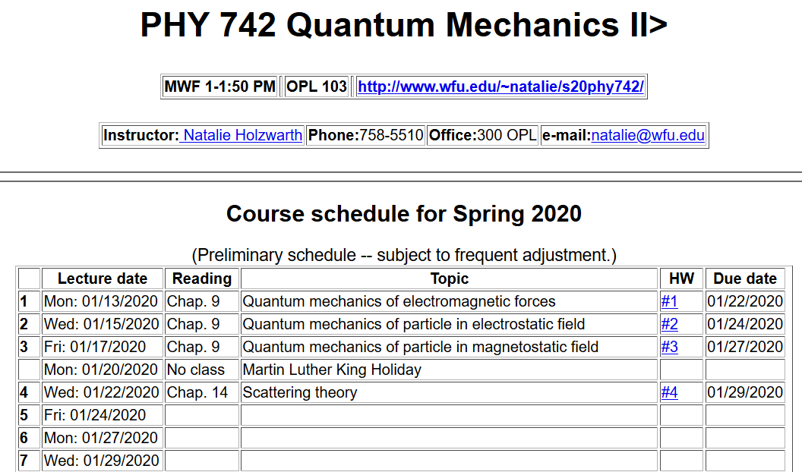

Slide 3
Introduction to scattering theory for quantum particles -- Chap. 14 of textbook; also see Merzbacher’s textbook
detector
Geometry of ideal scattering measurement

Slide 4
Representation of scattering in terms of probability amplitude
Scattering geometry

Slide 5
Scattering geometry
What we will show for spherical target

Slide 6
Representation of a free particle in quantum mechanics --
Continuum solutions of the time independent Schrödinger equation.
z
r
ö
y
x
Potential interaction due to spherical target for 0 ≤ r ≤ D

Slide 10
What we want to show, is that the scattering phase shift is a measure of the quantum mechanical scattering cross section:

Slide 11
Some details:

Slide 12
More details:

Slide 13
More details:

Slide 14
More details:

Slide 15
More details:

Slide 16
When the dust clears:
Imaginary part of forward scattering is proportional to the total scattering cross section.
Imaginary part of forward scattering is proportional to the total scattering cross section.

Slide 17
Example – scattering from an impenetrable spherical hard wall of radius a

Slide 18
Example – scattering from an impenetrable spherical hard wall of radius a
Different from classical case!

Slide 19
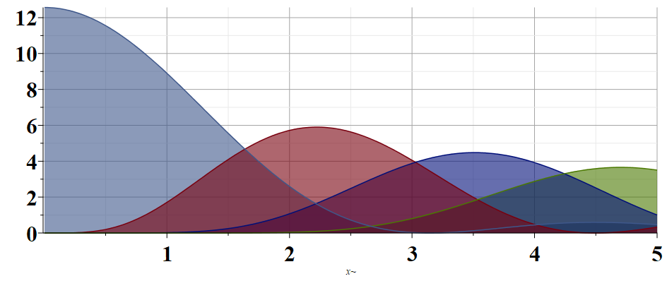
Example – scattering from an impenetrable spherical hard wall of radius a
Partial wave contributions to cross section
l=0
l=1
l=2
l=3
k

