Slide 1
PHY 742 Quantum Mechanics II
1-1:50 AM MWF Olin 103
Plan for Lecture 6
Continue reading Chapter 14 – Analysis of scattering phenomena
Summary of phase shift analysis and examples
Approximate treatments of scattering – Born approximation

Slide 2
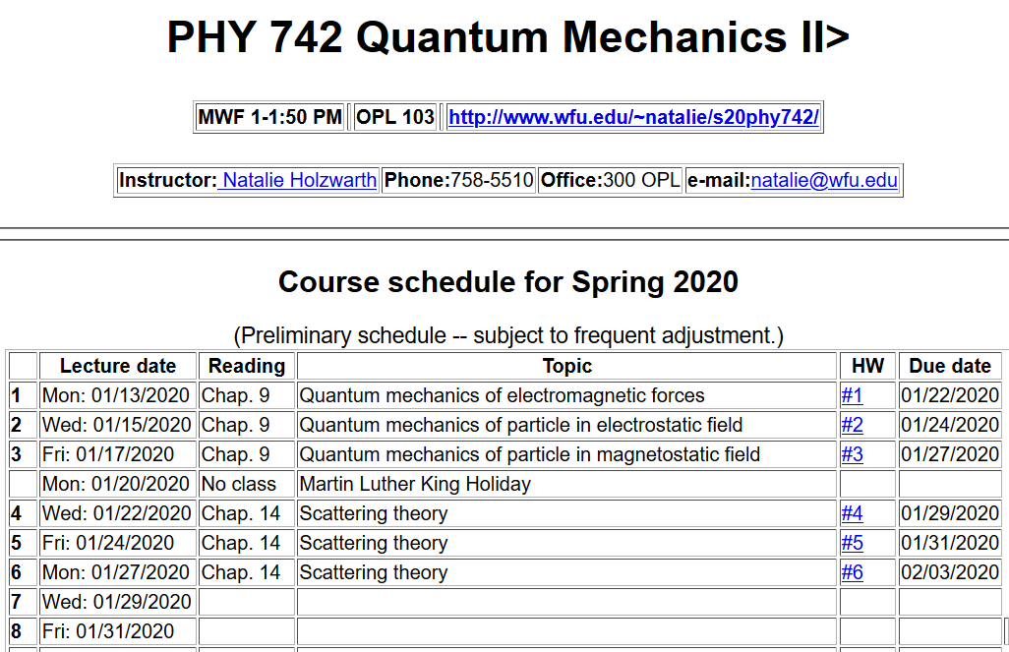

Slide 3
Representation of scattering in terms of probability amplitude
Scattering geometry

Slide 4
Summary of analysis for spherical target in terms of scattering phase shifts:
Imaginary part of forward scattering is proportional to the total scattering cross section.

Slide 5
Summary of analysis for spherical target in terms of scattering phase shifts -- continued:
Spherical Neumann function
Spherical Bessel function

Slide 6
Slight simplification in functions --

Slide 7
Slight simplification in functions – continued (Note: This notation is not standard.)
Scaled Bessel and Neumann functions:
Similarly, we have scaled modified Bessel and Neumann functions

Slide 8
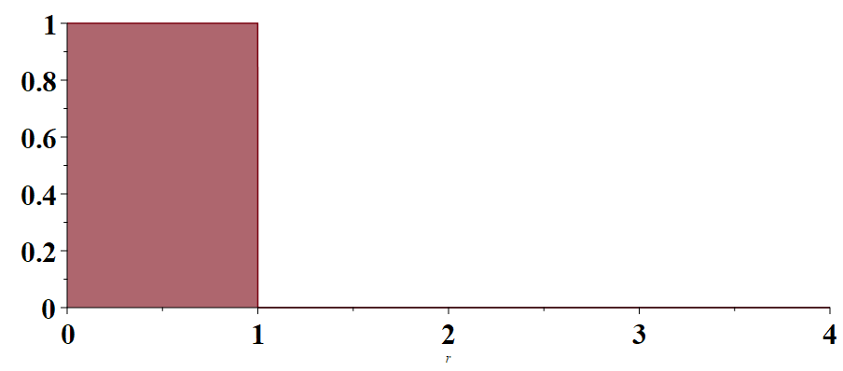
Example --
V(r)/V₀
r/a

Slide 9
Example -- continued

Slide 10
Example -- continued
Even more generally, this approach can be used to determine the exact cross section for this model from scattering amplitude:

Slide 11
Approximate treatment of scattering – Born approximation

Slide 14
Example – screened Coulomb interaction

Slide 15
Example – screened Coulomb interaction -- continued

Slide 16
Example – screened Coulomb interaction -- continued

Slide 17
Example – spherical well

Slide 18
Example – spherical well – continued

Slide 19
Example – spherical well – continued
(Ref. Landau and Lifshitz)
(Not generally consistent with phase shift analysis.)

Slide 20
Beyond the Born approximation

