Slide 1
PHY 742 Quantum Mechanics II
1-1:50 AM MWF Olin 103
Plan for Lecture 7
Approximation methods for analyzing quantum mechanical systems
Start reading Chapter 12-13
a. Variational methods

Slide 2
Topics for Quantum Mechanics II
Single particle analysis
Single particle interacting with electromagnetic fields – EC Chap. 9
Scattering of a particle from a spherical potential – EC Chap. 14
More time independent perturbation methods – EC Chap. 12, 13
Single electron states of a multi-well potential ➔ molecules and solids – EC Chap. 2,6
Time dependent perturbation methods – EC Chap. 15
Path integral formalism (Feynman) – EC Chap. 11.C
Relativistic effects and the Dirac Equation – EC Chap. 16
Multiple particle analysis
Quantization of the electromagnetic fields – EC Chap. 17
Photons and atoms – EC Chap. 18
Multi particle systems; Bose and Fermi particles – EC Chap. 10
Multi electron atoms and materials
Hartree-Fock approximation
Density functional approximation

Slide 3
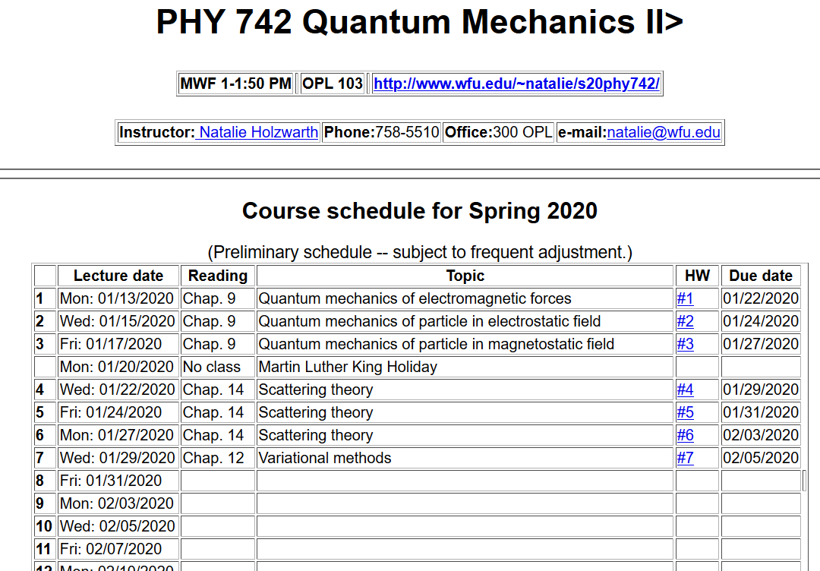

Slide 4
Variational methods for estimating the lowest energy eigenstate of a quantum mechanical system
Hermitian operator representing the Hamiltonian of the system

Slide 6
Significance of this inequality --
The inequality motivates a class of estimation methods known as variational methods to converge to the ground state energy E₀ and the corresponding ground state probability amplitude.

Slide 7
Example --
Unlike the case of a H atom, this Hamiltonian cannot be solved analytically.

Slide 8
Review -- Quantum mechanics of the hydrogen atom
z
r_{e}
R_{N}
y
x

Slide 9
Quantum mechanics of the hydrogen atom
z
In center of mass coordinates
r
y
x

Slide 14
Example of normalized radial functions R_{nl}(r):

Slide 15
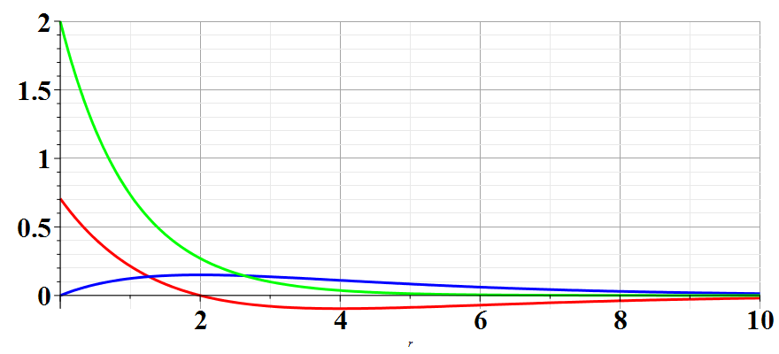
Hydrogen radial wavefunctions
R₁₀
R₂₀
R₂₁

Slide 16
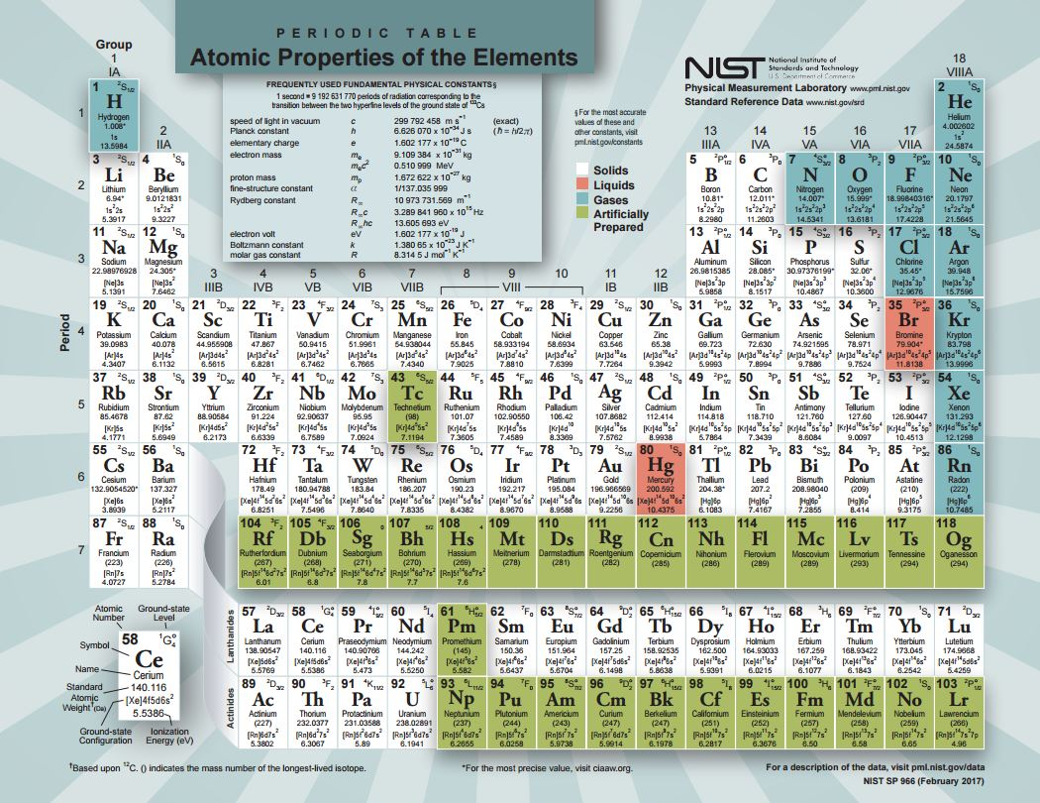

Slide 19
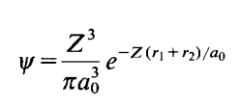
Back to estimate of wavefunction for He atom
Trial function for this case:
Here Z is a variational parameter

