Slide 1
PHY 742 Quantum Mechanics II
1-1:50 AM MWF Olin 103
Plan for Lecture 8
Approximation methods for analyzing quantum mechanical systems
Continue reading Chapter 12
Variational methods
WKB or semi-classical approximation

Slide 2
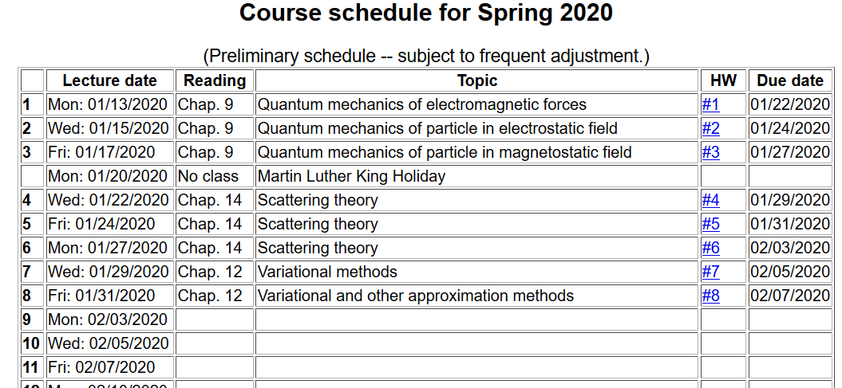

Slide 3
Inequality behind variational approximation method for finding ground state energy E₀
Summary of variational method:

Slide 4
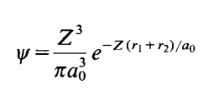
Back to estimate of wavefunction for He atom
Trial function for this case:
Here Z is a variational parameter

Slide 6
Some details

Slide 7
More details
=0

Slide 8
More details

Slide 9
More details
Useful identity:

Slide 10
More details
Consistent with earlier slides --

Slide 11
Quasi classical or WKB (Wentzl, Kramers, and Brillouin) method

Slide 12
Quasi classical or WKB (Wentzl, Kramers, and Brillouin) method -- continued

Slide 13
Quasi classical or WKB (Wentzl, Kramers, and Brillouin) method -- continued

Slide 14
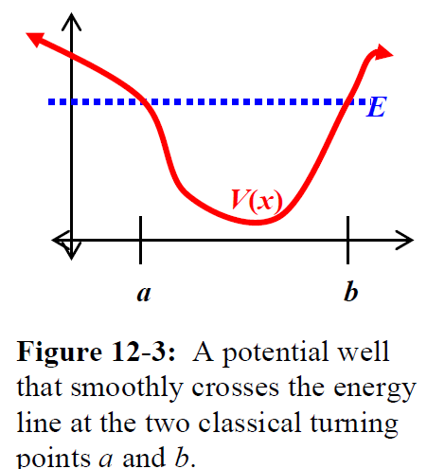
Quasi classical or WKB (Wentzl, Kramers, and Brillouin) method -- continued
WKB invalid

Slide 15
Analysis of exact solution for linear potential
Results will be used in their asymptotic limit to infer
WKB connection formula

Slide 17
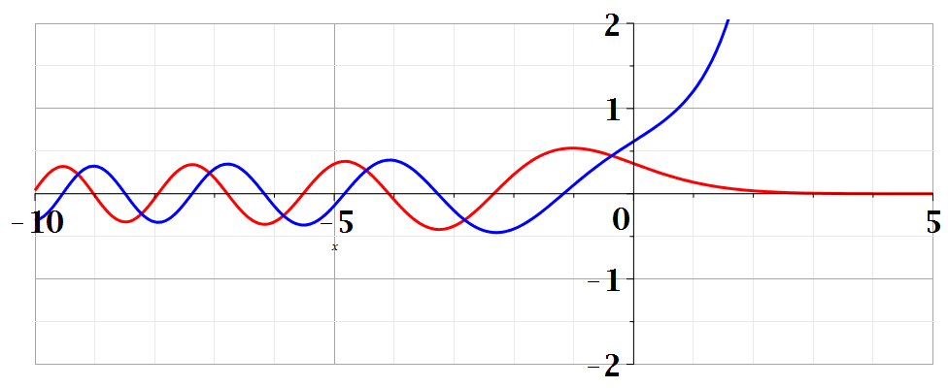
Bi(z)
Ai(z)

Slide 19
Some properties of Airy functions –
Integral form:

Slide 20
Relating asymptotic forms to WKB solutions (from Carlson’s textbook)
A similar analysis must be considered for a turning point on the other side.

Slide 21
WKB estimate of bound state energies
b
a
must vanish

Slide 22
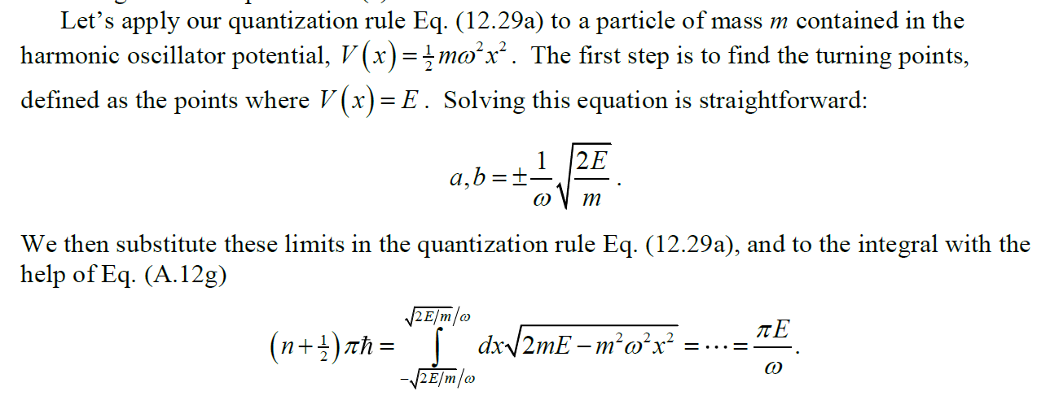
➔WKB estimate of bound state energy

