Slide 1
PHY 742 Quantum Mechanics II
1-1:50 AM MWF Olin 103
Plan for Lecture 9
Single particle states of molecules and solids
Part of this material is mentioned in Chapters 2 and 6 of Professor Carlson’s textbook
Comparison of the eigenstate analysis of a single well potential, a double well, and of a periodic array of wells.
Comparison of the eigenstate analysis of a H atom and an H₂⁺ molecular ion – next time

Slide 2
Topics for Quantum Mechanics II
Single particle analysis
Single particle interacting with electromagnetic fields – EC Chap. 9
Scattering of a particle from a spherical potential – EC Chap. 14
More time independent perturbation methods – EC Chap. 12, 13
Single electron states of a multi-well potential ➔ molecules and solids – EC Chap. 2,6
Time dependent perturbation methods – EC Chap. 15
Path integral formalism (Feynman) – EC Chap. 11.C
Relativistic effects and the Dirac Equation – EC Chap. 16
Multiple particle analysis
Quantization of the electromagnetic fields – EC Chap. 17
Photons and atoms – EC Chap. 18
Multi particle systems; Bose and Fermi particles – EC Chap. 10
Multi electron atoms and materials
Hartree-Fock approximation
Density functional approximation

Slide 3
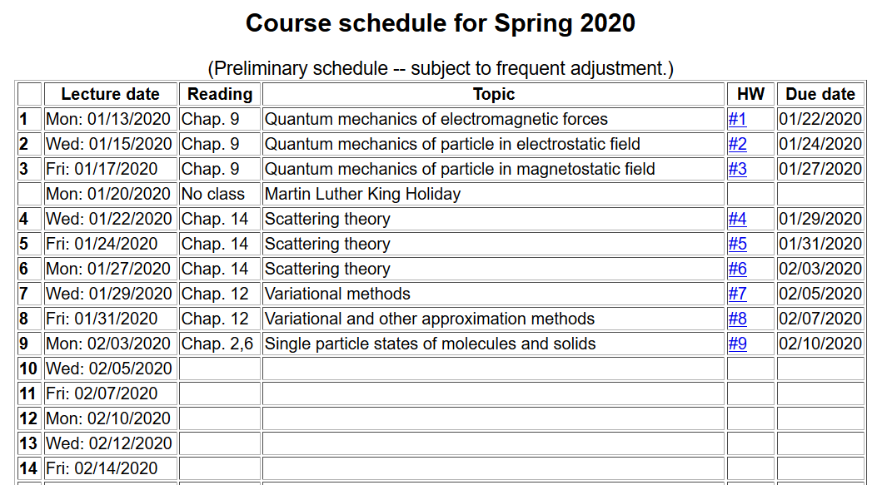

Slide 4
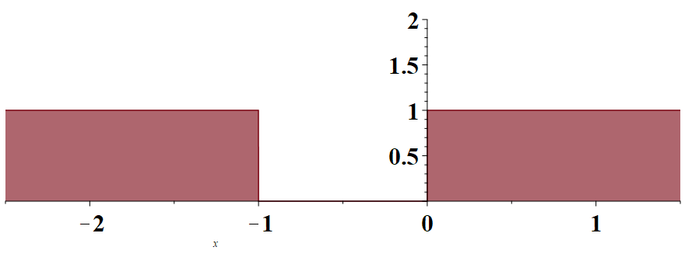
Examples of eigenstate analyses of the time independent Schrödinger equation for a single particle in a potential
Consider a single potential well
Spectrum
E
V/V₀
x/a

Slide 5
Some details
V/V₀
x/a

Slide 6
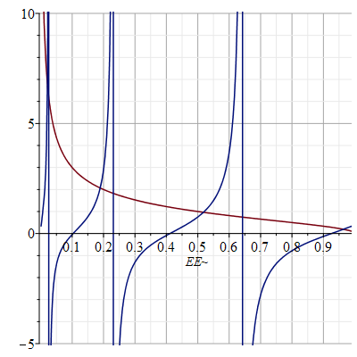
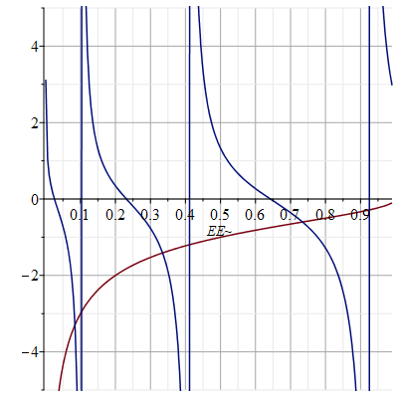
Numerical results for v=384

Slide 7
Summary of results for the case v=384
Maple syntax:
fsolve(tan(1/2*sqrt(384*EE)) = sqrt((1 - EE)/EE), EE = 0.95);
0.9634380037
ε
1__
0__

Slide 8
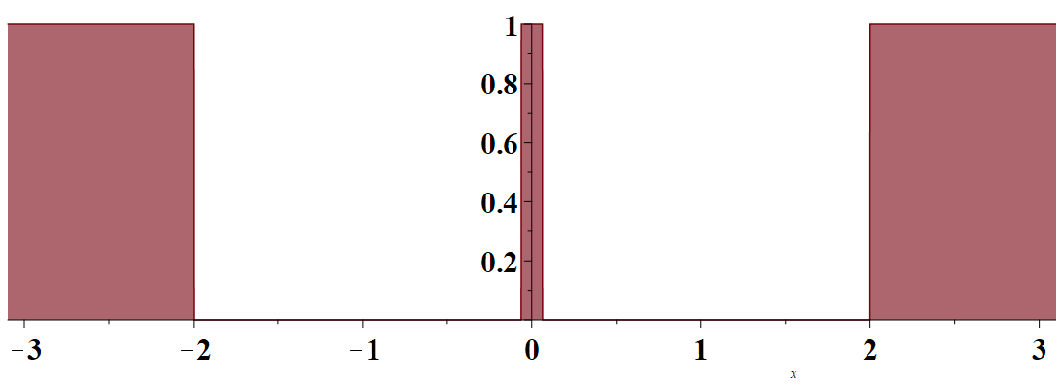
Example of a particle in a double well
V/V₀
-x₀-a
-x₀
x₀
x₀+a
x/a
even and odd solutions wrt x=0

Slide 9
Form of eigenstate solutions
ε
1__
even
even
even
0__
even

Slide 10
Another example of a one-dimensional system
Consider an electron moving in a one-dimensional model potential (Kronig and Penney, Proc. Roy. Soc. (London) 130, 499 (1931)
a
V₀

Slide 11
a
V₀
x/a

Slide 12
a
V₀

Slide 13
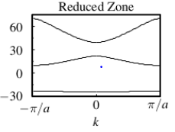
a
V₀
Band gap
E(k)

Slide 14
Consider a single potential well
Spectrum
E

Slide 15
Consider a periodic potential well system
Spectrum
E
a
V₀

Slide 16
a
V₀
b

Slide 17
a
V₀
b

Slide 18
a
V₀
b

Slide 19
v
Forbidden states
f
v
Forbidden states

Slide 20
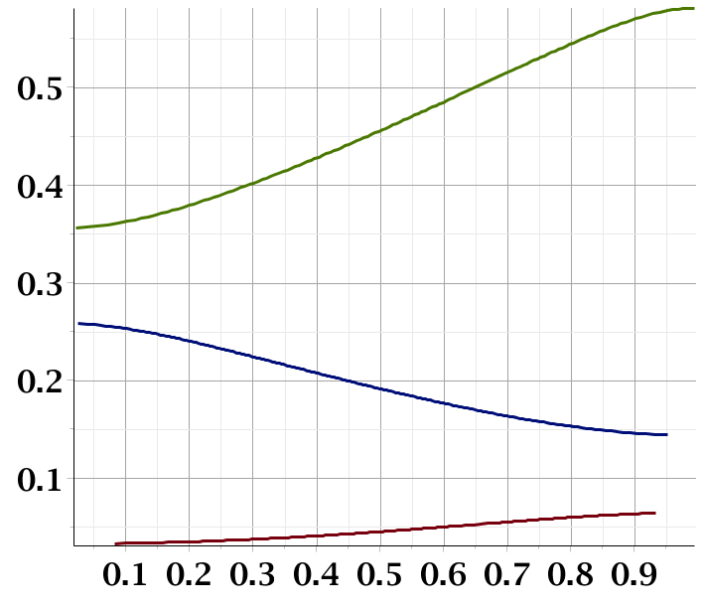
Corresponding single well states
f
Band gap
Band gap
ka/π

