Slide 1
PHY 341/641 Thermodynamics and Statistical Mechanics
MWF: Online at 12 PM & FTF at 2 PM
Plan for Lecture 1:
Reading: Chapters 1.1-1.3
Course structure and expectations
Some motivation and history
Temperature
Ideal gas equation of state
Notes:
Welcome to Thermodynamics and Statistical Mechanics.. In this lecture we will discuss the course structure and jump right in to Chapter 1.1-1.3 of your textbook.

Slide 2
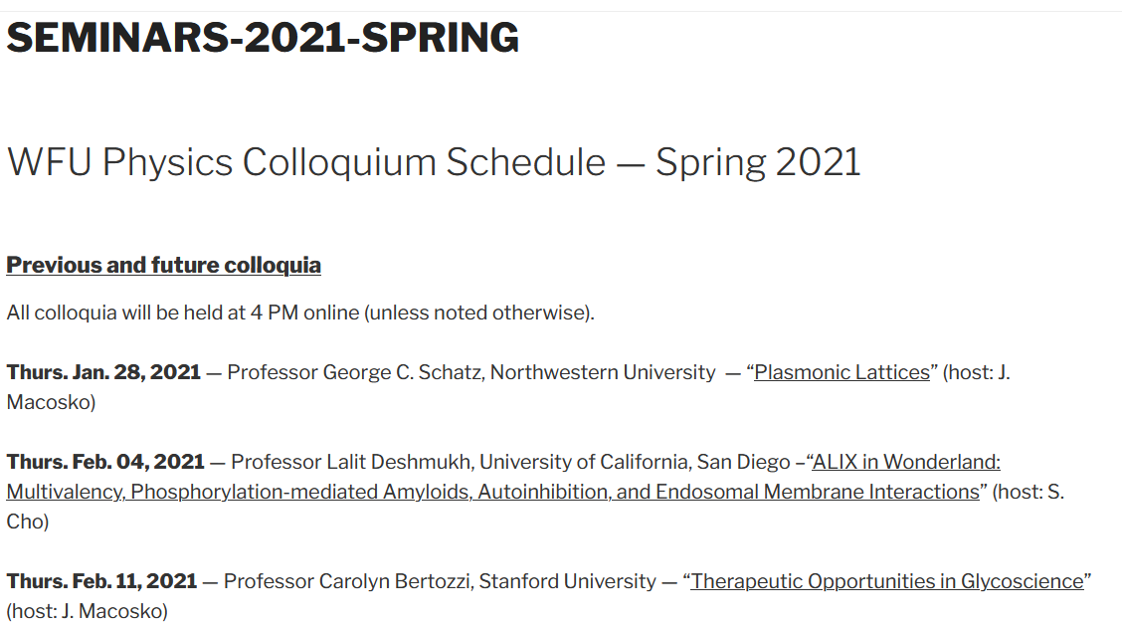
Physics Colloquium series – Thursdays 4-5 PM online
Notes:
First – an advertisement for Physics Colloquia at 4 PM on Thursdays. You should get mailings from Kittyae McBride each week.

Slide 3
http://users.wfu.edu/natalie/s21phy341/
Notes:
Back to our regularly scheduled program. Our webpage is set up and is the source of all information about the course.

Slide 4
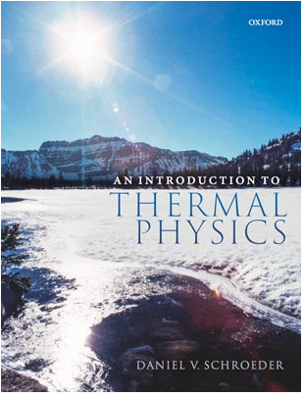
Textbook
author’s web page:
http://physics.weber.edu/thermal/
Notes:
The textbook is An Introduction to Thermal Physics by Daniel V. Schroeder. It has been highly recommended by a number of sources and I encourage you to visit the author’s website.

Slide 5
http://users.wfu.edu/natalie/s21phy341/info
Notes:
Information about the course structure is on our web page. We want to focus class time on discussing your questions. Please prepare at least one question 3 hours before (preferably the night before) each class. We will use your questions as well as spontaneous questions to form the basis of the class discussions. Again, there will typically be one homework per class, nominally due the day of the next class meeting.

Slide 6
Links to WFU pandemic policies – Since this class is online, however, it is possible that some of the one-on-one meetings can be face-to-face.
Wake Forest University's Standard Operating Procedure for Class Sessions Following Public Health Guidance (Policy 2.A.02). This is an updated version of our policies and procedures. Please note the clarification on our masking requirement for classes regardless of location (indoors or outdoors), a revision that makes this policy consistent with our current University masking policy.
Spring 2021 College COVID-19 Classrooms FAQs and Syllabus Statement. As in the fall, the Office of the Dean of the College expects the Spring 2021 COVID-19 Syllabus Statement to be on syllabi for any classes taught in-person (face to face or blended) to communicate clear expectations around masking, physical distancing, and illness from the very first day of class. Our COVID-19 Classroom FAQs includes classroom cleaning protocols; guidance on how to reserve space for out-of-class academic activities like masked and physically distanced office hours, small group workshops, film screenings, and language conversation hours through DeaconSpace; and assistance for anyone teaching in a less familiar space this semester.
Notes:
This content is required by the Dean’s office to help the university keep our physical environment safe. Please visit the links as needed.

Slide 7
➔ Schedule weekly one-on-one meetings (or could meet with small groups if preferred.
Notes:
This is the expected grade distribution. Instead of office hours, I would like to schedule weekly one-on-meetings with each of you and will be happy to meet more frequently as appropriate. If you prefer to form small groups for these meetings that also will be fine. Hopefully we can start those meetings next week.

Slide 8
http://users.wfu.edu/natalie/s21phy341/homework/
Notes:
The class schedule is available on the webpage and will be updated often. Please note the homework assignment due on Friday. Also shown is the anticipated schedule for the mid term take home exam (during the week when I hope to attend the annual meeting of the American Physical Society.

Slide 9
How to turn in your homework?
Students on campus can turn in your homework to my mailbox. (Please clearly mark which class and HW # and your name.)
Otherwise, students can turn in their work as a pdf file from algebraic manipulation software or from photographed or scanned paper. Also please clearly mark which class and HW & and your name.
Note if you want to collaborate on your homework with your (socially distanced) colleagues, that is fine. Active collaboration is encouraged. (Of course, the take home exams must be your own work.)

Slide 10
Comment – for some homework problems, you may wish to use algebraic manipulation software and VPN --
https://software.wfu.edu/audience/students/
Notes:
It is expected that some of your homework will need to use algebraic manipulation software such as Maple or Mathematica which are available at the website mentioned above. In most cases you will also want to get VPN software as well.

Slide 11
Your questions –
Michael --My question regarding the class design is this: On the class website it states that the problem sets for the class are to represent our own best efforts, so does this mean that we as students should not collaborate with other students on these problem sets? Even if we are really stuck on a certain problem/topic are we not supposed to reach out to other students to bounce ideas off each other? If so, what would be the best way to resolve some of the confusion that may arise with certain problem sets?
Chao --Is there any relations between the number of atoms composing the molecules and the molecules' degrees of freedom? How does f=6 for atoms in crystalline solid being derived?
Can we derive a formula for thermal energy of diatomic gas in class?
Rich -- -Is there any theoretical definition or practical use for temperature in a single dimension (ie Tx, Ty, Tz) ? Why is rotation down the length of a diatomic molecules not considered?
Kristen -- After doing the assigned reading I would love to discuss why it is that many of the equations of thermodynamics are correct only when measured on the kelvin scale. Additionally, in the text specifically with Equation 1.17, the term translational kinetic energy is used, I was hoping you could clarify how this is different from simple kinetic energy.

Slide 12
Parker --And as the book states instead of PV=NRT, do you recommend we remember the conversion factor nR=Nk? What is the reason for this?
Annelise --how come in the average pressure equation we only take into consideration the velocity in the x direction? I see that in the next theorem about kinetic energy we can conclude that the y, z, and x equations are all equal- is this true for the pressure equation as well?
Leon --My question for tomorrow's lecture material focus on degrees of freedom. I still have a blurred definition of it. I first thought it's like coordinates and then find it wrong. So is it defined like all possible forms of energy a molecule could have? And how to know the exact number of df for different molecules.
Noah -- One of the footnotes says that a decrease in the temperature by a factor of e is a more precise definition. Why is this?
2. I am curious to learn more about how some vibrational degrees of freedom do not contribute to temperature, and what types of modes these would be.

Slide 13
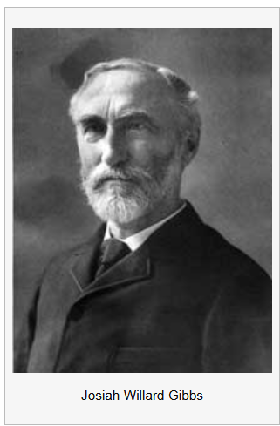
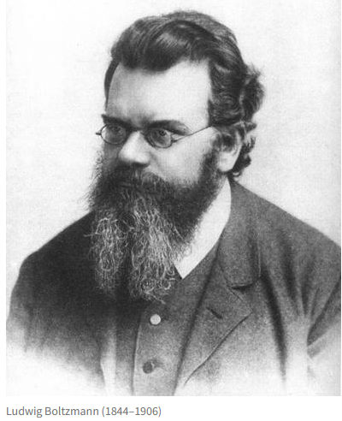
Giants of thermodynamics and statistical mechanics
Ludwig Boltzmann
1844-1906
Josiah Willard Gibbs
1839-1903

Slide 14
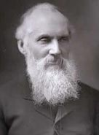
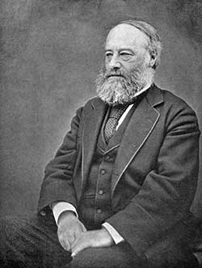
Giants of thermodynamics and statistical mechanics -- continued
Sir William Thomson
(Lord Kelvin) 1824-1907
James Prescott Joule
1818-1889
Note – it is not necessary to have a beard to study thermal physics.

Slide 15
What are we studying?
Thermodynamics is generally the study of heat and other forms of energy (work, mechanical, electrical, chemical, nuclear, etc.) typically measured in a macroscopic sample.
Statistical mechanics is the study of samples at the atomic level, attempting to reconcile the energetics at the atomic and macroscopic scales.

Slide 16
Useful concepts and quantities of thermodynamics
Equilibrium – in fact, we will be mostly be studying equilibrium thermodynamics. It perhaps would be more honest to call our study thermostatics. Dynamic processes, such as those involving flow and time dependent processes, involve additional considerations.
Temperature – T ≥ 0 in Kelvin scale
Volume – V in units of m³
Pressure – P in units of Pascals (Newtons/m²) (Note that 1 atmosphere = 101325 Pascals (as defined))
Mass – M in units of kg
Number of particles -- N
Energy – E or U in units of Joules

Slide 17
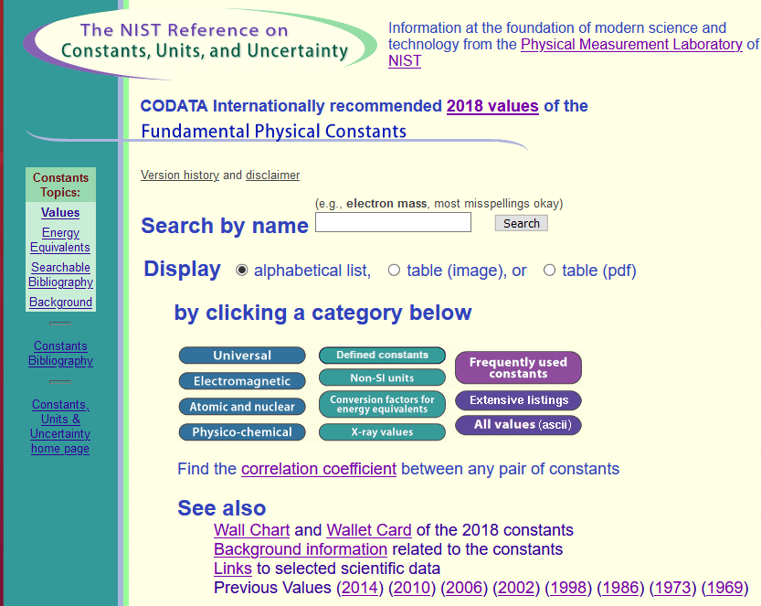
Reliable source for physical constants and unit conversions
https://physics.nist.gov/cuu/Constants/index.html

Slide 18
Note that, for a given system, the variables, P,V,N,T,E… are not independent. For a given materials, the specific relationship is often called the equation of state. For most materials this “equation of state” is very complicated. For most of this course we will use as a convenient and often useful materials system – the ideal gas. An ideal gas is a simplification of the behavior real gases (such as air) at low density described by the famous equation of state:

Slide 19
Where did the ideal gas equation of state come from?
It follows from first principles
It comes from observation
I never learned about this

Slide 20
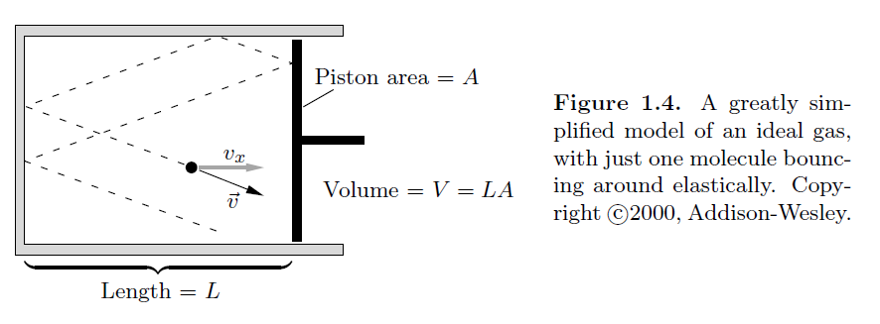
Microscopic analysis of ideal gas equation of state.
Figure from your textbook:
Collision of atom with piston exerts pressure

Slide 22
Does this make sense?
Yes
No
OK – but needs some refinement
Note that v denotes the magnitude of the translational velocity.

