Slide 1
PHY 341/641 Thermodynamics and Statistical Mechanics
MWF: Online at 12 PM & FTF at 2 PM
Discussion for Lecture 10:
Entropy and microstate multiplicity
Reading: Chapters 3.3-3.4
Entropy and pressure for ideal gas example
Entropy for a spin ½ system
Record!!!

Slide 2
Colloquium tomorrow --

Slide 3
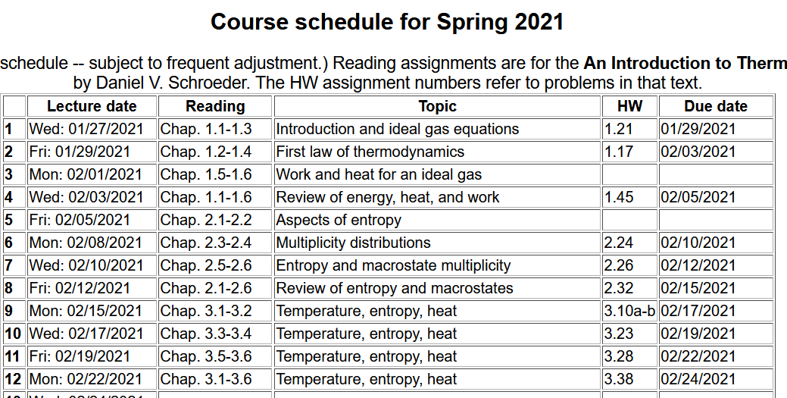

Slide 4
Your questions –
From Parker --should we think of the Thermodynamic identity
dU=T dS - P dV as a consequence of the laws of thermodynamics? Also does it apply to both the macroscopic and microscopic views, or just the macroscopic view?
From Kristen -- 1. How can a temperature be infinite, as in the paramagnet example when U=0? 2. How can we apply the idea of paramagnets to the real world? I am having trouble visualizing 3. Could you define quasistatic and isentrophic in more detail? 4. In the last part of section 3.4, it talks about how since the thermodynamic identity applies there is a positive change in the entropy. Why is that?
From Annelise --Does the Cv of something change based on the mass of whatever you are calculating? I am assuming that it does and that is what J/(K*Kg) means, but I just want to make sure. My discussion question for today is: why is the entropy highest when the U=0? I am confused when the book said that the temperature is infinite (meaning the system will gladly give up energy to any other system whose temperature is finite).
From Rich -- How do you derive the equations for change in entropy for a constant pressure process from the thermodynamic identity equation?

Slide 5
Your questions – continued
From Chao -- how does the formula 3.30 derived from the result of 3.29 and 3.28?
From Michael -- Can you give us an example of a real-world isentropic process that is both adiabatic and quasistatic?

Slide 6
Recall for the mono atomic ideal gas:

Slide 7
What if we consider the volume derivative of the entropy for a mono atomic ideal gaw?

Slide 8
What all of this tell us?
While we have derived these results for a mono atomic ideal gas, perhaps we can assume that the functional dependences are more general.
Looks a lot like the first law of thermodynamics.

Slide 10
Maxwell’s relations

Slide 11
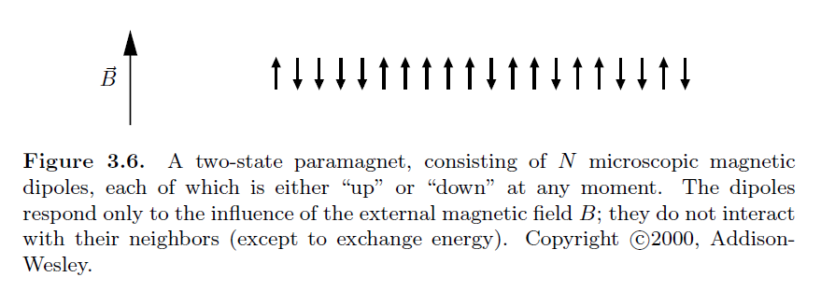
Consider a system of spin ½ particles in a magnetic field B
Note that in this model, the spins only interact with the magnetic field B and do not interact with each other.
Which of these real systems in a constant magnetic field is better represented by this model?
Ferromagnetic iron
Water

Slide 12
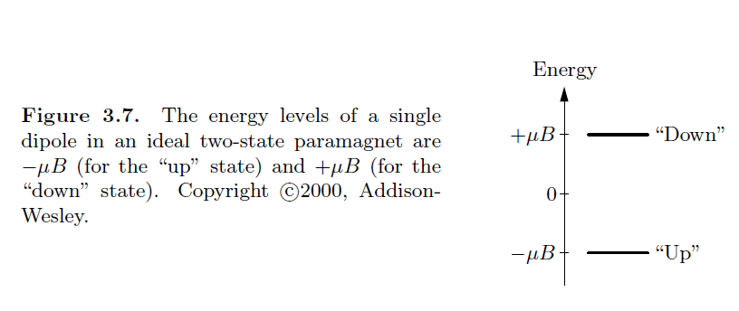

Slide 13
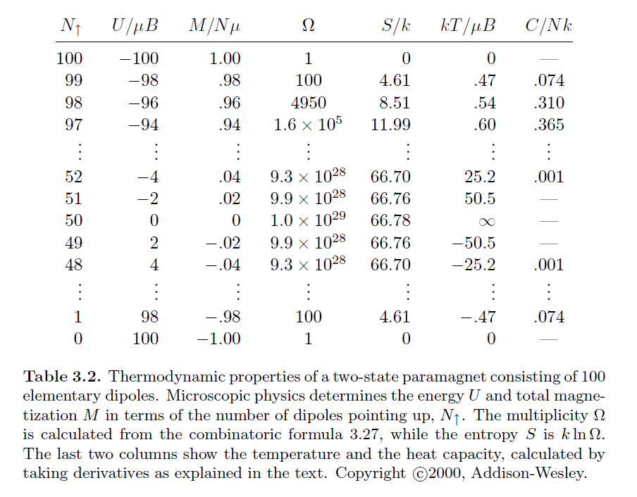
Example for N=100

Slide 14
Note that there is something fishy about the sign; μ can + or – depending on whether the particle is a proton or electron

Slide 16
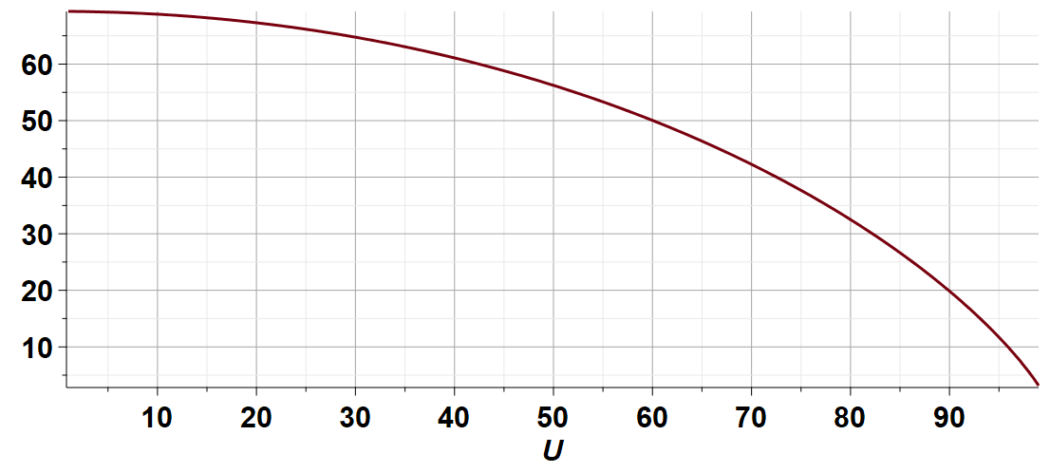
Plot of entropy vs U in scaled units for N=100

Slide 17
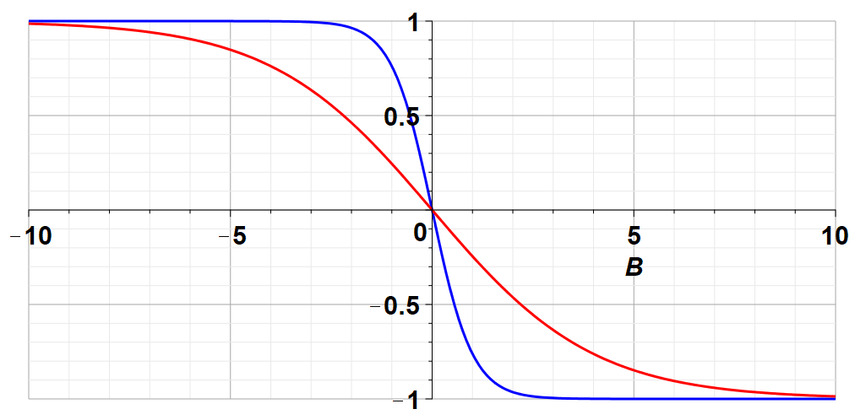
Plot of (U/B) vs B at fixed T
Low T
High T
U/B

Slide 18
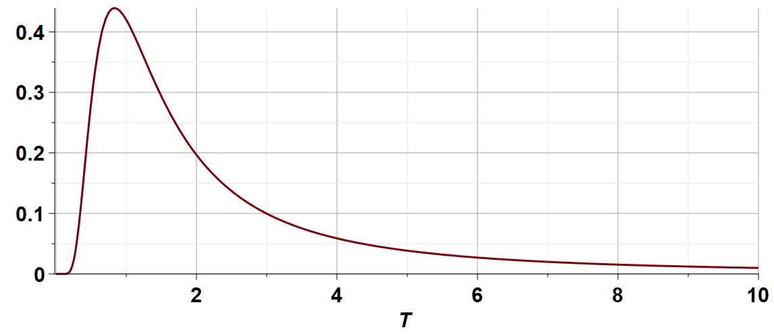
Heat capacity of system at constant field --

