Slide 1
PHY 341/641 Thermodynamics and Statistical Mechanics
MWF: Online at 12 PM & FTF at 2 PM
Discussion for Lecture 11:
Variations in the number of particles
Begin discussion of heat engines
Reading: Chapters 3.5-3.6; 4.1
Dependence of thermodynamic functions on the number of particle
Notions of chemical potential
Cyclic thermodynamic processes; engines
Record!!!

Slide 2
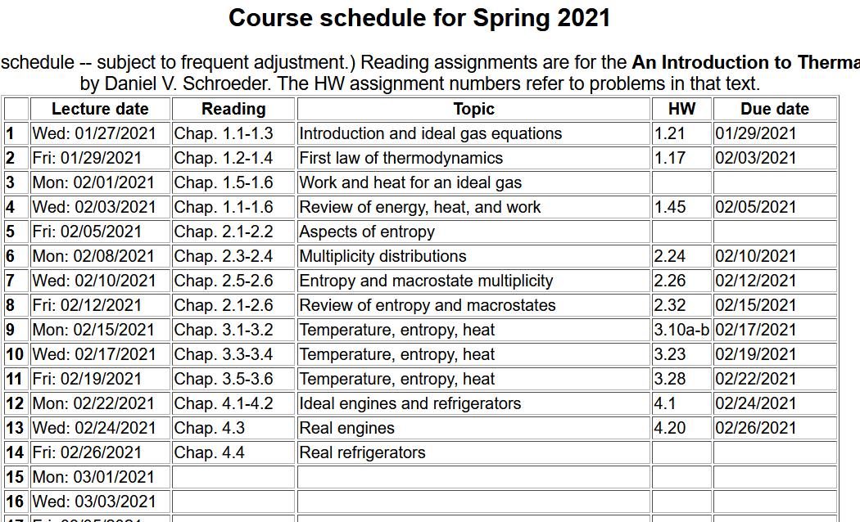

Slide 3
Your questions –
From Parker -- what physically is chemical potential, like what does it mean and physically correspond to?
From Kristen -- 1. Could you explain why the total entropy is a maximum at equilibrium? I find this counterintuitive. 2. How can we just add another term into the entropy equation as in formula 3.57? 3. What does diffusive equilibrium actually mean?
From Rich -- Could we discussion equation 3.60 more in class? Since entropy is not in the equation, how could the energy increase from adding the molecules without entropy increasing?
From Chao -- In the real Industry, is this formula still working. Do we need to consider other factors in the industrial production?
From Annelise -- What is diffusive equilibrium? I am a little confused about what is being exchanged and what is being held fixed?
From Zezhong -- I wonder if there is a definition by word description on chemical potential instead of mathematical formula?

Slide 4
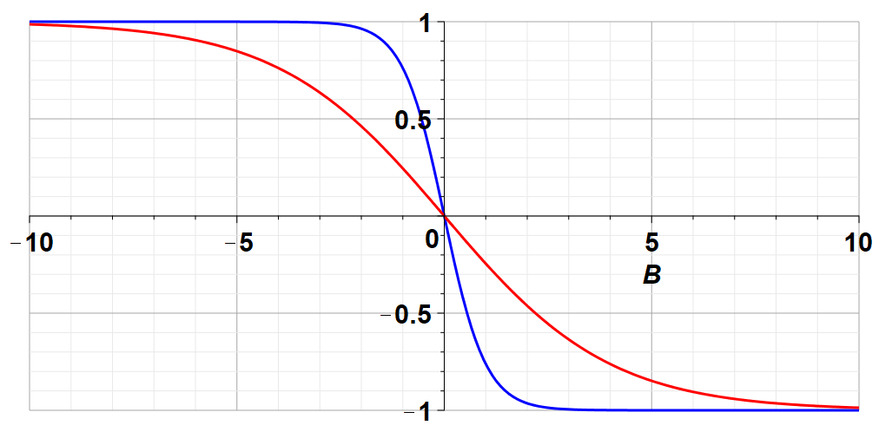
Correction from Wednesday’s lecture --
Plot of (U/B) vs B at fixed T
Low T
High T
U/B

Slide 5
Variables of thermodynamics
Temperature – T ≥ 0 in Kelvin scale
Volume – V in units of m³
Pressure – P in units of Pascals (Newtons/m²)
Entropy – S in units of Joules/K
Mass – M in units of kg
Number of particles – N
Chemical potential – μ in units of Joules

Slide 6
Recall for the mono atomic ideal gas:

Slide 7
What happens when the number of particles N changes?
μ was introduced by Gibbs as the “chemical potential”

Slide 9
Summary --

Slide 10
Expressing result in term of the internal energy
Generalization of first law of thermo
heat
mechanical work
chemical work
Are these equations consistent with each other?
Are they useful?

Slide 11
Note that we will see other relationships with μ that may be more convenient or physical, namely perhaps at constant T and P.

Slide 12
How might this be useful?
In practice G (Gibbs free energy) is often more useful than U (internal energy) for analyzing this situation.

Slide 13
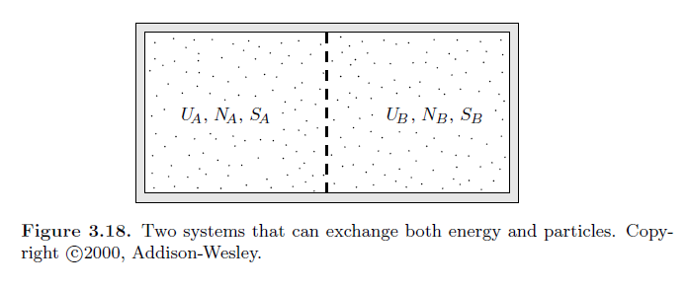
Comment – One practical consideration of allowing N to vary, is that we need to relax our focus on “isolated” systems, and to think about particles diffusing --

Slide 14
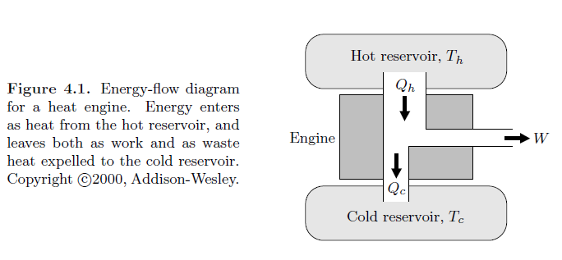
Introduction to the thermo(statics) of heat engines
In the engine, the desirable output is the net work while the necessary input is the heat input
Note that the net work of interest is the work done by the system.

Slide 15
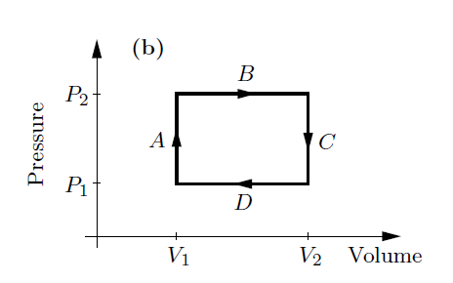
Net work done in a cyclic process
Consider the following 4 step cycle
A ➔ no work
B ➔ negative work
C ➔ no work
D ➔ positive work
net work

Slide 16
Carnot invented a very efficient ideal cycle which Clausius further analyzed as “entropy” S which is related to heat
according to
T
V₂
B
V₃
T₂
A
C
T₁
V₁
V₄
D
S
S₁
S₂

Slide 17
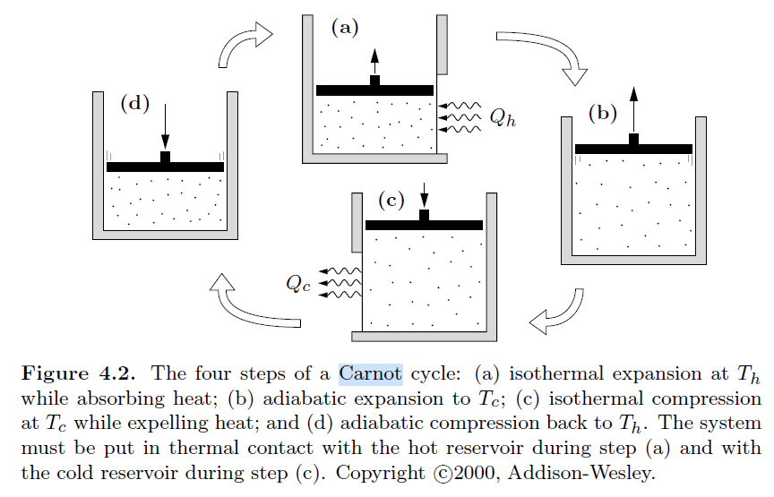

Slide 18
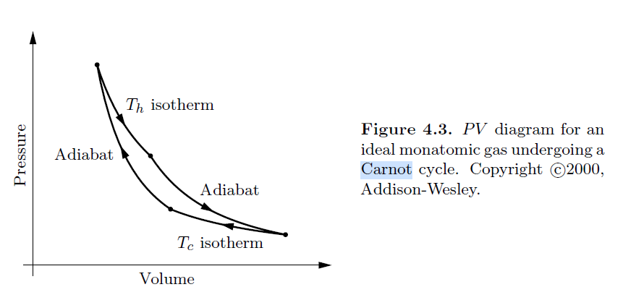
Some details from Lecture 5 --

Slide 19
Carnot invented a very efficient ideal cycle which Clausius further analyzed as “entropy” S which is related to heat
according to
T
V₂
B
V₃
T₂
A
C
T₁
V₁
V₄
D
S
S₁
S₂

Slide 21
Summary of results
T
V₂
B
V₃
T₂
A
C
T₁
V₁
V₄
D
S
S₁
S₂

Slide 22
Q_{B}
Q_{D}

