Slide 1
PHY 341/641 Thermodynamics and Statistical Mechanics
MWF: Online at 12 PM & FTF at 2 PM
Discussion for Lecture 12:
Variations in the number of particles
Begin discussion of heat engines
Reading: Chapters 4.1-4.2
Details of Carnot cycle (using consistent PV and ST diagrams)
Efficiency of engines
Efficiency of refrigerators and heat pumps
Record!!!

Slide 2
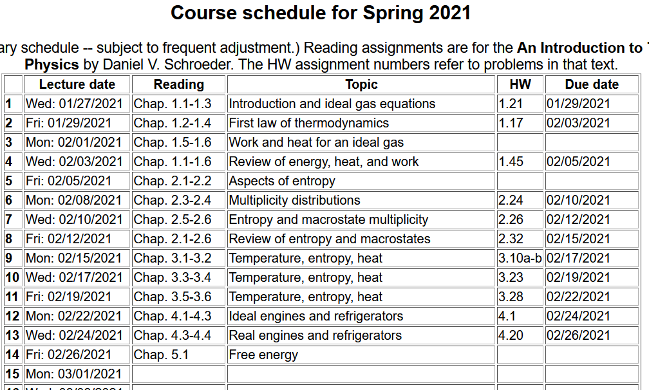

Slide 3
Your questions –
From Parker -- My question for this reading is.what is what does the compression ratio gamma mean, it comes into play for an adiabatic exponent? What does it physically correspond to? Comment – gamma=C_p/C_v. Compression ratio is something else.
From Michael -- Why do more cars not have diesel engines if they are more efficient than combustible engines?
From Kristen -- 1. Could you explain why exactly the Carnot cycle is the most efficient? Because with the formula 1-Tc/Th for efficiency, would it mean that Tc was almost zero? 2. Why is it that refrigerators can be much more "efficient" than engines?
3. How come in the Internal Combustion Engine you can simply get rid of the cold reservoir?

Slide 4
Your questions – continued
From Annelise -- why are the engines we have so inefficient? Is it because no one has figured out how to make the engines run more efficiently, or are they the way they are because of the laws of thermodynamics?
From Rich -- Is the Carnot cycle efficiency ever truly attainable since the temperature differences must be so marginally small and unchanging, or is this efficiency only true at a limit?
From Chao -- For the Otto circle, why does it happen that in the ignition process, the pressure increase dramatically, while the Volume stays constant?

Slide 5
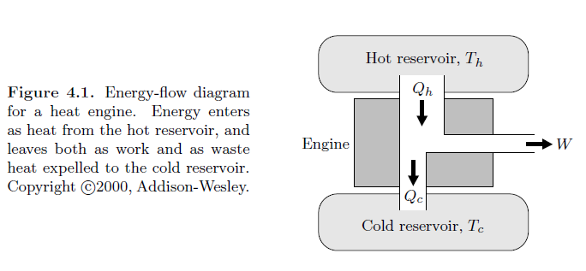
Introduction to the thermo(statics) of heat engines
In the engine, the desirable output is the net work while the necessary input is the heat input
Note that the net work of interest is the work done by the system.

Slide 6
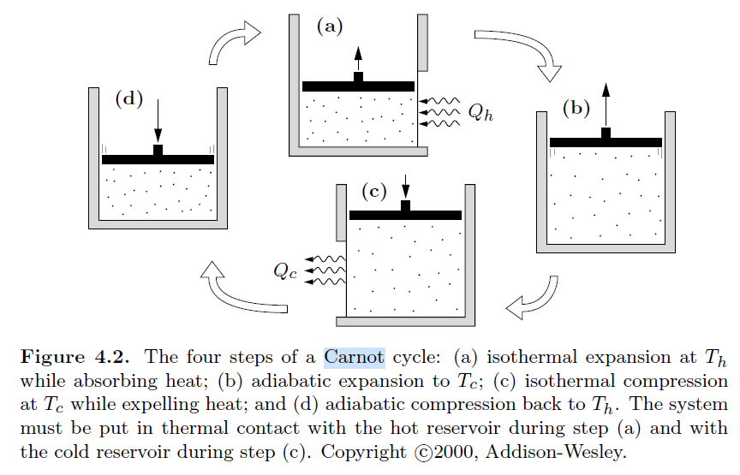
Note that in previous lectures, the ST diagrams used different numberings and notations. In this lecture we will label all steps consistently.

Slide 7
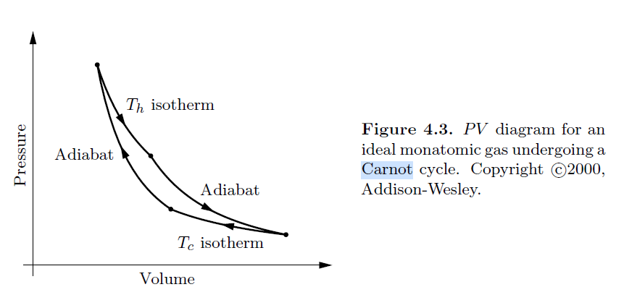
PV diagram from your textbook
a
b
γ is an empirically measured quantity related to degrees of freedom of ideal gas
d
c

Slide 8
T versus S diagram
P versus V diagram
a
T_{H}
b
a
Temperature
b
d
d
c
c
T_{C}
Entropy

Slide 9
T versus S diagram
P versus V diagram
a
a
T_{H}
b
Temperature
b
d
d
c
c
T_{C}
Entropy

Slide 10
a
Q_{ab}
b
d
c
Q_{cd}

Slide 11
Comment: Here we have assumed that there are no energy losses and that all of the processes are reversible.

Slide 12
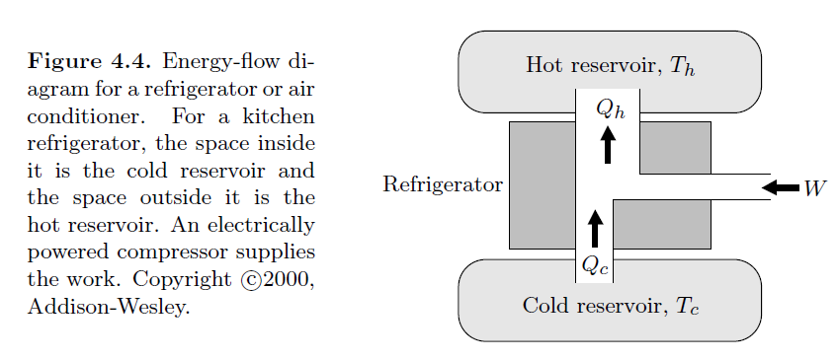
Using the Carnot cycle for heating and cooling

Slide 13
Example COP for refrigerator having T_{H}=300K and T_{C}=280K -- COP=14
Question: For this refrigerator, suppose that Q_{cd} is
300 Watt s. What power is needed for an ideal compressor to achieve heat removal at a rate of 300 Watts

Slide 14
Example based on problem 4.14
A heat pump is an electrical device that heats a building by pumping heat to from the cold outside. In other words, it’s the same as a refrigerator, but its purpose is to warm the hot reservoir rather than to cool the cold reservoir (although it does both). Define the following symbols:
T_{H} – temperature inside building
T_{C} – temperature outside building
Q_{H} – heat pumped into the building per day
Q_{C} – heat pumped out of the building per day
W – energy needed for mechanical pump per day
In practice, the performance is less than this….

Slide 15
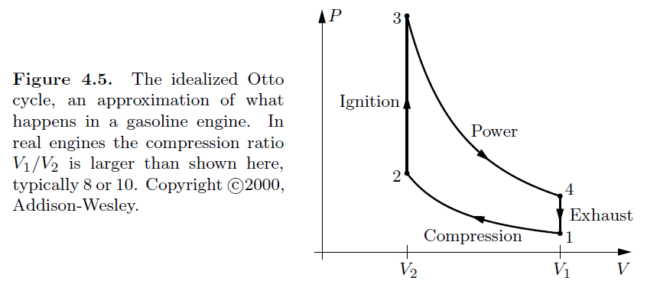
Another thermodynamic cycle example
Q₃₄=0
Q₁₂=0

Slide 16
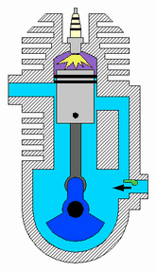
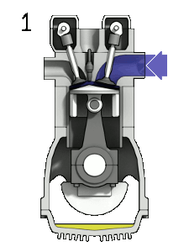
Animations of the Otto cycle from web page
https://energyeducation.ca/encyclopedia/Otto_cycle

Slide 17
Idealized Otto cycle
Q₃₄=0
Q₁₂=0

Slide 18
Idealized Otto cycle
Q₃₄=0
Q₁₂=0

