Slide 1
PHY 341/641 Thermodynamics and Statistical Mechanics
MWF: Online at 12 PM & FTF at 2 PM
Discussion for Lecture 13:
Practical thermodynamic cycles
Engines, refrigerators, etc.
Reading: Chapters 4.3-4.4
Otto and Diesel cycles
Rankine cycle
Other processes
Record!!!

Slide 2
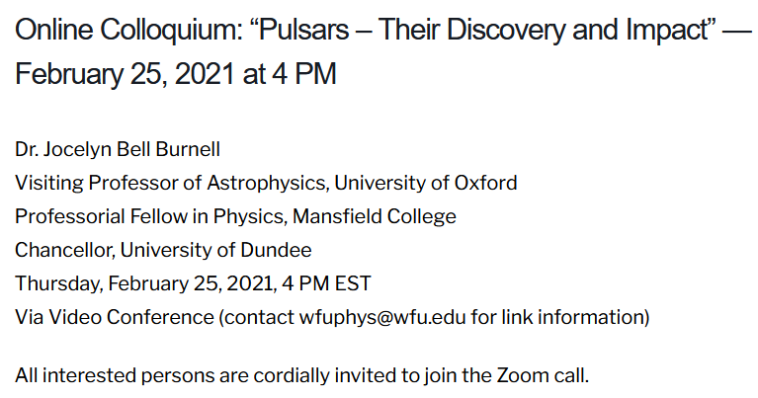
Thursday’s Physics Colloquium --

Slide 3
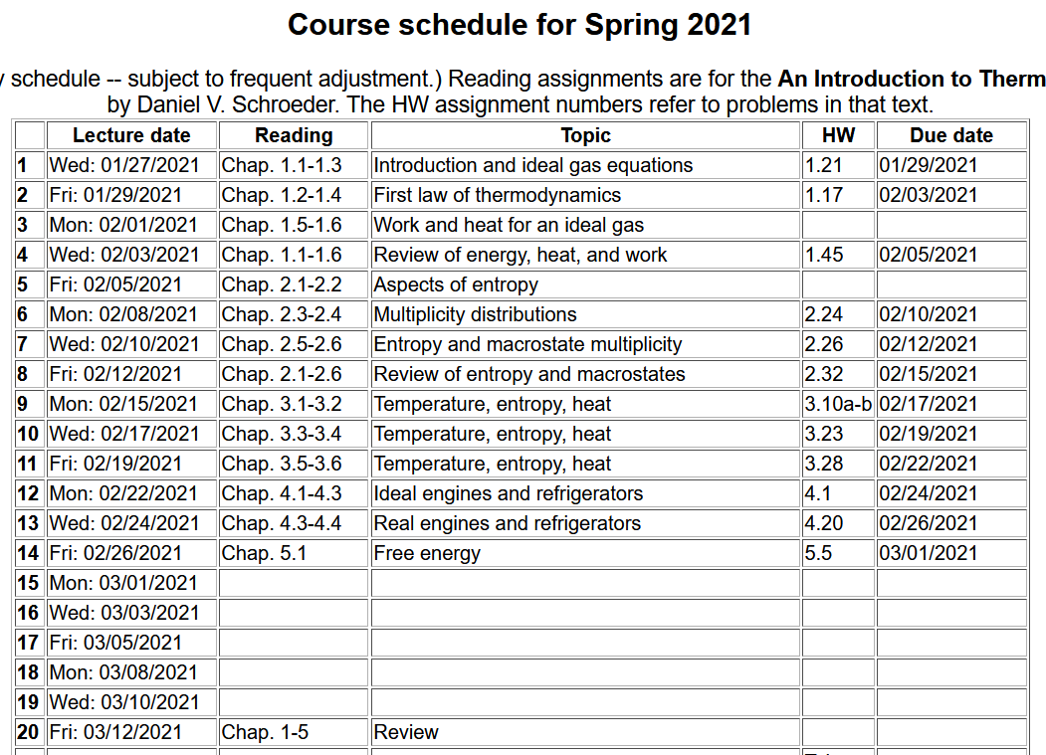

Slide 4
Your questions –
From Kristen -- 1. For the refrigerator discussed in the beginning of 4.4, (Figure 4.9), how can something be compressed without changing its volume? 2. With laser cooling, how does hitting the atoms cause them to slow down?
From Parker -- Why is the force between any two molecules weakly attractive at long distances and strongly repulsive at short distances, and usually the attraction dominates making U potential energy negative?
From Michael -- Can you further explain how a throttling valve operates in order to make the incoming gas cold enough to liquefy? I can't conceptually understand this concept currently.
From Rich -- In a heat exchanger, does the throttled gas heat the liquid in the evaporator? Where is the excess heat sent? In laser cooling, why wouldn't the effects/forces of all lasers cancel out?

Slide 5
Questions continued –
From Chao -- Why when temperature reaches absolute zero, the entropy will become Zero? If we look at the formula of microstate, Omega, it seems like there is a factor of 5/2 out there.
From Zezhong -- Is there any difference on heat cycle between the real refrigerator and helium dilution refrigerator although their structures are quite different.
Comment – from Sackur-Tetrode equation
Probably need to consider details of derivation in the limit that T →0. Is the ideal gas law still true?

Slide 6
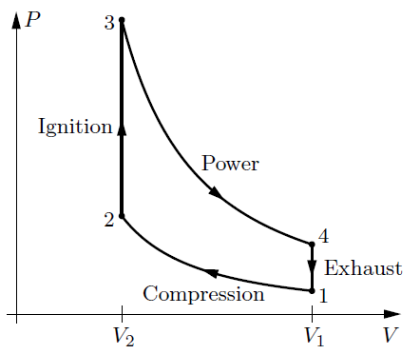
Idealized Otto cycle
Q₃₄=0
Q₁₂=0

Slide 7
Idealized Otto cycle
Q₃₄=0
Q₁₂=0

Slide 8
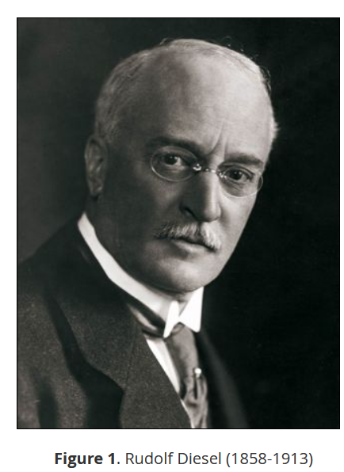
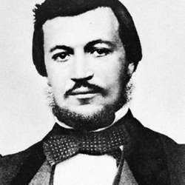
Nikolaus Otto
1832-1891
https://www.britannica.com/biography/Nikolaus-Otto
https://dieselnet.com/tech/diesel_history.php#diesel

Slide 9
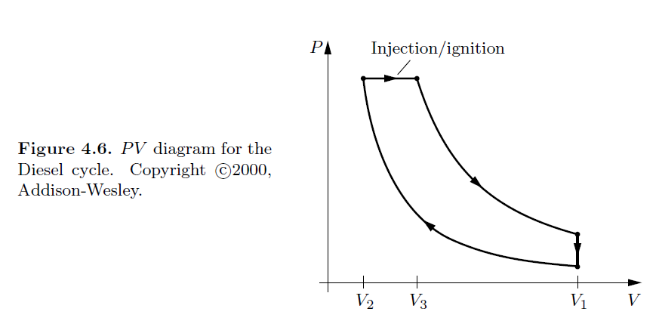
Idealized Diesel cycle
a
b
Power stroke
c
Compression
stroke
d

Slide 10
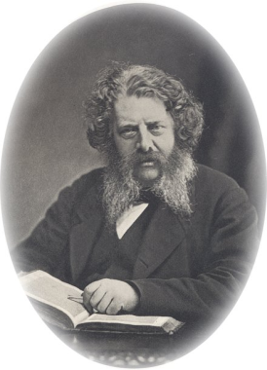
Example of a cycle NOT using an ideal gas – the Rankine cycle
Developed the steam
turbine cycle
William John Macquorn Rankine (1820-1872)

Slide 11
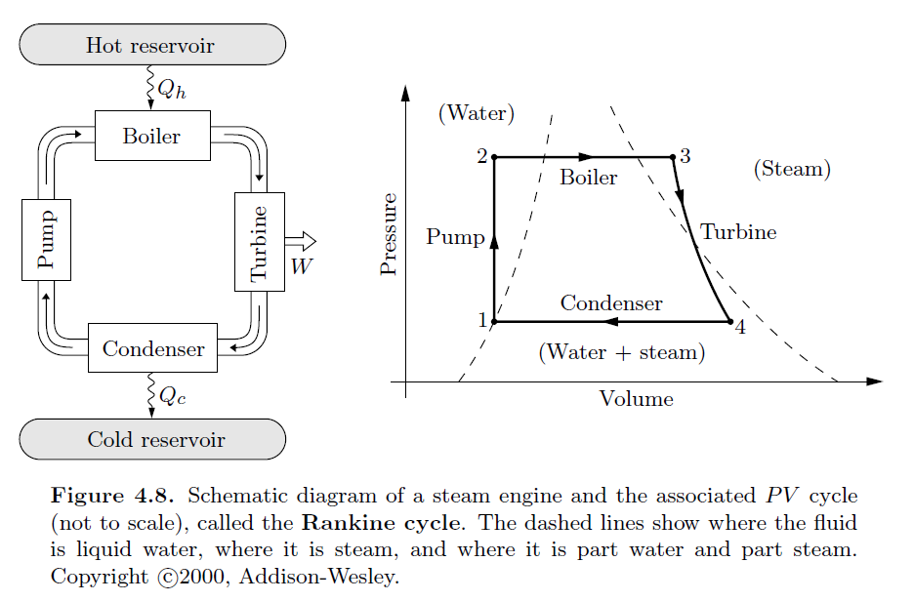

Slide 12
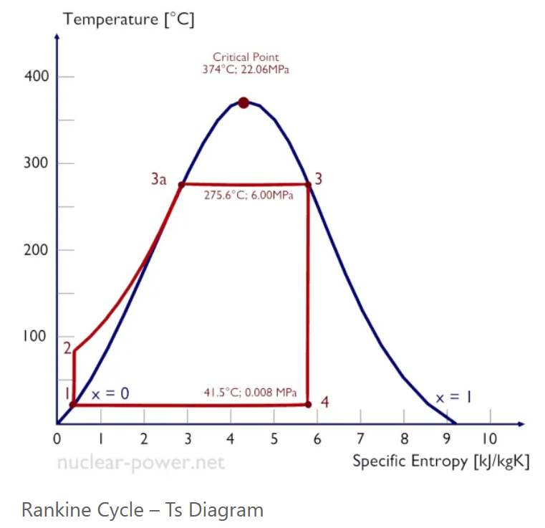
Other representations of the Rankine cycle –
https://www.nuclear-power.net/nuclear-engineering/thermodynamics/thermodynamic-cycles/rankine-cycle-steam-turbine-cycle/
1→2 adiabatic compression of condensed water to high P
2→3a water is heated to boiling
3a→3 water is vaporized at constant T and high P
3→4 adiabatic expansion of steam
4→1 steam is condensed and cooled at constant T

Slide 13
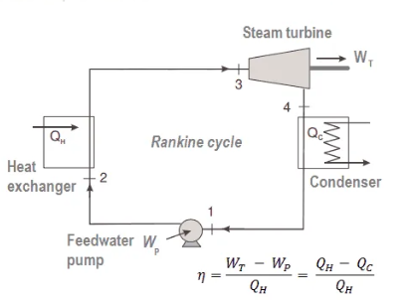
1→2 adiabatic compression of condensed water to high P
2→3a water is heated to boiling
3a→3 water is vaporized at constant T and high P
3→4 adiabatic expansion of steam
4→1 steam is condensed and cooled at constant T

Slide 14
Some details from your textbook --

Slide 15
Efficiency of Rankine cycle

Slide 16
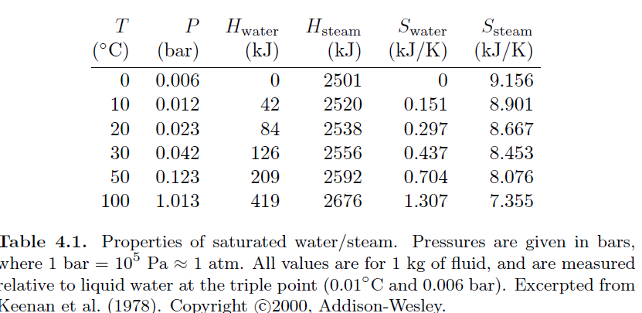
Conditions in textbook:
T= 20ºC, P=0.023 bar 3. T=600º C P=300 bar
4. S=6.233 kJ/K
Some numerical values from your textbook –
H₁

Slide 17
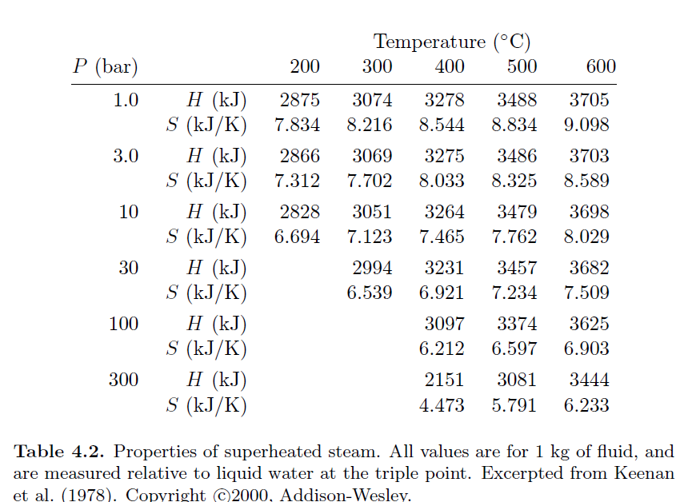
H₃
S₃

Slide 18
(using values from the tables)

Slide 19
Thermodynamics for cooling
However, in order to cool even further, phase change processes are needed. While water works well in a steam engine, the temperatures involved are not appropriate for refrigeration.

Slide 20
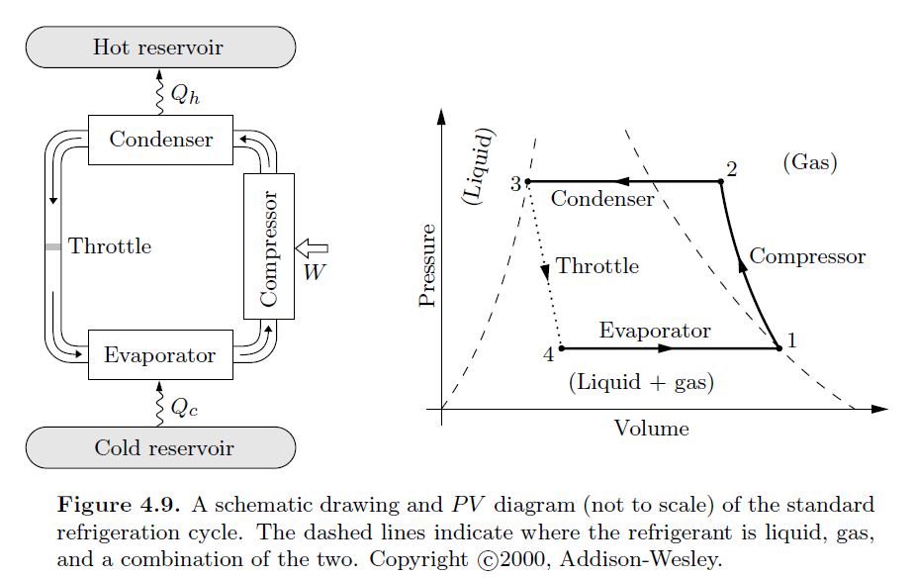
Refrigeration process based on Freon

Slide 21
1 – gas compressed adiabatically to higher T and P, smaller V
2 – gas liquifies and heat removed
3 – pressure reduced on liquid forming liquid and gas -- “throttle”
4 – gasification at constant pressure

Slide 22
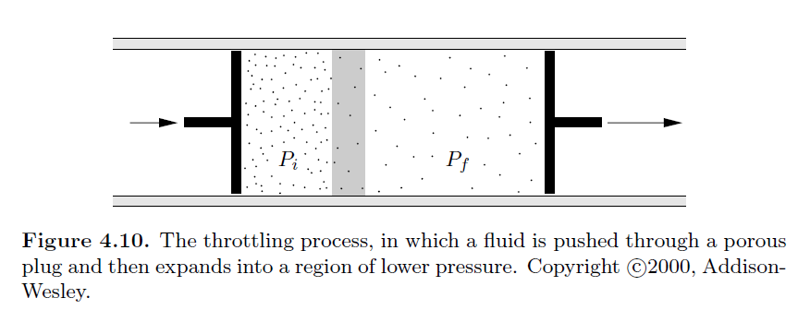
Details of throttle process for ideal gas
Porous plug

Slide 23
Because of its convenient melting point (-158ºC) and boiling point (-30ºC) Freon has been used throughout the 20th century as the refrigerant of choice. However, since 2010 has been gradually replaced because of it’s contribution to ozone deletion in the atmosphere.

Slide 24
Extreme refrigeration due to quantum mechanics
Helium dilution refrigeration <0.001K the two isotopes of He – ³He and ⁴He have very different behaviors near T ~ 0 having Fermi and Bose statics, respectively. Dissolving small amounts of ³He into ⁴He absorbs heat. The cycle involves steps separating and then mixing ³He and ⁴He. https://nationalmaglab.org/about/around-the-lab/what-the/dilfridge
Lasers can be used to generate strong electromagnetic fields that can control the motions of atoms a low temperature resulting in laser cooling. The process involves quantum mechanical absorption and emission of light. http://info.phys.unm.edu/~ideutsch/Classes/Phys500S09/Downloads/newoptics.pdf

