Slide 1
PHY 341/641 Thermodynamics and Statistical Mechanics
MWF: Online at 12 PM & FTF at 2 PM
Discussion for Lecture 14:
Useful thermodynamic energy functions
    Reading: Chapters 5.1
      Internal energy U
      Enthalpy H
      Helmholtz free energy F
      Gibbs free energy G
Record!!!

Slide 2
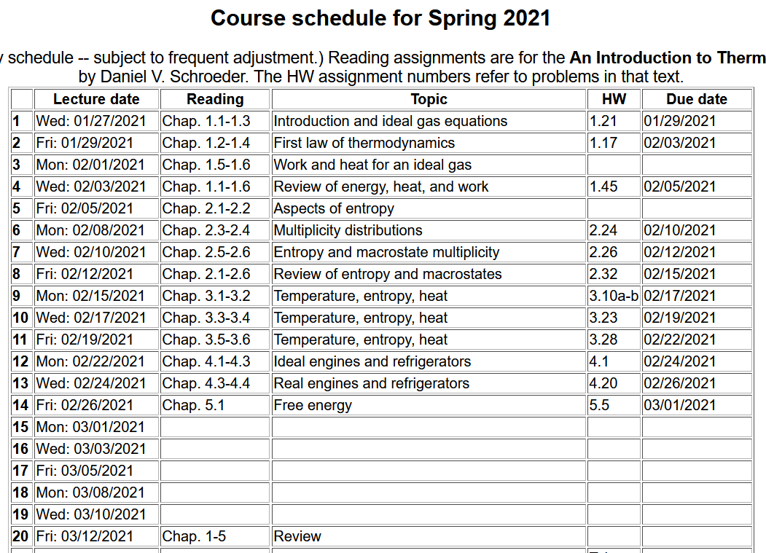

Slide 3
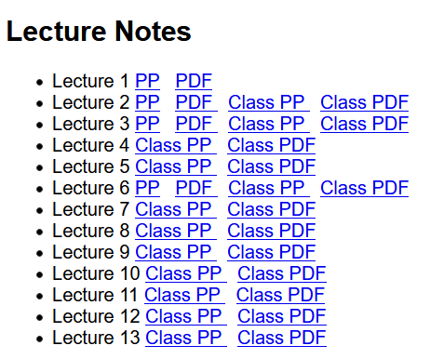
Reminder – lecture notes are available on the class webpage
http://users.wfu.edu/natalie/s21phy341/lecturenote/

Slide 4
Your questions –
From Kristen – 1. For the heat that is free from the environment, as in Helmholtz free energy, if there is indefinite heat, will it absorb all of the energy it needs from this or will we still have to input some work? 2. Could we review a bit about the reaction for the battery as discussed on page 154, I just need a bit of clarification.
From Parker -- We will invoke the Legendre transformation mathematically for changes in V to P and TS from S to T in this class?
From Michael -- Can you further explain why fuel cell engines are not more abundant in production given their high efficiency?
From Rich – In the Gibbs Free energy equation, how can the change in entropy be negative without violating the second law of thermodynamics?
From Noah -- Can you explain more why a problem would or would not care about the +PV term? E.g. why does the example of electrolysis use Gibbs free energy instead of Helmholtz?

Slide 5
Internal energy U

Slide 6
Maxwell’s relations

Slide 7
Generalizing U to allow for variable N --

Slide 8
Summary of results for internal energy and entropy --

Slide 9
What can we do to rationalize these interdependencies?
General notions of mathematical transformations for continuous functions of several variables and Legendre transforms --
Consider:

Slide 10
Desired thermodynamic functions --

Slide 11
Summary of thermodynamic functions
Various first derivative relationships

Slide 12
Which energy to use?
  ➔Choose the one that most easily describes the circumstances of the system
  ➔At constant T and P, the Gibbs free energy is often a good choice

Slide 13
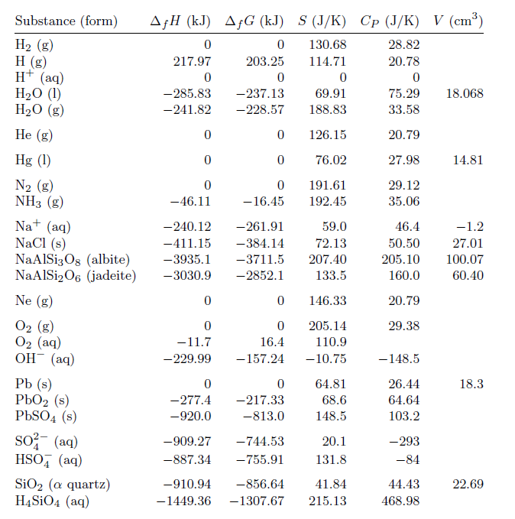
Table of energies from your textbook
for T=298 K and
P=1 bar

Slide 14
237.13 kJ/mole

Slide 15
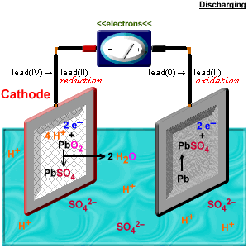
Electrochemical reactions

