Slide 1
PHY 341/641 Thermodynamics and Statistical Mechanics
MWF: Online at 12 PM & FTF at 2 PM
Discussion for Lecture 15:
Properties of the Gibbs free energy
Reading: Chapters 5.1-5.2
Intensive and extensive variables
General properties of Helmholtz and Gibbs free energies
Ideal gas relationships
Gibbs free energy G
Record!!!

Slide 2
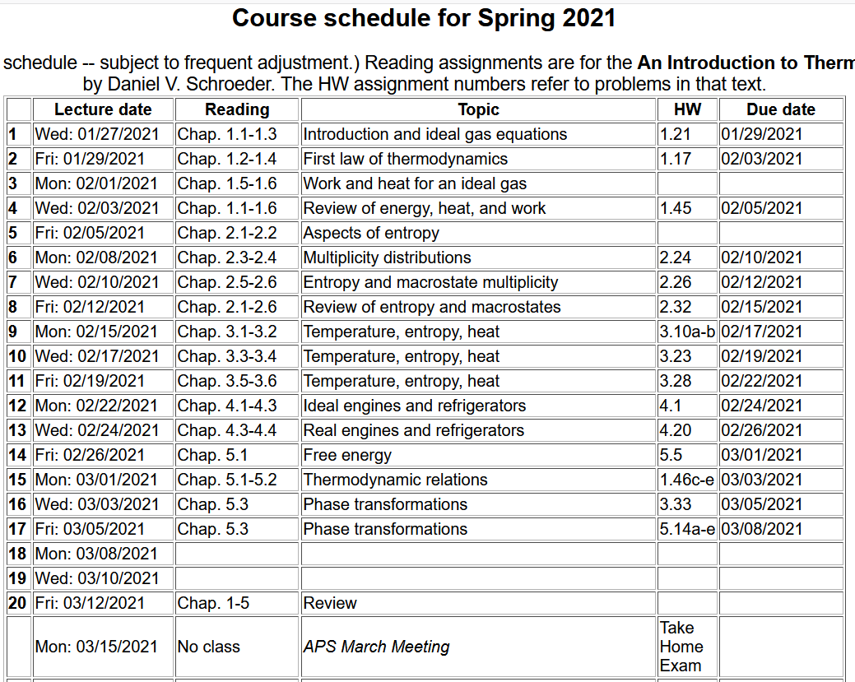

Slide 3
Comment – the homework assignments include problems from earlier chapters that we are now in a better position to understand. They involve evaluating material properties. For most materials, these must be determined experimentally for each different material. In some cases, we can evaluate them analytically assuming the ideal gas law.

Slide 4
Your questions –
From Parker – What is the advantage of using the Helmholtz versus the Gibbs free energy, when is one more appropriate than the other?
From Chao -- While expressing Gibbs free energy this time, why are we doing the summation of the chemical potentials, instead of just a single mu times dN?
From Kristen – 1. In the book it says that the entropy of the environment can increase if it acquires volume from the system, what does this mean exactly? 2. Could you explain how we get equation 5.35?
From Michael -- Could you elaborate a little more about what the book means when it says "it was crucial that the two variables being held fixed in eq 5.34, T and P, were both intensive so that all extensive quantities could grow in proportion to N"?
From Rich -- In the equation for dStotal, is T the system or environmental temperature?

Slide 5
Thermodynamic quantities
Among the many thermodynamic functions and variables that we have encountered, it is useful to distinguish two types in terms of how they scale with size –
Intensive – independent of system size
Extensive – proportional to system size
Examples –
Temperature T – Intensive or Extensive?
Volume V – Intensive or Extensive?
Pressure P – Intensive or Extensive?
Entropy S – Intensive or Extensive?

Slide 6
Examples of intensive variables
Temperature T
Pressure P
Chemical potential μ
Number density N/V
Examples of extensive variables
Number of particles N
Volume V
Entropy S
Internal energy U
Enthalpy H
Helmholtz free energy F
Gibbs free energy G

Slide 7
Summary of thermodynamic energies
Note that, in order to maintain constant T, P, etc. we need to introduce the notion of interaction of our system with a “reservoir”. For the moment, we will assume that the effects of the reservoir are negligible and that all processes in our “system” are performed under quasi-static conditions. More generally, corrections from reservoir effects lead to the inequalities mentioned in our textbook.

Slide 8
Summary of thermodynamic functions
Various first derivative relationships

Slide 9
Properties of the Helmholtz free energy

Slide 10
Properties of the Gibbs free energy

Slide 11
Helmholtz free energy for monoatomic ideal gas
[We have only worked out the entropy for this case.]

Slide 12
Gibbs free energy for monoatomic ideal gas
[We have only worked out the entropy for this case.]

Slide 13
Summary of results for chemical potential of ideal gas --
Are these equivalent?
a. Yes?
b. No?

Slide 14
One further comment about chemical potential using ideal gas example

Slide 15
Note that for most materials, the equation of state and equations describing thermodynamic energies are much more complicated than that of the ideal gas. We rely on experimental measurements to find values of the parameters to analyze the systems. Some useful parameters are as follows.

Slide 16
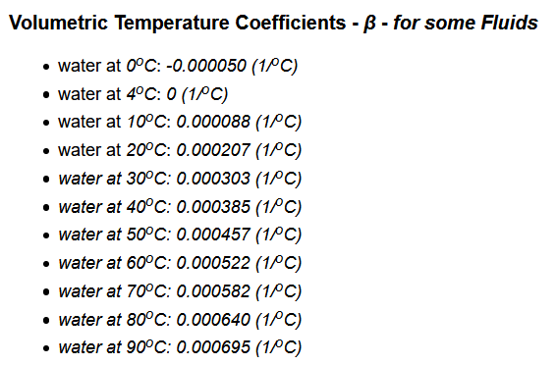
Example --
https://www.engineeringtoolbox.com/volumetric-temperature-expansion-d_315.html

Slide 19
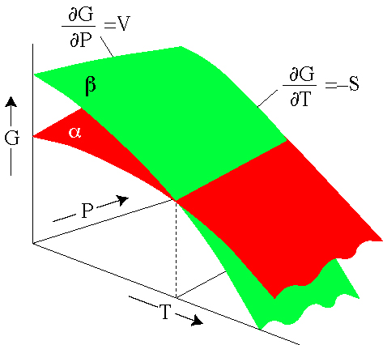
Behavior of Gibbs free energy for a material that changes phase http://hacker.faculty.geol.ucsb.edu/geo124T/lecture.html
coexistence line
Example material that has phases α and β --

Slide 20
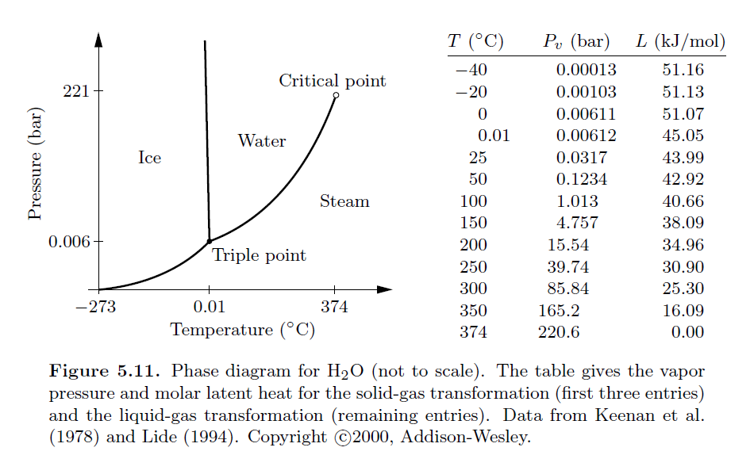
Coexistence line as a function of T and P for phases of water

