Slide 1
PHY 341/641 Thermodynamics and Statistical Mechanics
MWF: Online at 12 PM & FTF at 2 PM
Discussion for Lecture 16:
Thermodynamics of phase change
Reading: Chapter 5.3
Examples of phase transformations
Equations related to phase transformations
Model equations of state that caption some of the physics of phase transformations
Record!!!

Slide 2
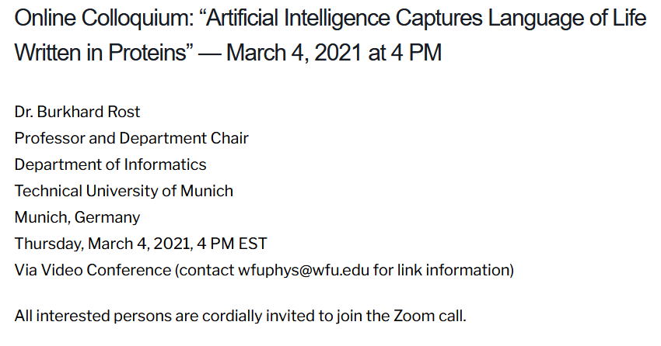

Slide 3
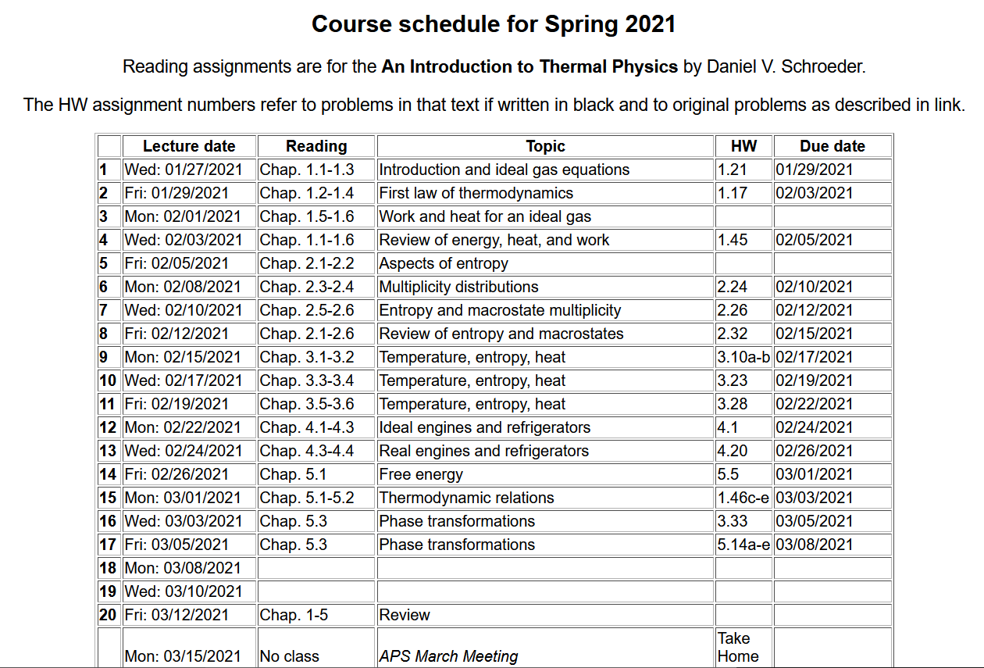
From now on HW will be original problems.

Slide 4
Your questions –
From Kristen – Could you explain the critical point in a bit more detail? 2. Could you explain figure 5.21 in more detail, specifically the references to integrals made in the text (the Maxwell construction)?
From Parker – My question for the week is what is the purpose of using the van der Waals Model instead of the usual ideal gas equation?
From Michael – How are the critical temperature, critical pressure, and critical volume all related to one another. Would they follow the same mathematical expression we would expect using the ideal gas law?
From Rich -- -Does the Van der Waals equation accurately model liquids, and if not, how could it accurately be used to model the phase shift? -For the unattainable conformations in the Gibbs Free energy/phase shift plot, what would these positions look like for the system theoretically?

Slide 5
Your questions –
From Chao -- In the last class we got the formula above. However, since the pressure is constant, why we have two different value of p?
Comment -- This expression is useful if the constant P is different from the value in the table (for example P₀) and if the system is an ideal gas.

Slide 6
Comment – on another property of the Gibbs free energy and the chemical potential -- Gibbs-Dunham relationship
Recall from Lecture 15 regarding a single component system (with the specific example of the monoatomic ideal gas –
(Expected true for all one component systems)

Slide 7
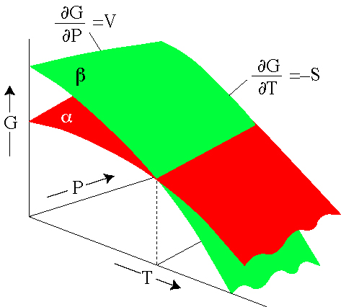
Behavior of Gibbs free energy for a material that changes phase http://hacker.faculty.geol.ucsb.edu/geo124T/lecture.html
coexistence line
Example material that has phases α and β --

Slide 8
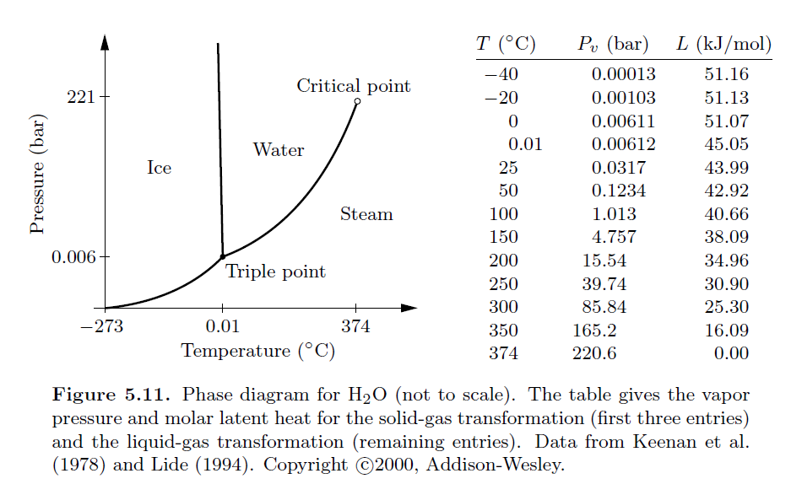
Coexistence lines as a function of T and P for phases of water

Slide 9
Phase transition terminology
Triple point: A particular temperature (T_{t}) and pressure (P_{t}) at which three phases (solid, liquid, gas) of the system exist together. At the triple point the chemical potentials are all equal – μ_{solid}= μ_{liquid}=μ_{gas}.
Critical point: A particular temperature (T_{c}) and pressure (P_{c}) at which the existence or coexistence of phase change qualitatively. For example, the critical point of water involves the change from the coexistence of liquid and vapor to a single “fluid” phase

Slide 10
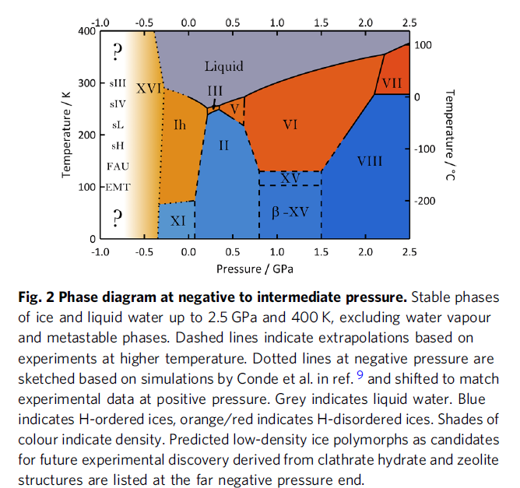
Some details of crystalline phases of ice
Ref: (DOI)
10.1038/s42004-020-00349-2

Slide 11
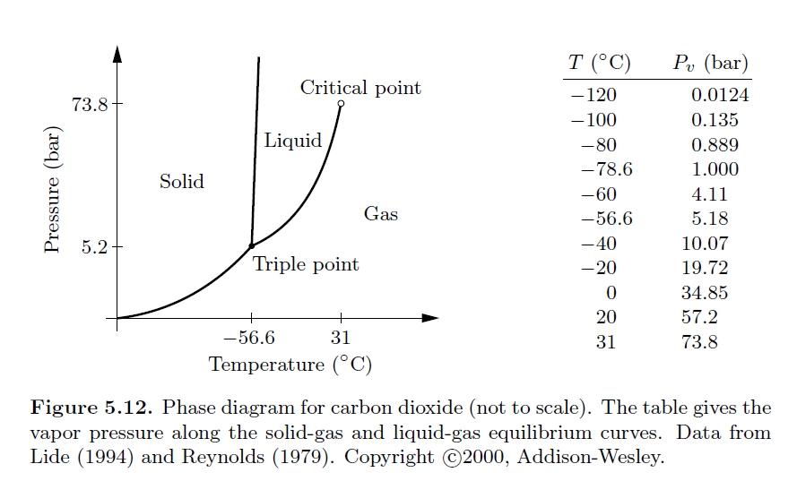
Coexistence lines as a function of T and P for phases of CO₂

Slide 12
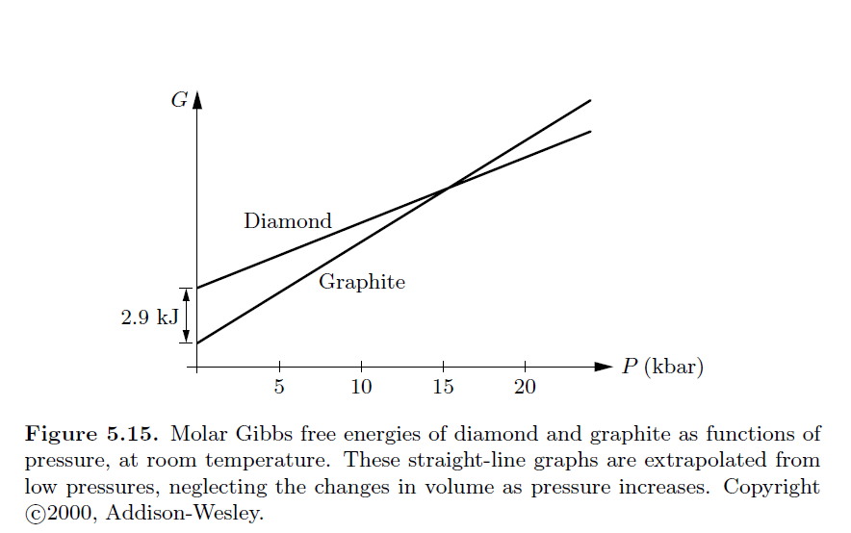
Gibbs free energy versus pressure at T=298 K for graphite and diamond.

Slide 13
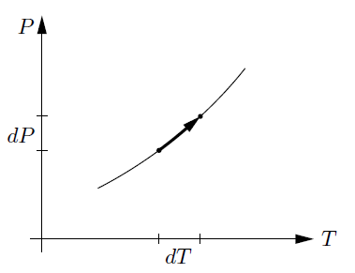
Analysis of coexistence curve – the Clausius-Clapeyron equation

Slide 14
Analysis of coexistence curve – the Clausius-Clapeyron equation
solid
gas
Clausius-Clapeyron equation

Slide 15
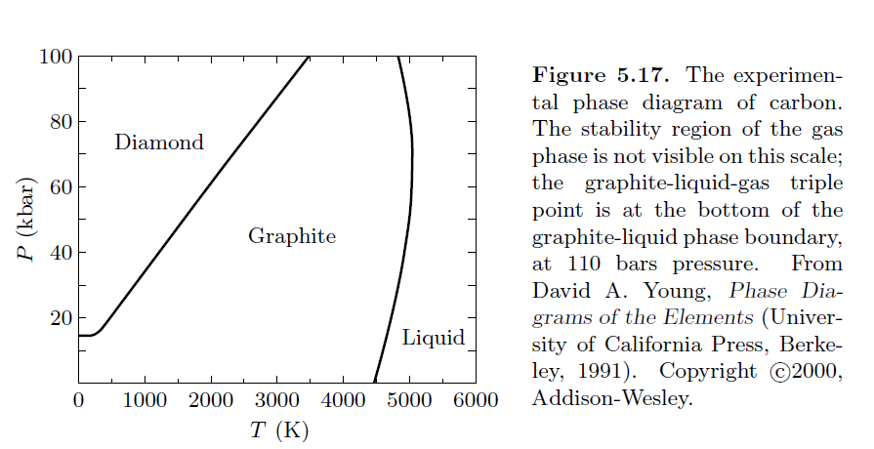
Example of Clausius-Clapeyron equation -- for diamond and graphite

Slide 16
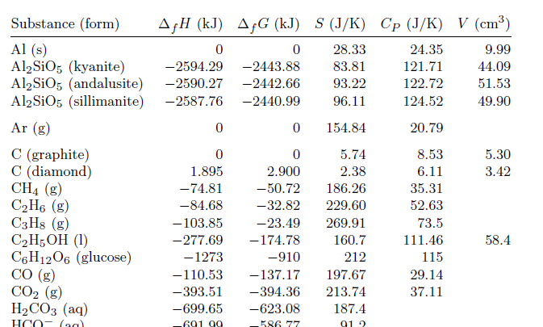
Table from your textbook at T=298 K

Slide 17
Example of Clausius-Clapeyron equation -- for water ice and liquid at T=273 K
For 1 kg of water:
L=333000 J
V_{solid}=1.091 x 10⁻³ m³ V_{liquid}=1.0 x 10⁻³ m³
Note that in this range, the coexistence line has negative slope meaning that as pressure increases, the melting temperature decreases.

Slide 18
Example of Clausius-Clapeyron equation -- for water ice and liquid at T=273 K and P= 1 atm=1.01325 x 10⁵ Pa
For 1 kg of water:
L=333000 J
V_{solid}=1.091 x 10⁻³ m³ V_{liquid}=1.0 x 10⁻³ m³
Unusual property of ice
What temperature does ice under P> 1 atm melt?

Slide 19
Example of Clausius-Clapeyron equation -- for water liquid and vapor at T=T_{ref} =373 K and P=P_{ref} = 1 atm=1.01325 x 10⁵ Pa
For 1 mole of water:
L=407000 J
V_{gas}=RT/P V_{liquid}<< V_{gas}
R=8.315 J/K

Slide 20
Example of Clausius-Clapeyron equation -- for water liquid and vapor at T=T_{ref} =373 K and P=P_{ref} = 1 atm=1.01325 x 10⁵ Pa
For 1 mole of water:
L=407000 J
V_{gas}=RT/P V_{liquid}<< V_{gas}
R=8.315 J/K

Slide 21
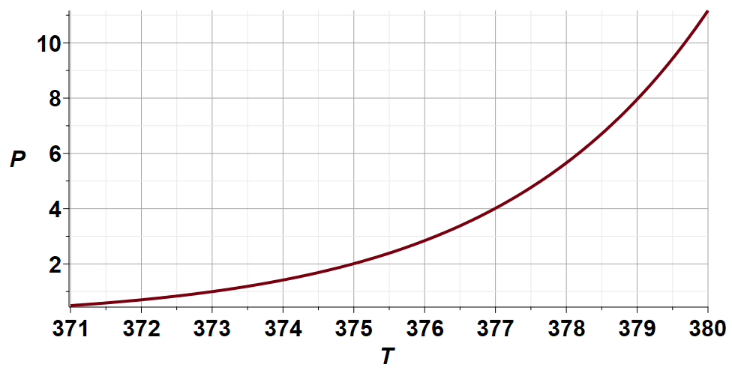
Example of Clausius-Clapeyron equation -- for water liquid and vapor at T=T_{ref} =373 K and P=P_{ref} = 1 atm=1.01325 x 10⁵ Pa
For 1 mole of water:
L=407000 J
V_{gas}=RT/P V_{liquid}<< V_{gas}
R=8.315 J/K
P/P_{Ref}
(K)

Slide 22
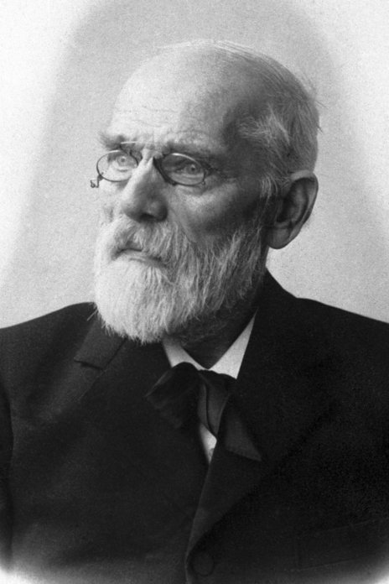
How can we understand phase transitions from the viewpoint of an equation of state? Obviously, the ideal gas law cannot help.
Representing attractive forces
Representing finite size effects
Johannes Diderik van der Waals 1837-1923
Developed equation in 1873
Awarded Nobel Prize in 1910

Slide 23
Interesting paper -- DOI:10.1021/acs.jced.9b00264

Slide 24
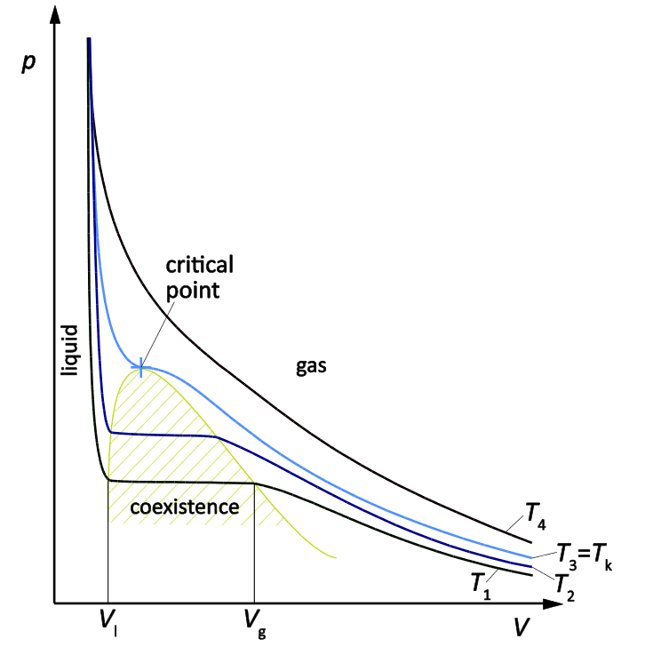
Pressure versus volume plots for a real system near its critical point: https://home.uni-leipzig.de/prakphys/pdf/VersucheIPSP/Thermodynamics/W-15E-AUF.pdf
Notice that at the critical point the P(V) slope is zero and the slope of the slope is also zero.

Slide 25
Can the Van der Waals equation of state represent this behavior?
Examine the equation near T_{c}, P_{c}, and V_{c}:
➔ Want to adjust parameters a and b so that these values are 0.

Slide 26
Some values from Thermal Physics by Ralph Baierlein
 | a (eV ang³) | b (ang³)
Water | 9.55 | 50.7
Sulfur dioxide | 11.9 | 94.7
Carbon dioxide | 6.3 | 71.3
Oxygen | 2.38 | 52.9
Argon | 2.36 | 53.8
Nitrogen | 2.36 | 64.3
Hydrogen | 0.428 | 44.3
Helium-4 | 0.0597 | 39.4

Slide 27
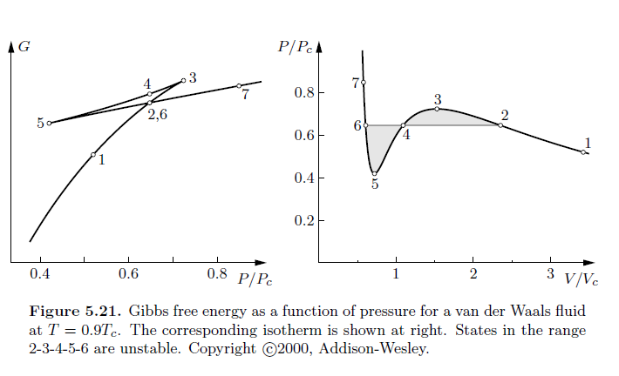
Some fudging --

Slide 28
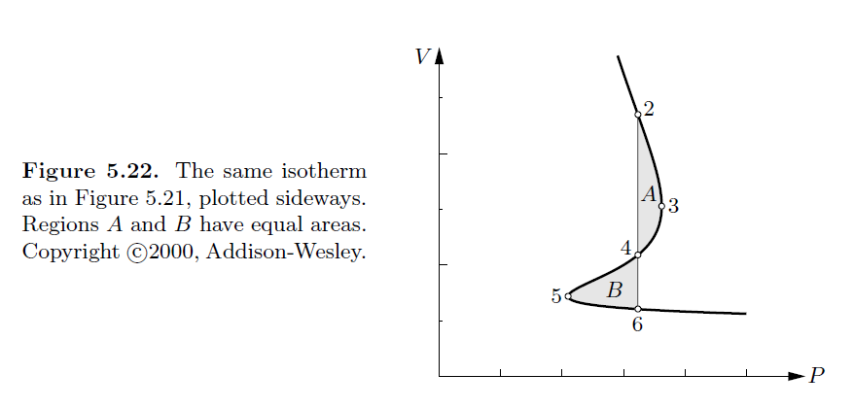
Comment on unphysical behavior of van der Waals equation of state below the critical point. V(P) is multivalued.

Slide 29
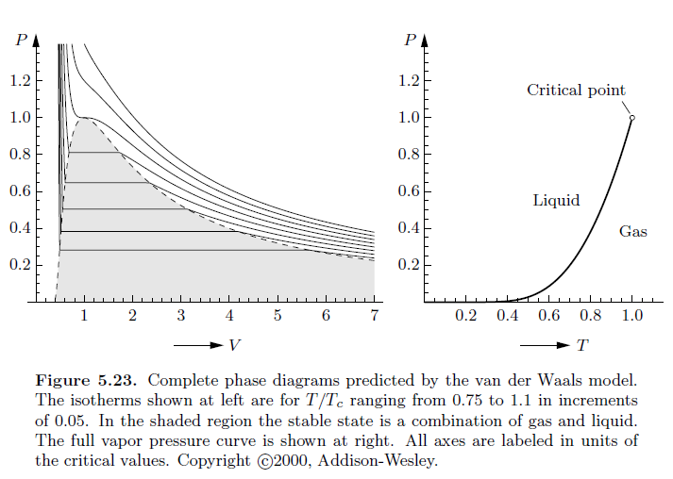
Van der Waals equation of state with Maxwell’s modification

