Slide 1
PHY 341/641 Thermodynamics and Statistical Mechanics
MWF: Online at 12 PM & FTF at 2 PM
Discussion for Lecture 17:
Thermodynamics multicomponent systems
Reading: Chapter 5.4
Thermodynamic energies for multicomponent systems
Thermodynamics of mixing
Some phase diagrams
Record!!!

Slide 2
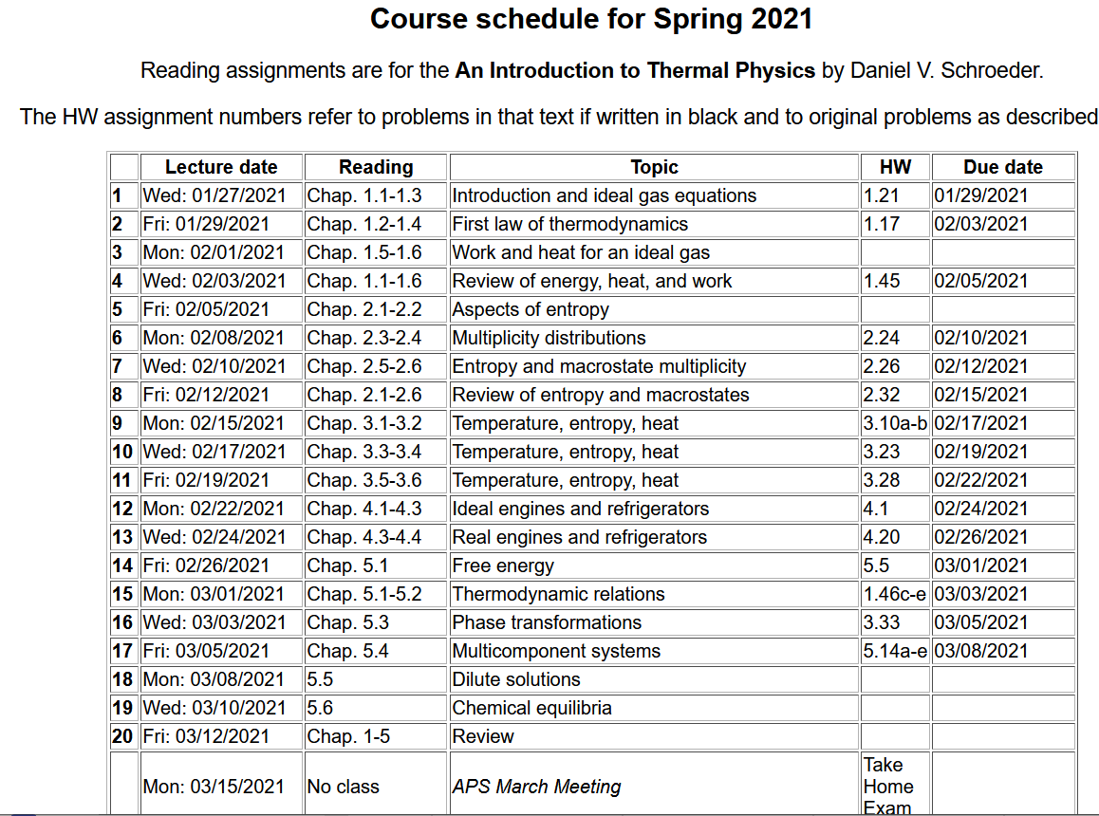

Slide 3
Your questions –
From Parker – What is a Eutectic System?
From Kristen – 1. Could you explain in more detail the "competition in G" as shown in figure 5.26? 2. What exactly is an "impurity molecule"? 3. I'm a bit confused about what happens in the center of a phase diagram with two curves, such as figure 5.31.
From Michael – Can you please expand on the solubility gap and what exactly this means, specifically on a graph? Do all mixtures of two substances have a solubility gap?
From Noah – Can you explain eutectic points? I am confused because the book initially says the stable configuration is the unmixed solids, but then goes on to say that a liquid near the eutectic point is stable because it has more mixing entropy than unmixed solids.

Slide 4
Generalizing the thermodynamic functions for a single component system --

Slide 5
Generalizing thermodynamic functions to multi-component systems --

Slide 6
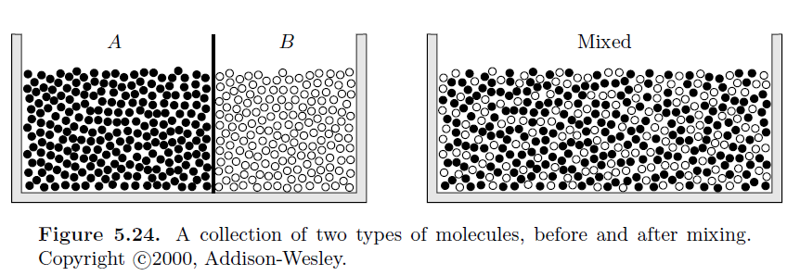
Thermodynamics of mixing -- first consider a two-component (binary) system N_{A}=N(1-x) N_{B}=xN
Mixed system depends on details of system even if no chemical reactions occur.

Slide 7
Possible mixing behaviors.
Consider the case of the monoatomic ideal gas for which we derived the Gibbs free energy expression:
T and P independent constant
For binary example --

Slide 9
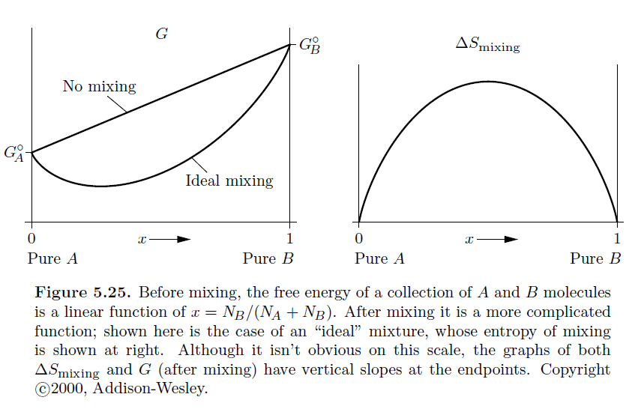
Ideal mixing of binary system --

Slide 10
Given these plots, which configuration is more favorable?
A and B separate
A and B ideally mixed
Experimentally, it is found that real systems are more complicated

Slide 11
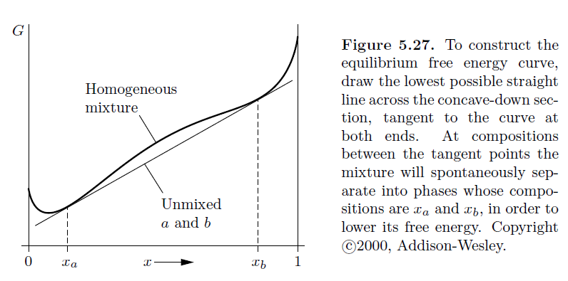
Gibbs free energy diagram of a more complicated mixture
At these compositions, separated phases are more stable

Slide 12
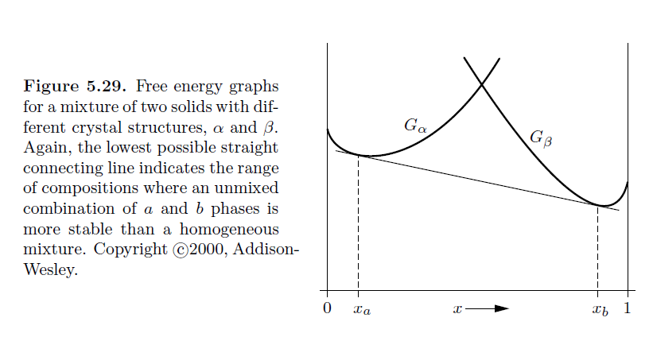
Gibbs free energy diagram of a binary mixture based on two crystalline phases α and β

Slide 13
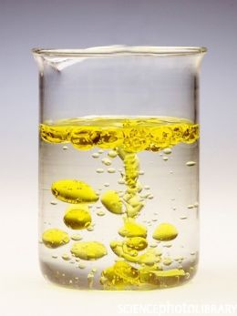
Image of oil and water, example of immicible liquids

Slide 14
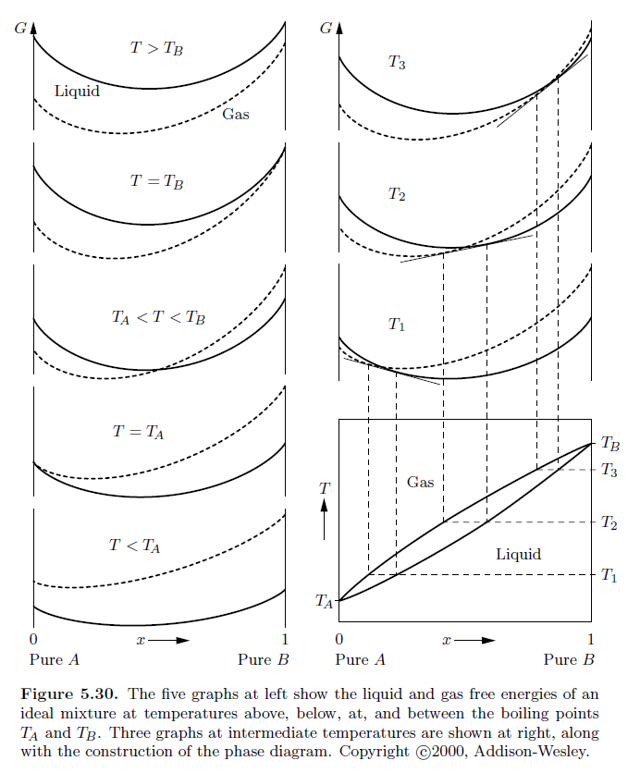
Some details from
your textbook –

Slide 15
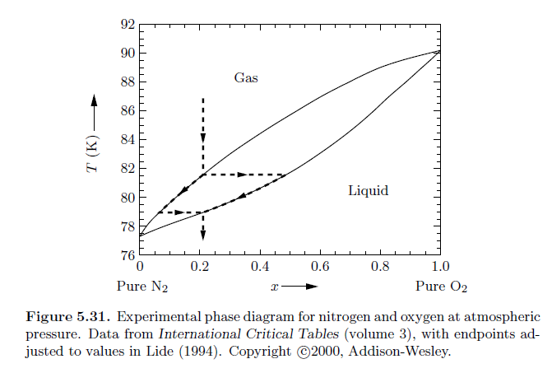
Example of (1-x)N₂ and xO₂ mixture at atmospheric pressure
Gas and
Liquid

Slide 16
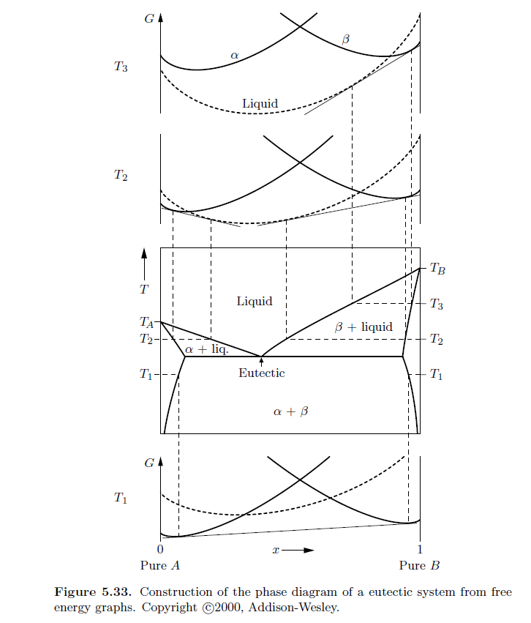
More complicated
systems
This system has an “eutectic” point which is observed to have the lowest solid-liquid melting temperature at a specific composition.

Slide 17
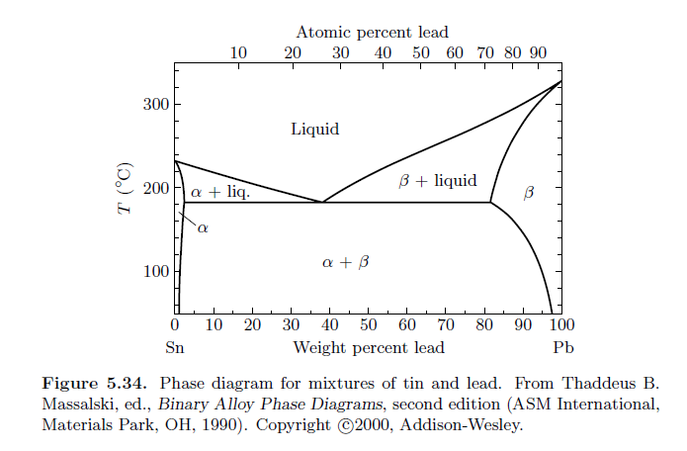
Phase diagram of tin and lead --

Slide 18
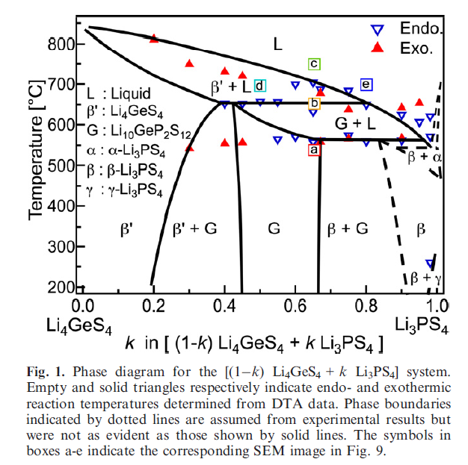
Example from recent
Literature from Toyota
Research Lab 2015 –
looking for solid state
electrolytes
DOI: 10.1111/jace.13694

Slide 19
Which of these factors determine the mixing properties of materials?
Statistics and probability
Forces between particles of the same type
Forces between particles of the opposite type
Temperature
Pressure
Other

