Slide 1
PHY 341/641 Thermodynamics and Statistical Mechanics
MWF: Online at 12 PM & FTF at 2 PM
Discussion for Lecture 18:
Thermodynamics of dilute solutions
Reading: Chapter 5.5
Gibbs free energy of a dilute solution
Osmotic pressure
Solute effects on temperature of phase transitions
Record!!!

Slide 2
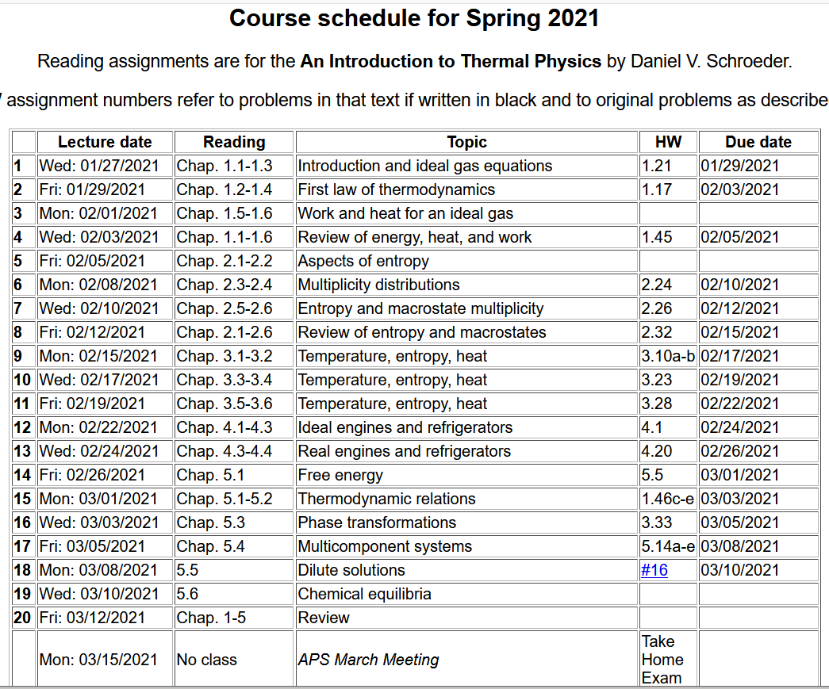

Slide 4
Your questions –
From Michael – Why do particles tend to flow towards lower chemical potentials?
From Kristen – 1. Does each type of solute have its own chemical potential (equation 5.72) that is independent of the solvent, or is it dependent? 2. I'm a bit confused about the derivations to obtain equations 5.86 and 5.9, could we go over them?
From Rich -- How would equation 5.72 (the one relating chemical potential to molality) change if we wanted to use molarity instead? -What approximation is used to move from 5.73 to 5.74?
From Chao -- When deriving formulas for entropy, why can we write microstate with only Avegadoro's Number, instead of a factorial expression?
From Parker -- how do you explain Raoult's Law?

Slide 5
Consider a system with N_{A} solvent particles and N_{B} solute particles with N_{A}>>N_{B}.

Slide 7
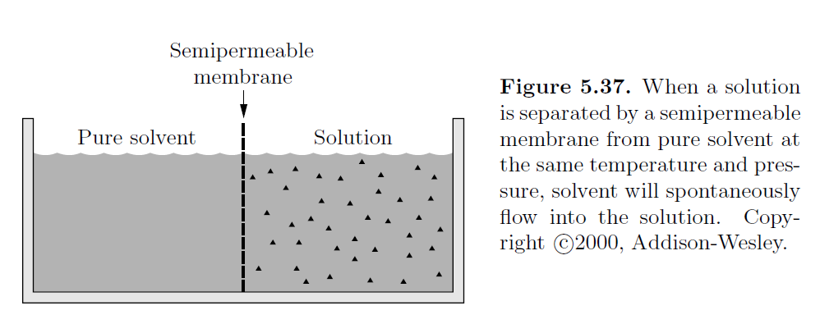
Consider the situation where a semi-permeable membrane separates pure solvent (left) from the dilute solution (right). Solvent can flow through membrane but solute cannot.
What is the reason for solvent flowing?
When will it stop flowing?

Slide 8
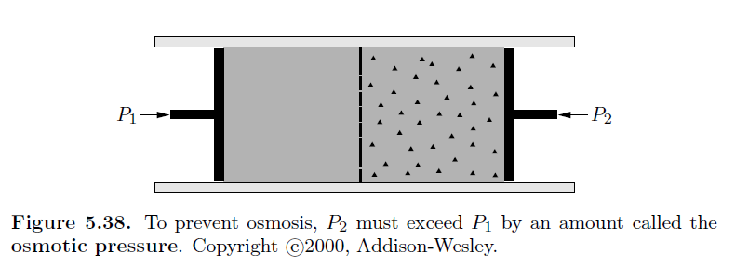
Osmotic pressure
van’t Hoff formula

Slide 9
Practical evaluations –
Nk_{B} → nR
particles x Boltzmann constant → moles x Gas constant

Slide 10
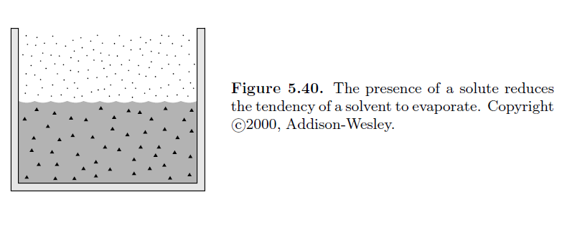
Liquid solutions and vapor pressure
Gas
Dilute solution
Assume that only A particles vaporize; compare the vapor composition above the dilute solution of B into A to that above pure A

Slide 11
Liquid solutions and vapor pressure
Dilute solution
Ideal gas
Taylor expansion of both phases about a reference pressure P₀ and fixed T at which

Slide 12
Liquid solutions and vapor pressure

Slide 13
Liquid solutions and vapor pressure
Raoult’s law
vapor pressure changes at constant T
Now consider temperature changes at constant P

Slide 14
Liquid solutions and vapor pressure – effects on phase change temperature
From previous slide:

Slide 15
Liquid solutions and vapor pressure – effects on phase change temperature

