Slide 1
PHY 341/641 Thermodynamics and Statistical Mechanics
MWF: Online at 12 PM & FTF at 2 PM
Discussion for Lecture 19:
Thermodynamics of equilibrium chemical reactions
Reading: Chapter 5.6
Comment on calculating moles in solution
Chemical reactions in equilibrium
Chemical reactions in dilute solutions
Record!!!

Slide 2
Physics Colloquium – 4 PM 3/11/2021

Slide 3
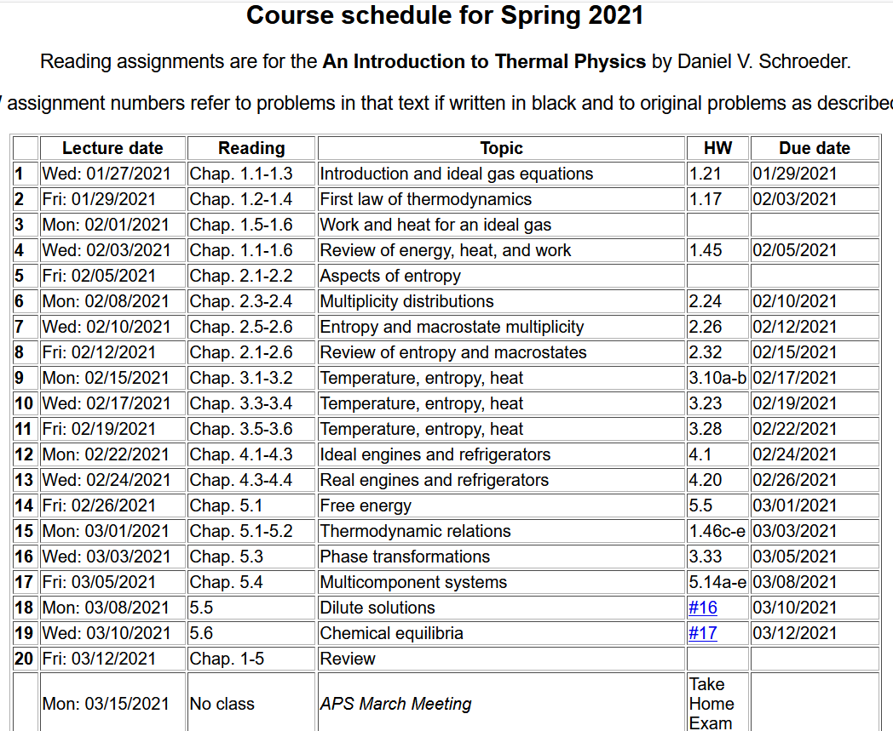

Slide 5
Please send me suggestions for topics to be covered in Friday’s review.
Your questions –
From Kristen – 1. When they talk about Le Chatelier's principle, does a partial pressure increase mean that the number of particles of that compound have increased?
2. How can we assume from the value of K which direction the reaction is most likely to favor?
From Rich -- How would the set-up change for the dissociation of water example if molarity was used instead of molality?

Slide 6
Comment of boiling point elevation discussion from Lecture 18 --
How should we estimate n_{B}?
Textbook says that for 1 kg of water there are 35 g of NaCl
Molecular mass of NaCl 58.44 g
n_{B}=0.6 or n_{B}=1.2 ?????

Slide 7
Note that in this lecture we will use “k” for the Boltzmann constant (instead of k_{B})

Slide 8
Notion of chemical reactions
N₂ + 3H₂ ←→ 2NH₃
In this case, the reaction of hydrogen and nitrogen gas forming ammonia gas can in principle proceed in either direction, depending on conditions.
We want to use the Gibbs free energy to analyze the reaction at fixed T and P.

Slide 9
In the case that all of the particles are approximately ideal gasses, we can start with Gibbs free energy of each type of particle. For particle A, for example:

Slide 11
Note that at constant temperature and pressure, when the reactions is at equilibrium A⁰=0

Slide 12
Summary for reaction:

Slide 13
ΔG(T₀,P₀)

Slide 14
Consider the gas phase reaction –
N₂O₄ ←→2NO₂
ν_{A}=-1 ν_{C}=2
Suppose initially only N₂O₄ is present.
Ref: L. E. Reichl
A modern course in Statistical Mechanics

Slide 15
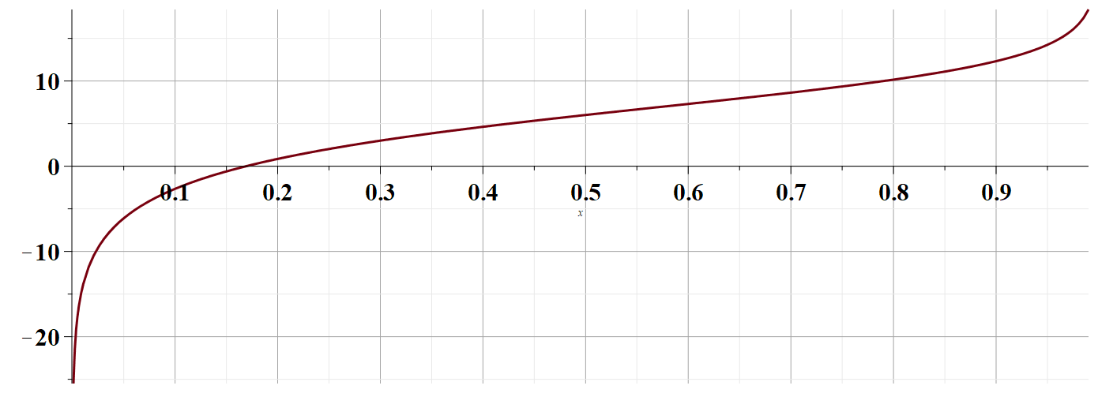
Consider the gas phase reaction –
N₂O₄ ←→2NO₂
ν_{A}=-1 ν_{C}=2
At T₀=298K P₀=1 atm
A
χ
Equilibrium

Slide 16
Another example of equilibrium chemical reactions – processes in dilute solutions
Dissociation of water:
In this case, we cannot use the ideal gas expressions but the notions of equilibrium and the “affinity” function are still relevant

Slide 17
Using the units in your text book:

