Slide 1
PHY 341/641 Thermodynamics and Statistical Mechanics
MWF: Online at 12 PM & FTF at 2 PM
Discussion for Lecture 20:
Review of Chapters 1-5
      Comment on schedule and exam
      Your questions
      Some review
Record!!!

Slide 2
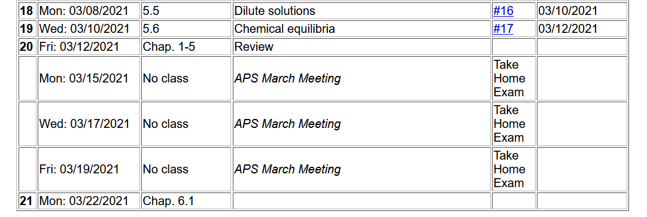
Schedule --
Exam available by 9 AM
Exam due at 5 PM
Note that mid term grades are due at 12 noon on Monday, March 22, 2021
“Due” means receiving your exam submission electronically by that time. If you prefer paper submission, please slide the exam under my office door and let me know that you have done so.

Slide 3
Comments about exam –
According to the honor code, your exam submission must be your own work. In completing this take-home exam, you may consult your textbook, and other course materials, particularly those posted on the class webpage. You may consult other texts (within reason) as long as these are acknowledged and documented. Should questions arise about the exam, please email natalie@wfu.edu but no one else.
Exams will be graded on the basis of correct reasoning as well as correct answers. It is expected that you will use Maple, Mathematica, or Wolfram and these should be included in your exam submission.

Slide 4
Your questions –
From Rich -- I tried using k*T on the homework, but I could not get the right answer without using R*T. Why is this the case? -Does the constant of reactivity still work when comparing across different measurements, like pressure and molality?
From Annie -- For tomorrow's review can we do some example problems? I have a difficult time applying all the formulas we derive- like any problems showing us how to do stuff with H,S,G, Cp,Cv,U,V,F,n. For the most part I understand where these equations come from, but I just don't know what to do with them.
Also, is the exam going to be derivation oriented or more problem solving? Because if it is derivations, please disregard the suggestion I made above, and instead possibly review how the variables relate to each other when certain elements are fixed and stuff like that.
From Kristen – 1. How to find Cv and Cp, I know we take the derivative of Q but how does f come in? 2. The important takeaways from the sections on phase transformations. 3. The most important key ideas to know about the tendencies of a system and why they happen (ex: the tendency to go to a state of lowest Gibbs free energy).

Slide 5
From – Michael -- 1) Could you please explain how the change in entropy can be negative and how this isn't in violation of the second law of thermodynamics? 2) How does the formula (T = To + (KbTo^2)/L for saltwater not give us a number above freezing if To is 273K, shouldn't (KbTo^2)/L always be positive? 3) Last lecture you mentioned that to estimate nB we need to double 0.6 to 1.2, why is that again?

Slide 6
Comment of boiling point elevation discussion from Lecture 18 --
How should we estimate n_{B}?
  Textbook says that for 1 kg of water there are 35 g of NaCl
  Molecular mass of NaCl 58.44 g
  n_{B}=0.6 or n_{B}=1.2 ?????

Slide 7
General comments –
For numerical questions, please make sure that your units are consistent. For example, many of our discussions mention N as the number of particles, but since we are typically talking about 10²³ particles, it is more convenient to use moles
Nk_{B}T←→nRT
Materials properties are often listed per kg or per liter. If we know the mass density of the material, it is possible to convert to consistent units.

Slide 8
Some mathematical tools
Mathematical representation –
  Thermodynamics involves a lot of functions and a lot of variables which can be nicely modeled using concepts of multivariable functions. Here we need to use the concept of partial derivatives and total derivatives.

Slide 9
Notion of partial derivatives continued --

Slide 10
Notion of the Legendre transformation
General notions of mathematical transformations for continuous functions of several variables and Legendre transforms --
Consider:

Slide 11
Desired thermodynamic functions --

Slide 12
Summary of thermodynamic functions
Various first derivative relationships

Slide 13
Some concepts to remember
Here Q is heat added to system and W is work added to system.
Under quasi static conditions: Q→dQ→TdS
W→dW→-PdV

Slide 14
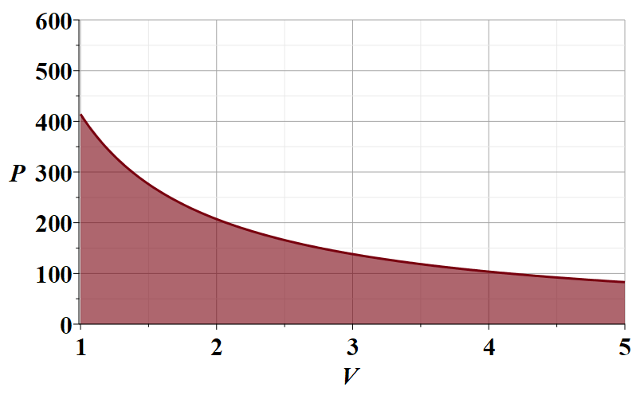
Work for various processes for an ideal gas
Now consider an isothermal process
  In order to evaluate W, it is useful to consider a plot of P versus V
N=10²³
T=300 K
P (Pa)
V (m³ )

Slide 15
Special properties for an ideal gas
For a mono atomic ideal gas f=3 and γ=5/3
Entropy for a mono atomic ideal gas
Sackur-Tetrode equation --

Slide 16
Some details about entropy on the basis of Boltzmann’s analysis
The multiplicity function Ω for a “micro canonical ensemble” counts the number of microstates for which the macroscopic variables ( such as N, V, U ) are measured.

Slide 17
Measurements of heat

Slide 18
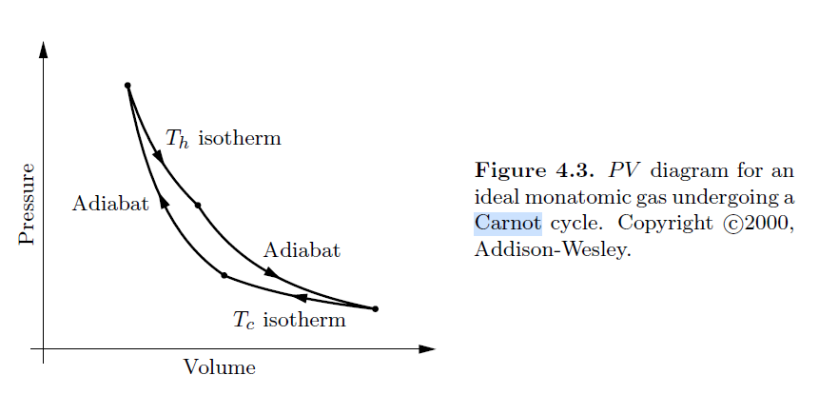
Analysis of cyclic processes – Carnot cycle
PV diagram from your textbook
a
b
γ is an empirically measured quantity related to degrees of freedom of ideal gas
d
c

Slide 19
T versus S diagram
P versus V diagram
a
T_{H}
b
a
Temperature
b
d
d
c
c
T_{C}
Entropy

Slide 20
a
Q_{ab}
b
d
c
Q_{cd}

Slide 21
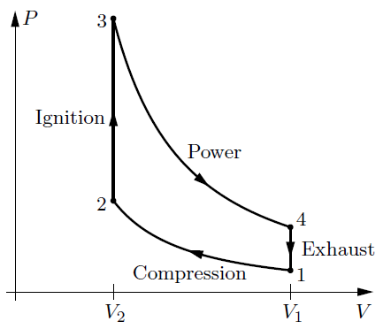
Other cyclic processes such as the Otto cycle --
Q₃₄=0
Q₁₂=0

