Slide 1
PHY 341/641 Thermodynamics and Statistical Mechanics
MWF: Online at 12 PM & FTF at 2 PM
Discussion for Lecture 21:
Introduction to statistical mechanics –
Microcanonical vs canonical ensembles
Reading: Chapter 6.1 and 6.5
Microcanonical ensemble and multiplicity factor
Boltzmann’s entropy in the context of a heat bath
Canonical ensemble
Record!!!

Slide 2
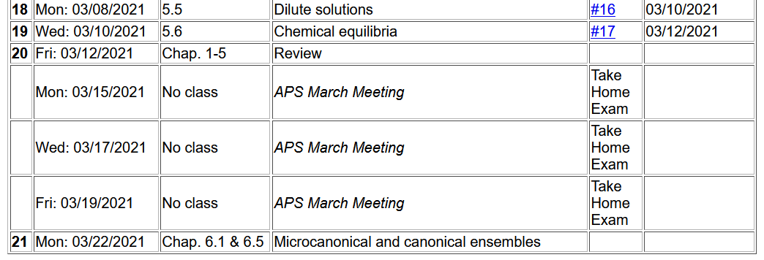

Slide 3
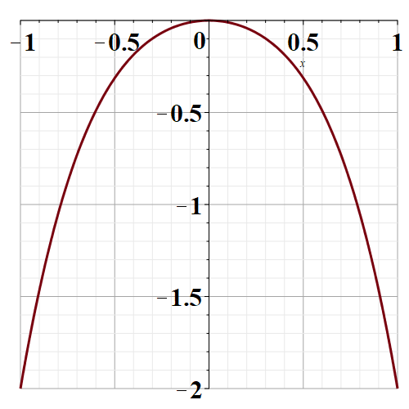
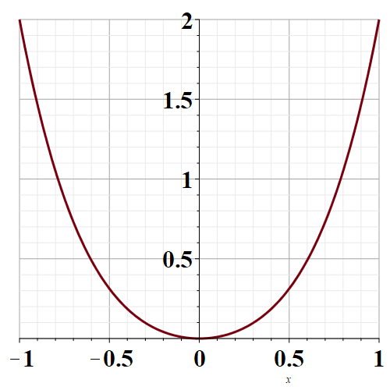
Comment on last question on mid term –
The curves below represent a potential function V(x) Which of them have a stable equilibrium point?
left
right
x
V
V
x

Slide 4
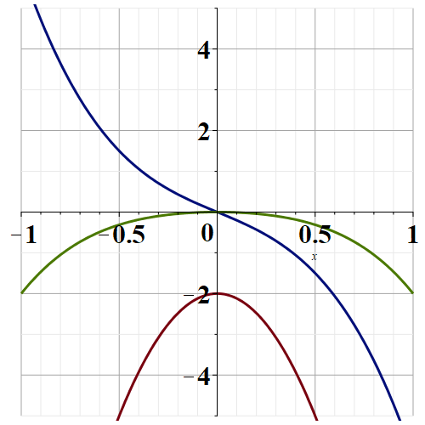
Left curve
x

Slide 5
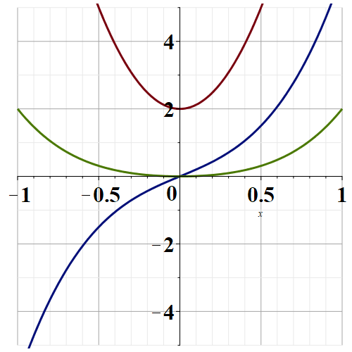
Right curve
x

Slide 6
Introduction to statistical mechanics –
Up to now our discussion of statistical mechanics has been focused on the analysis of the multiplicity function Ω which, for an isolated system, describes the number of “micro” states which have the same values of the microstate variables such as N,V, U for a free electron gas. The literature refers to this as a “micro canonical ensemble”.

Slide 7
For a mono atomic ideal gas having N particles in a volume V at an energy U --
Sackur-Tetrode expression for the entropy

Slide 8
Now consider the notion of the micro canonical system in terms of probabilities. The tacit assumption is that each micro state of our system is equally likely.

Slide 9
We will then introduce a “canonical ensemble”

Slide 10
Now, we would like to extend the analysis of an isolated system to that of a system within a heat bath. The system within the heat bath will be analyzed in terms of a “canonical ensemble” --
Canonical ensemble:
E_{b}
E_{s}

Slide 11
Canonical ensemble in terms of the internal energies of the bath (b), system (s), and total

Slide 12
Canonical ensemble (continued)

Slide 13
Canonical ensemble:

Slide 14
Canonical ensemble continued – average energy of system:
Heat capacity for canonical ensemble:

Slide 15
Comment – Note that in this formulation we are accessing the system energies U_{s} while typically we only know the individual particle energies. For real evaluations, additional considerations will be needed.

Slide 16
Analyzing the relationship of the partition function with the notion of entropy
- Helmholtz free energy

Slide 17
Recap:

Slide 18
Canonical ensemble

Slide 19
Generalization --

Slide 20
Example: Canonical distribution for free particles

Slide 21
Example of a canonical ensemble consisting of 2 particles
Consider a system consisting of 2 distinguishable particles. Each particle can be in one of two microstates with single-particle energies 0 and Δ. The system is in equilibrium with a heat bath at temperature T.
s | ε₁ | ε₂ | U_{s}
1 | 0 | 0 | 0
2 | 0 | Δ | Δ
3 | Δ | 0 | Δ
4 | Δ | Δ | 2Δ

Slide 22
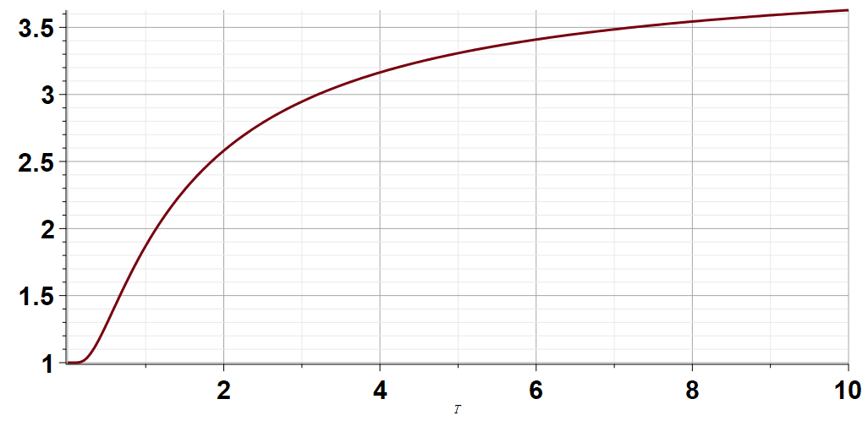
T =Δ/k
kT/Δ

Slide 23
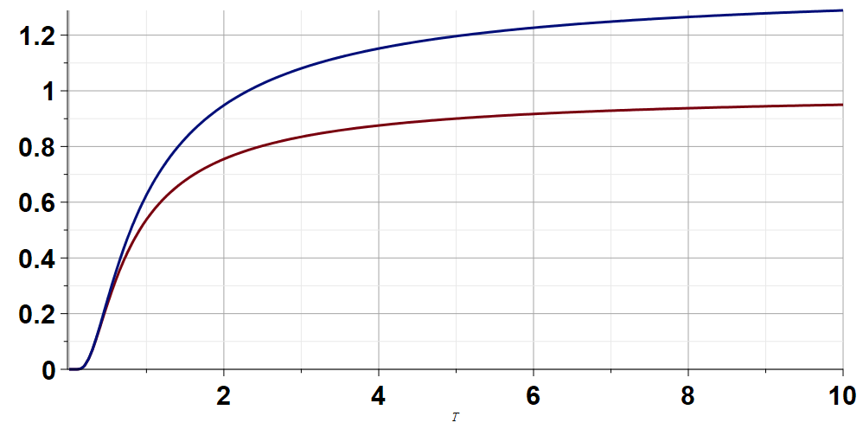
Model results for Helmholtz free energy and internal energy
F(T)
U(T)
kT/Δ

