Slide 1
PHY 341/641 Thermodynamics and Statistical Mechanics
MWF: Online at 12 PM & FTF at 2 PM
Discussion for Lecture 22:
Introduction to statistical mechanics –
Analysis of physical properties for canonical ensembles
Reading: Chapter 6.1-6.2
Simple examples
Experimental evidence
More complicated examples
Record!!!

Slide 2
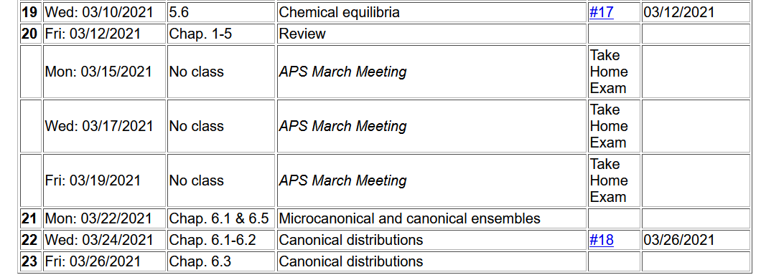

Slide 3
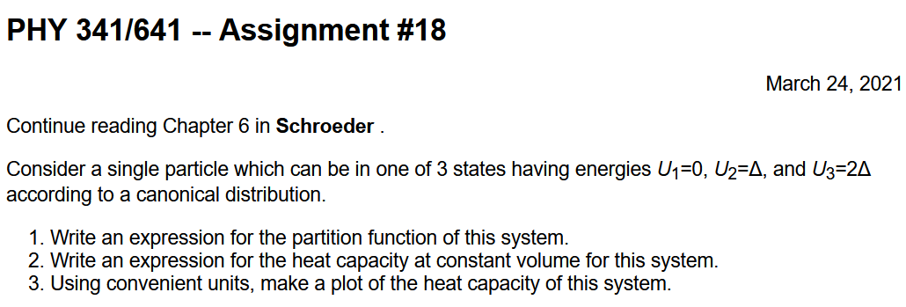

Slide 4
4 PM online

Slide 5
Your questions – (some from Monday)
From Michael -- Could you further elaborate on how we are able to determine that hydrogen atoms are much more abundant in the sun's atmosphere than any other types of atoms? What does the partition function in regards to rotational energy actually mean?
From Noah -- When talking about degenerate states for a particle in a system is this the same thing as talking about the macrostates of the system or is it different because we are only concerned with a single particle?
Section 6.5 is all about finding a quantity that increases in a system with constant temperature. Are there analogous quantities for all of the physical parameters like constant pressure and constant volume?
From Kristen -- 1. When computing the average values for the energy, for example, the probabilities that we are using, is that the number of atoms in that state which just happens to represent the probability of it being in that state? Could you define the probability that we learned about in class today in this context? 2. Why do we divide by Z in the average value equation? 3. Could you explain a bit more about what the equipartition theorem actually tells us?

Slide 6
From Parker -- Should we think of the partition function for energy as the weighted average for a discrete set of energy levels?

Slide 7
Important results concerning the notion of the canonical system

Slide 8
Evaluating averages for a canonical distribution:
Average energy for canonical ensemble:
Heat capacity for canonical ensemble:

Slide 9
Other quantities that can be calculated based on the Helmholtz free energy

Slide 10
Some examples assuming a discrete set of energies for U_{s}
These discrete states typically come from quantum systems. At the moment, we will only use the discrete nature of these states and leave the more detailed aspects of quantum statistical mechanics for later (Chapter 7).

Slide 11
Simple example of a single particle system –
Suppose you have a single particle which is well described by a canonical distribution among two discrete internal energies U₁=0 and U₂=Δ

Slide 12
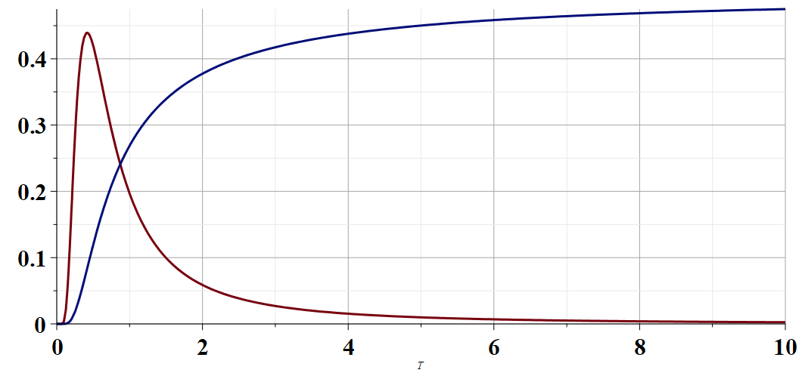
Single particle which is well described by a canonical distribution among two discrete internal energies U₁=0 and U₂=Δ
<U>
C
kT/Δ

Slide 13
More results for our simple model from the Helmholtz free energy
S
kT/Δ
F

Slide 14
Question – what happens if the zero of energy shifts?
Suppose you have a single particle which is well described by a canonical distribution among two discrete internal energies U₁=a and U₂=a+Δ
Nothing changes
All results change

Slide 15
Experimental evidence of canonical distribution (your book refers to the terms as Boltzmann factors)
spectrum
Diffractometer
Light from star
Spectral analysis of star light can be used to identify characteristic atomic transitions. Assuming the Boltzmann distribution, we can deduce the star temperature.

Slide 16
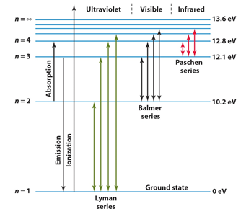
Hydrogen energy levels and transitions

Slide 17
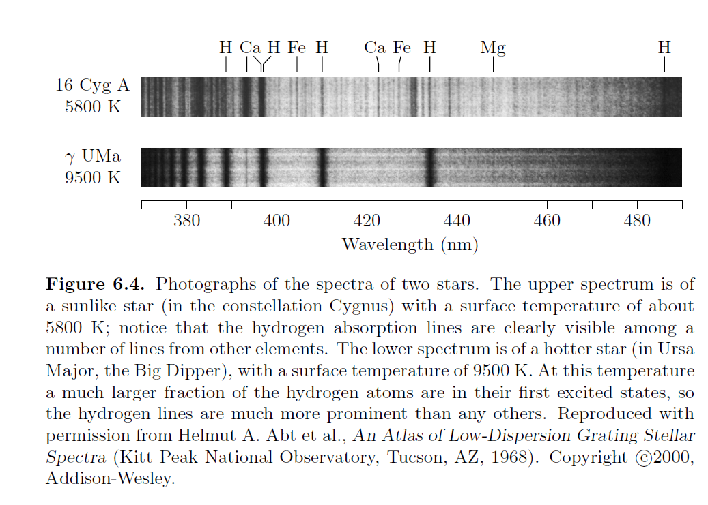
Focusing H spectrum --

Slide 18
Note that these lines are absorbed from the star’s total spectrum.

Slide 19
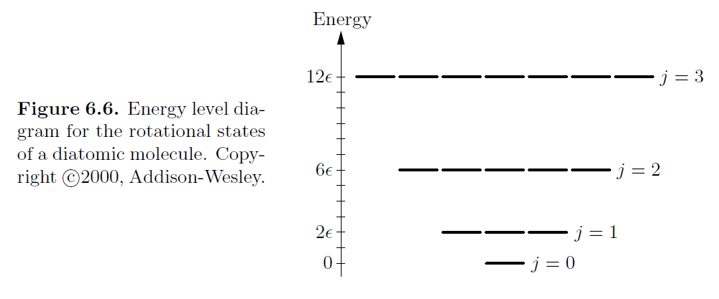
Another example – rotations of a diatomic molecule

Slide 20
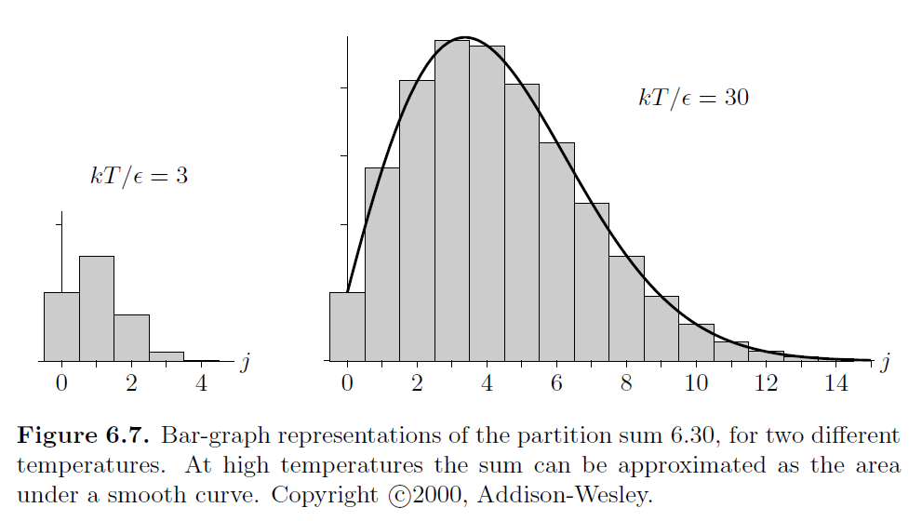
For each diatomic molecule within a canonic ensemble, the partition function is given by

Slide 21
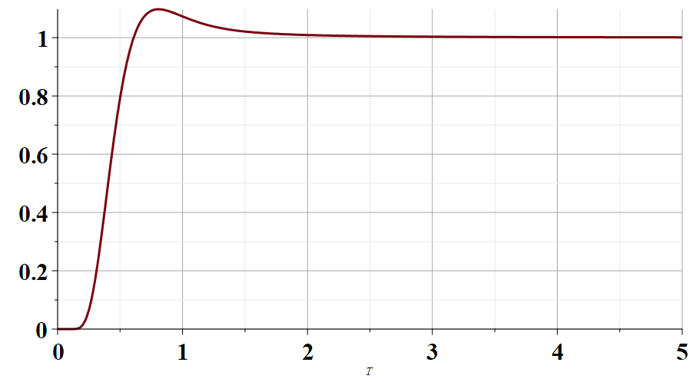
C (ε²/k)
kT/ε

Slide 22
So far, we have considered single particles in a canonical ensemble, what happens when we have N non-interacting particles?
Z_{N}=N Z₁
Z_{N}= (Z₁)^{N}
Something else?

