Slide 1
PHY 341/641 Thermodynamics and Statistical Mechanics
MWF: Online at 12 PM & FTF at 2 PM
Discussion for Lecture 23:
Introduction to statistical mechanics –
Single particle and multi particle systems
Reading: Chapter 6.1-6.7
Partition function for a simple free particle
Partition function for a complex free particle
Partition function for multiple particles; distinguishable or indistinguishable
Record!!!

Slide 2
Homework problem from textbook:
6.49 For a mole of nitrogen (N₂) gas at room temperature and atmospheric pressure, compute the following: U,H,F,G,S, and
μ. The rotational constant ε for N₂ is 0.00025 eV. The electronic ground state is non degenerate.

Slide 3
Your questions –
From Kristen -- 1. While I mostly understand the proof of the equipartition theorem, I am still a bit unsure about what it is actually telling us/why it is important.
2. What does Vrms (the root-mean-square speed) actually mean and how can we drive its equation from the equipartition formula?
From Rich -- What do you use for Uint and Fint when calculating the Cv or F from the partition function?

Slide 4
Canonical ensemble for system in bath
Bath
System

Slide 5
Examples for systems of single particles:
First consider a single atom of mass m in box of volume V
Its energy depends on only on its momentum p in terms of its kinetic energy
V
Planck’s constant for compatibility with QM
See Appendix B

Slide 6
Now consider the motions of a more complicated system such as a diatomic molecule
Rotation
Translations of center of mass
Vibration

Slide 7
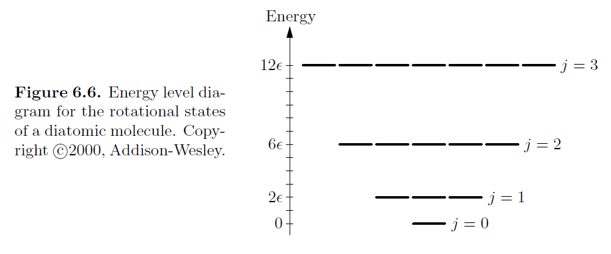
Rotations of a diatomic molecule

Slide 8
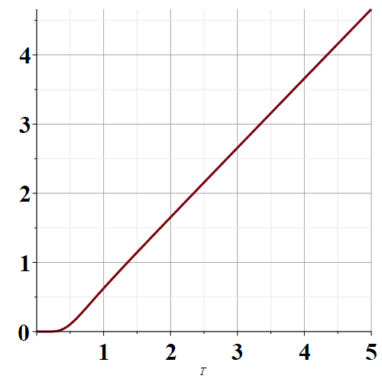
Rotations of a diatomic molecule -- continued
U_{rot}
kT/ε

Slide 9
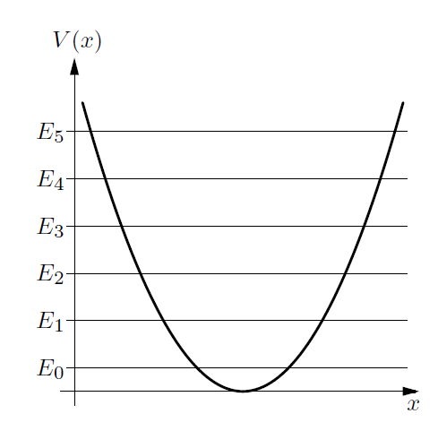
Vibrations of a diatomic molecule (see Appendix A)

Slide 11
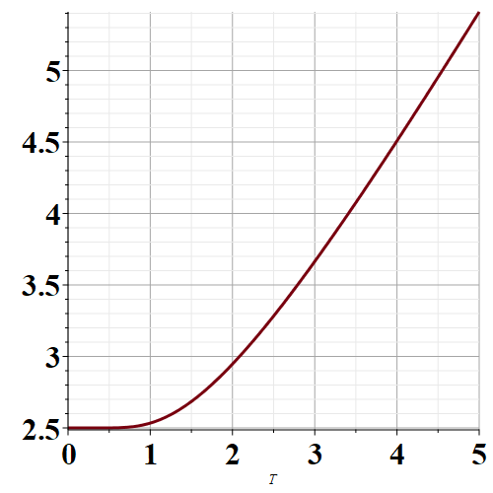
Vibrations of a diatomic molecule
U_{vib}
kT/hω

Slide 12
Partition function for single molecule including translational and “internal” motions
Now suppose that there are N particles. Last time we suggested that if the particles are not interacting, then
Z_{N}=(Z₁)^{N}
It turns out that this approach is correct if the particles are distinguishable. However, for indistinguishable particles, the correct N particle partition function should be

Slide 14
First consider the mono atomic case:

Slide 15
Now consider a complex molecule with

Slide 16
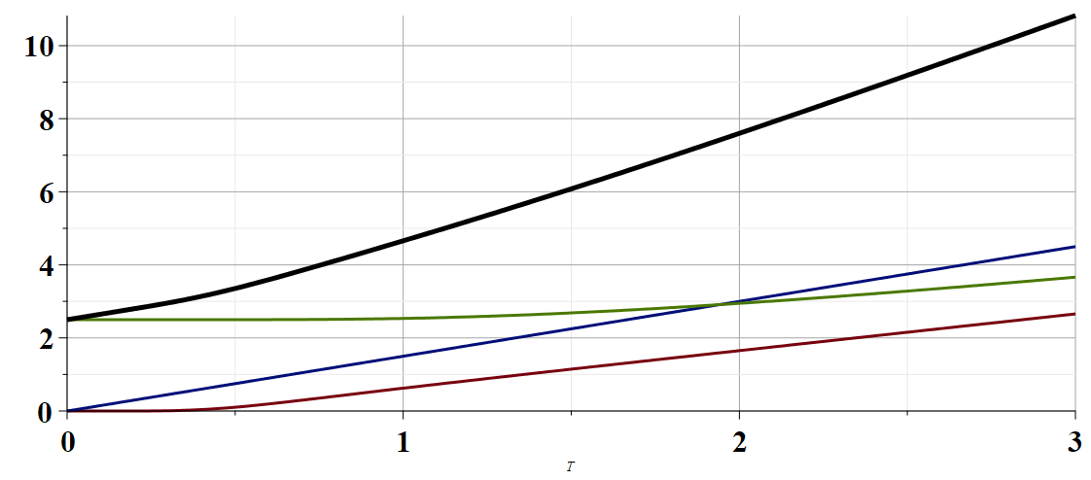
Plot of internal energy as a function of temperature for model diatomic molecule
U
U_{tot}
U_{trans}
U_{vib}
U_{rot}
T

Slide 17
