Slide 1
PHY 341/641 Thermodynamics and Statistical Mechanics
MWF: Online at 12 PM & FTF at 2 PM
Discussion for Lecture 25:
Introduction to statistical mechanics –
Canonical ensembles and their thermodynamic properties
Reading: Appendix A and begin Chapter 7
Elements of quantum mechanics
Fermi quantum particles and Bose quantum particles compared with distinguishable particle combinations
Record!!!

Slide 2
4 PM
ZOOM link

Slide 4
Your questions – To be answered on Friday --
From Kristen -- 1. Could you explain why in this case we keep the mu dN term (equation 7.3)? 2. Why must Z be an integer in the example given in the beginning of section 7.2? 3. Could you explain what the quantum volume represents?
From Rich -- How do you calculate Zint for equation 7.10?
From Chao –
From Michael -- How do we distinguish the Gibbs sum/grand partition function from other partition functions we have learned about thus far, and when would we use it exactly?

Slide 5
What new physics does Quantum Mechanics bring?
Classical mechanics
Newton’s Laws of motion –
Particle motion described in term of position and momentum r, p. In many cases, energy is conserved and equal to the Hamiltonian function:
Quantum mechanics
Schoedinger Equation --
Particle motion is described in terms of a probability amplitude ψ; momentum becomes an operator; particles have intrinsic spin; energy is an eigenvalue of the Schroedinger equation:
Particles can be distinguishable
Particles are generally indistinguishable and have characteristic properties depending on their intrinsic spin

Slide 6
Intrinsic S spin of a particle having a gyromagnetic ratio γ

Slide 7
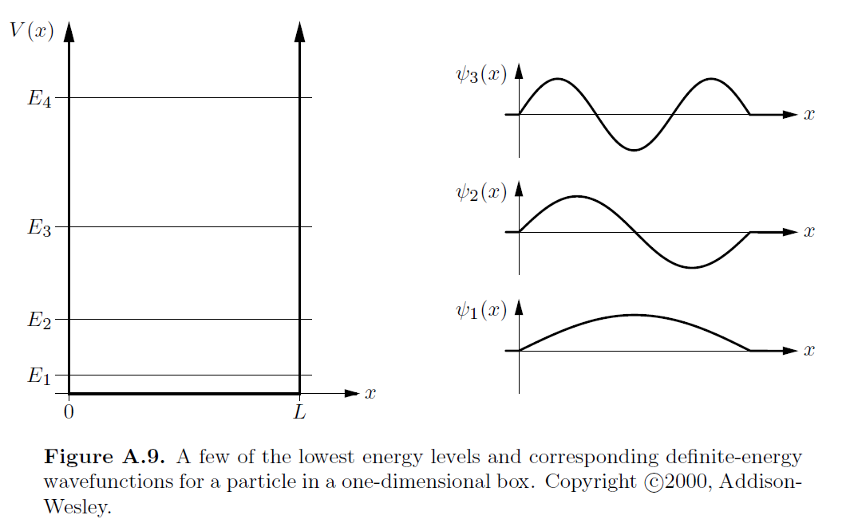
Particle confined within a one-dimensional box of length L

Slide 8
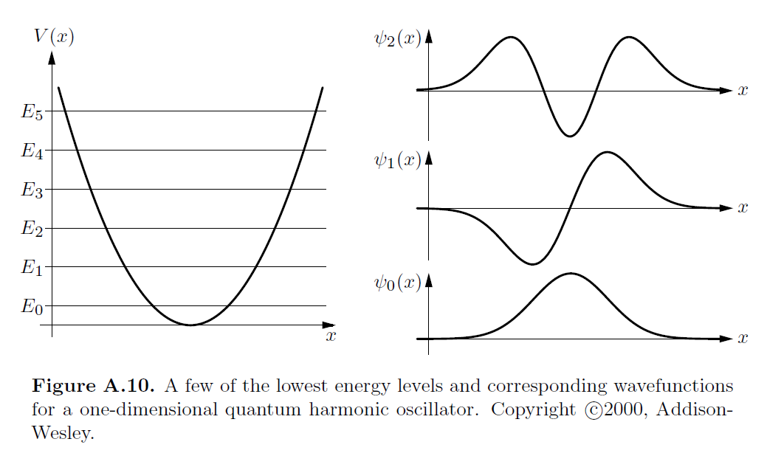
Harmonic oscillator in one-dimension

Slide 9
Rigid rotor with moment of inertia I_{rot}

Slide 10
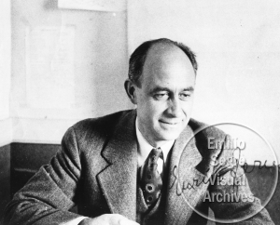
Enrico Fermi
1901-1954
Bose particles have integer s
Fermi particles have half integer s

Slide 11
Experimentally observed properties of Bose and Fermi particles --
Bose particles have integer s. It is observed that non interacting identical Bose particles are symmetrical under particle swapping – Ψ(1,2)=Ψ(2,1). In terms of single particle states
Fermi particles have half integer s. It is observed that non interacting identical Fermi particles are anti-symmetrical under particle swapping – Ψ(1,2)=-Ψ(2,1). In terms of single particle states

Slide 12
What happens if the wavefunctions for A and B are the same?
This affects both Bose and Fermi particles the same way
This affects Bose particles significantly.
This affects Fermi particles significantly.

Slide 13
Conclusions for properties of non interacting identical Bose particles ➔ Many Bose particles may occupy the same quantum state
Explains behavior of quanta of electromagnetic radiation (photons)
Explains “Bose condensation”
Conclusions for properties of non interacting identical Fermi particles ➔ A quantum state may accommodate 1 or 0 Fermi”
Explains behavior of electrons in an ideal metal

Slide 14
Suppose that you have three states A, B, C with different wavefunctions and energies and two non interacting particles. What valid combinations exist for your system
System of distinguishable classical particles 1 & 2:
A | B | C | Config. energy
12 |  |  | 2A
 | 12 |  | 2B
 |  | 12 | 2C
1 | 2 |  | A+B
2 | 1 |  | A+B
 | 1 | 2 | B+C
 | 2 | 1 | B+C
1 |  | 2 | A+C
2 |  | 1 | A+C

Slide 15
System of indistinguishable Bose particles 1 & 2:
A | B | C | Config. energy
12 |  |  | 2A
 | 12 |  | 2B
 |  | 12 | 2C
1 | 2 |  | A+B
 | 1 | 2 | B+C
1 |  | 2 | A+C

Slide 16
System of indistinguishable Fermi particles 1 & 2:
A | B | C | Config. energy
1 | 2 |  | A+B
 | 1 | 2 | B+C
1 |  | 2 | A+C

