Slide 1
PHY 341/641 Thermodynamics and Statistical Mechanics
MWF: Online at 12 PM & FTF at 2 PM
Discussion for Lecture 26:
Quantum effects in statistical mechanics
Reading: Appendix A and Chapter 7
Statistical mechanics of photons as Bose particles
Notion of density of states for photon states
Black body radiation
Record!!!

Slide 3
Your questions – To be answered on Friday --
From Kristen -- 1. Could you explain why in this case we keep the mu dN term (equation 7.3)? 2. Why must Z be an integer in the example given in the beginning of section 7.2? 3. Could you explain what the quantum volume represents?
From Rich -- How do you calculate Zint for equation 7.10? Could you breakdown and better explain the (e-u)/kT phrase of the Fermi-Dirac and Bose-Einstein distributions?
From Chao –
From Michael -- How do we distinguish the Gibbs sum/grand partition function from other partition functions we have learned about thus far, and when would we use it exactly? What exactly do the Fermi-Dirac and Bose-Einstein Distributions tell us?

Slide 4
From Parker -- What is the meaning behind degenerate energy levels that are equivalent in quantum mechanics as they are linearly independent, but are counted separately in statistical mechanics?

Slide 5
Summary of results from Wednesday --
Experimentally observed properties of Bose and Fermi particles --
Bose particles have integer s. It is observed that non interacting identical Bose particles are symmetrical under particle swapping – Ψ(1,2)=Ψ(2,1). In terms of single particle states
Fermi particles have half integer s. It is observed that non interacting identical Fermi particles are anti-symmetrical under particle swapping – Ψ(1,2)=-Ψ(2,1). In terms of single particle states

Slide 6
Conclusions for properties of non interacting identical Bose particles ➔ Many Bose particles may occupy the same quantum state
Explains behavior of quanta of electromagnetic radiation (photons)
Explains “Bose condensation”
Conclusions for properties of non interacting identical Fermi particles ➔ A quantum state may accommodate 1 or 0 Fermi”
Explains behavior of electrons in an ideal metal

Slide 7
Consider the case of Bose particles. In this lecture we will focus on photon particles from quantum electromagnetic rays. It is reasonable to assume that the photon particles are non-interacting.

Slide 9
Partition function for ensemble of photons at equilibrium at temperature T and having characteristic energies ε_{a}, ε_{b}, ε_{c}, …..

Slide 10
Electromagnetic modes within volume V=L³

Slide 11
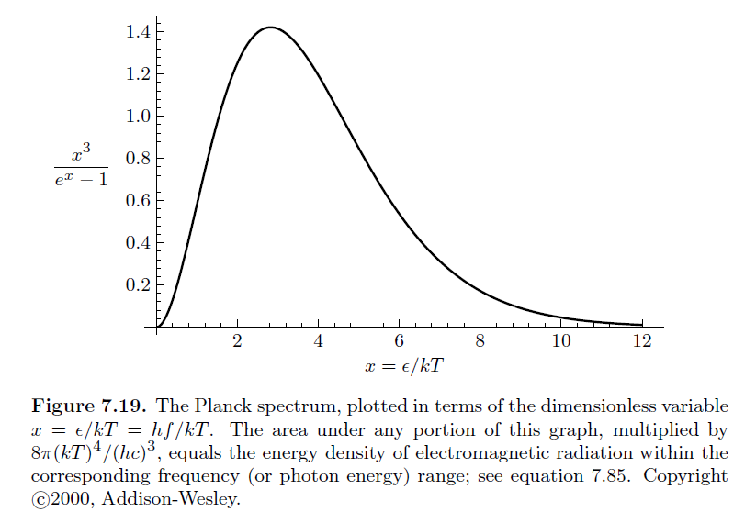

Slide 12
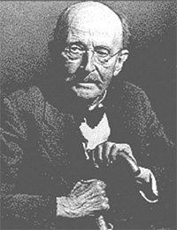
Historical importance of the formula for Blackbody radiation
Max Planck 1858-1947
A blackbody means an idealized opaque (non-reflective) material which can absorb and emit electromagnetic radiation. If the body has an equilibrium temperature T, the energy associated with the blackbody is <U>.

Slide 13
Heat capacity and entropy associated with the equibrium blackbody radiation

Slide 14
Checking results

Slide 15
More modern evidence of blackbody radiation from the remnant radiation from the initiation of the universe measured by the cosmic background explorer satellite.

Slide 16
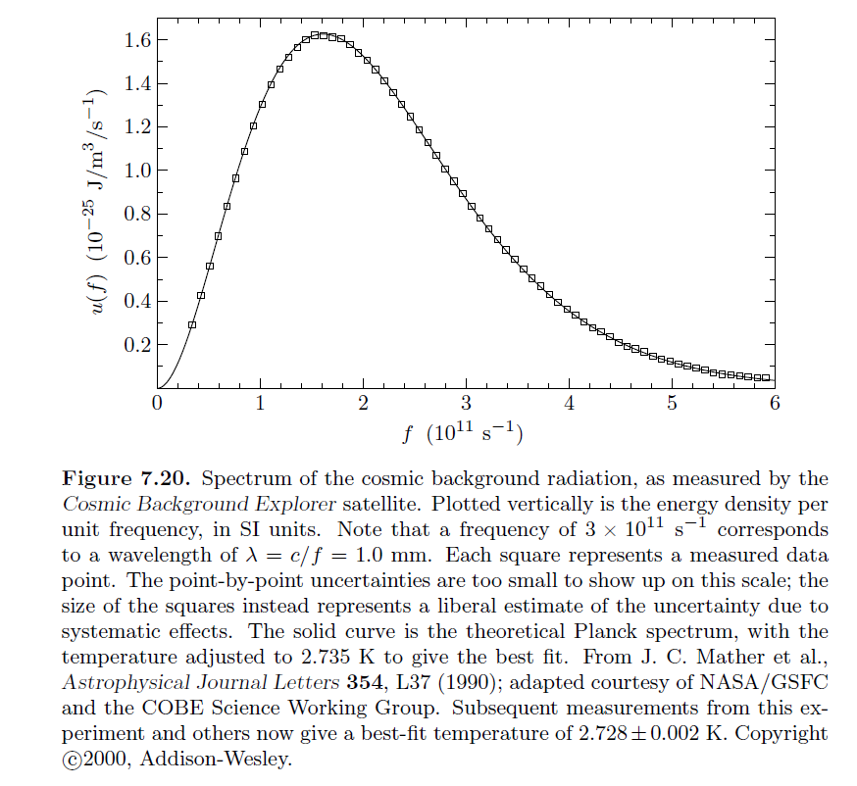
Best fit T=2.735K

Slide 17
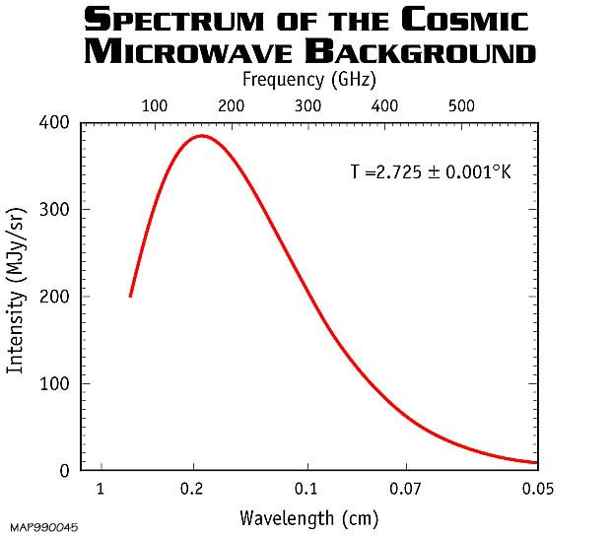
From NASA website -- https://wmap.gsfc.nasa.gov/universe/bb_tests_cmb.html

Slide 18
Next –
What happens with Boson particles with a fixed number?
What happens with Fermi particles with a fixed number?

