Slide 1
PHY 341/641 Thermodynamics and Statistical Mechanics
MWF: Online at 12 PM & FTF at 2 PM
Discussion for Lecture 27:
Quantum effects in statistical mechanics
Reading: Chapter 7 (mostly 7.3)
Recap of statistical mechanics for photons (blackbody radiation)
Statistical mechanics of Bose particles
Statistical mechanics of Fermi particles
Examples
Record!!!

Slide 3
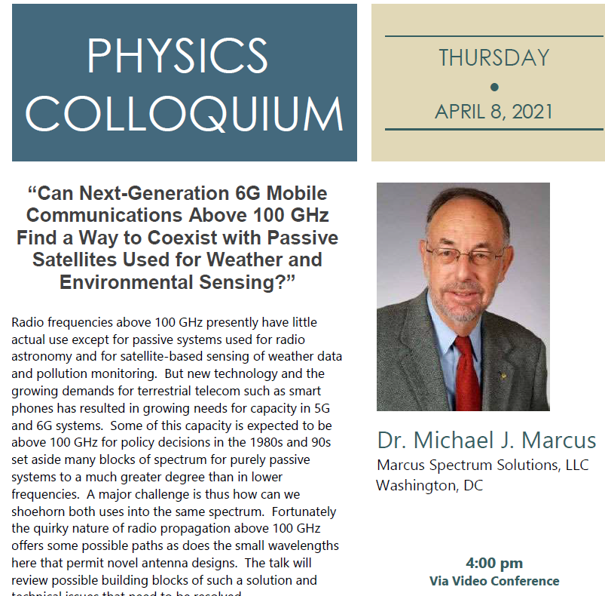
4 PM

Slide 4
Review: Blackbody radiation. Photons are spin 1 particles which obey Bose statistics.

Slide 6
Bose statistics of blackbody radiation -- continued

Slide 7
Comment on density of states
Electromagnetic modes within volume V=L³

Slide 8
L³=V
L
2 polarizations

Slide 9
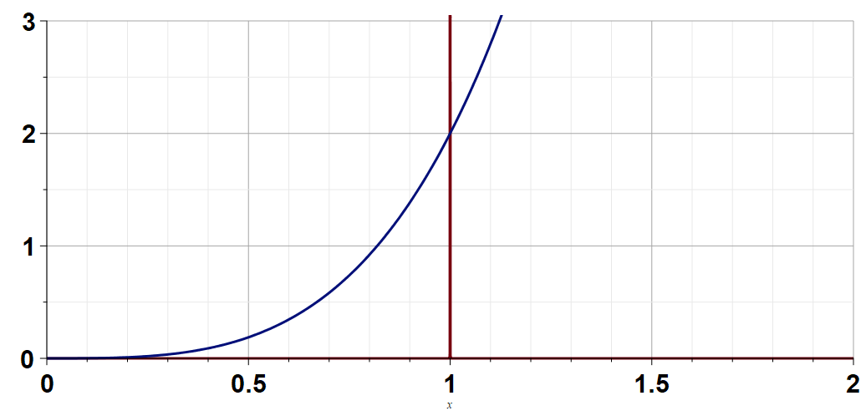
G(x)
δ(a-x)

Slide 10
The case of photon statistical analysis was simplified by the fact that any number of photons can contribute to the system. However, for particle systems, the number of particles need part of the analysis.

Slide 11
Note that the following discussion follows the textbook
F. Reif, “Fundamentals of Statistical and Thermal Physics” (1965)
Why is this a good idea?

Slide 12
Evaluating the Grand Partition Function for the Bose system
Obviously, α must depend upon N

Slide 13
➔Recipe for determining α

Slide 15
Summary of results for Bose particles
When the energy levels of our system are continuous, the summation over states s will change into the integral of energies ε with the density of states function g(ε).

Slide 16
Statistical mechanics of Fermi particles, analyzed using a similar approach --
For Fermi particles n_{s}=0 or n_{s}=1 only

Slide 17
Summary of results for Bose particles
Summary of results for Fermi particles
Do you think that Fermi and Bose particles behave the same at low temperatures?

Slide 18
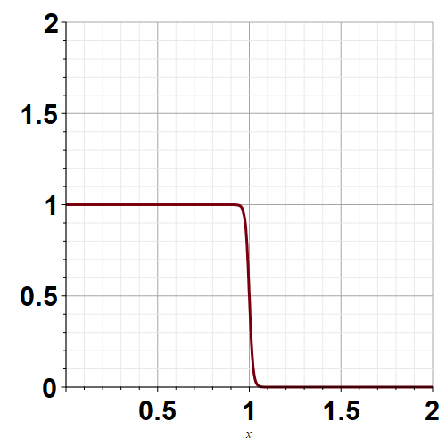
β=100

