Slide 1
PHY 341/641 Thermodynamics and Statistical Mechanics
MWF: Online at 12 PM & FTF at 2 PM
Discussion for Lecture 28:
Quantum effects in statistical mechanics
Reading: Chapter 7 (mostly 7.3&4)
Summary of results concerning statistical mechanics of Fermi and Bose particles
Examples of Fermi systems
Examples of Bose systems
Record!!!

Slide 3
Accumulated questions –
From Skye -- So when we are doing the taylor expansion, would the term inside the block have a negative sign? Since the derivative f'(x) = -5b(n)^4
Comment – You are correct. There is a minus sign error in the Lecture notes:
Original:
Corrected:
From Kristen -- 1. I don't quite understand the purpose of the triplet of positive integers (n) if you could elaborate on that I would appreciate it.
2. How is it that we can simply approximate the temperature T, to be zero?
3. Could you elaborate on what the Sommerfield expansion actually does?

Slide 4
Some results from last time
For Fermi particles n_{s}=0 or n_{s}=1 only

Slide 5
For Bose particles, the summation over n_{s} is a geometric sum
resulting the analytic form:
Summary of results for Fermi particles

Slide 6
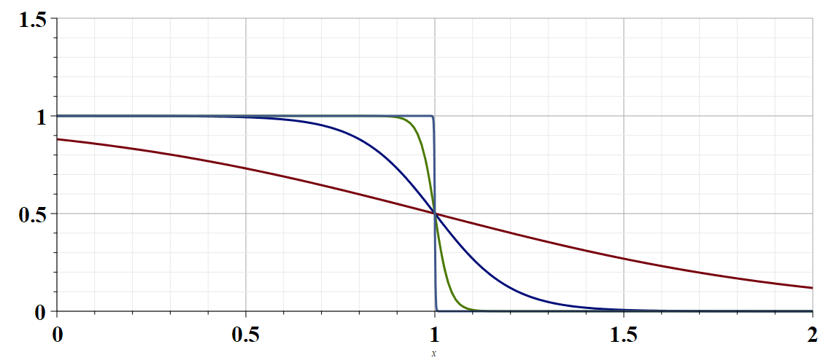
β=1000
β=50
β=10
β=2
μ=1

Slide 7
Evaluation for an ideal gas of Fermi particles
Recall that Fermi particles have intrinsic half integer spin. For example, electrons have spin s=1/2, so that each spatial state can be occupied by 0 or 1 spin up electrons and by 0 or 1 spin down electrons. Generally, the spin
degeneracy factor is given by (2s+1). To evaluate the
spatial states, for an ideal quantum gas, we can use
the cube of length L similar to the photon analysis.

Slide 8
Note that this a bit different from your textbook;
L³=V
L
Spin degeneracy

Slide 9
Evaluation of integrals --

Slide 10
Determination of chemical potential for T=0:

Slide 11
What can we do with the Grand Partition function?
Summary of thermodynamic energies that we have studied so far:

Slide 14
Summary of results for an ideal Fermi gas of s=1/2 particles in three dimensions evaluated in the limit that T→0 K

Slide 15
Evaluating these functions for T>0

Slide 16
This approach is useful at high temperatures; for low temperatures, further considerations are needed.

