Slide 1
PHY 341/641 Thermodynamics and Statistical Mechanics
MWF: Online at 12 PM & FTF at 2 PM
Plan for Lecture 2:
Reading: Chapters 1.2-1.4
Ideal gas equation of state
Notion of degrees of freedom
Work
First law of thermodynamics
Notes:
In this lecture, we will review the ideal gas equation of state and then start discussing energy measures for ideal gasses.

Slide 2
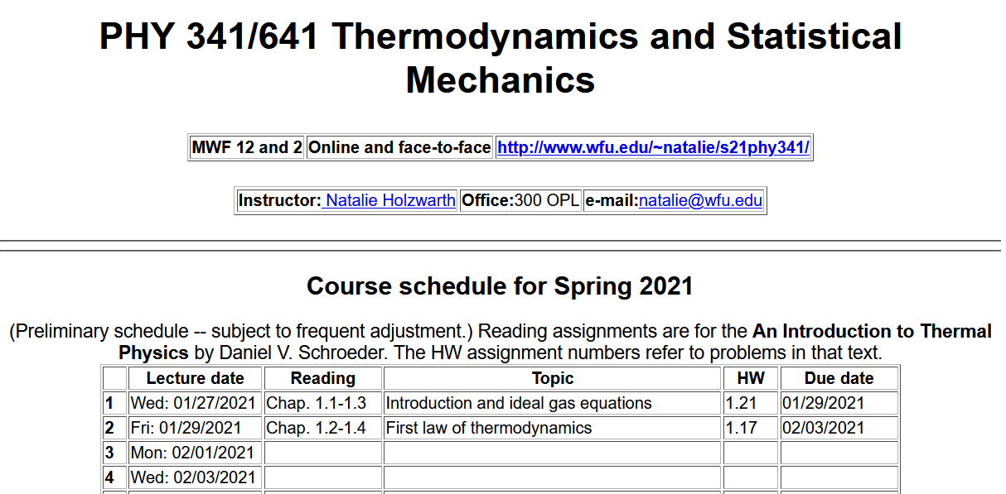
http://users.wfu.edu/natalie/s21phy341/homework/
Notes:
The homework for this time is a bit more involved and will be due by the time of lecture 4.

Slide 3
Comment on HW 1.17
This problem explores a “corrected” equation of state for a
gas and asks you to estimate some of the parameters
from data on N₂ gas.

Slide 4
Your questions – unanswered questions from last time --
Chao --Is there any relations between the number of atoms composing the molecules and the molecules' degrees of freedom? How does f=6 for atoms in crystalline solid being derived?
Can we derive a formula for thermal energy of diatomic gas in class?
Rich -- -Is there any theoretical definition or practical use for temperature in a single dimension (ie Tx, Ty, Tz) ? Why is rotation down the length of a diatomic molecules not considered?
Kristen -- After doing the assigned reading I would love to discuss why it is that many of the equations of thermodynamics are correct only when measured on the kelvin scale. Additionally, in the text specifically with Equation 1.17, the term translational kinetic energy is used, I was hoping you could clarify how this is different from simple kinetic energy.
Notes:
Here are some of the questions from last time, that we did not yet cover. Please continue to pose your questions and suggestions for class discussion.h

Slide 5
Parker --And as the book states instead of PV=NRT, do you recommend we remember the conversion factor nR=Nk? What is the reason for this?
Annelise --how come in the average pressure equation we only take into consideration the velocity in the x direction? I see that in the next theorem about kinetic energy we can conclude that the y, z, and x equations are all equal- is this true for the pressure equation as well?
Leon --My question for tomorrow's lecture material focus on degrees of freedom. I still have a blurred definition of it. I first thought it's like coordinates and then find it wrong. So is it defined like all possible forms of energy a molecule could have? And how to know the exact number of df for different molecules.
Noah -- One of the footnotes says that a decrease in the temperature by a factor of e is a more precise definition. Why is this?
2. I am curious to learn more about how some vibrational degrees of freedom do not contribute to temperature, and what types of modes these would be.

Slide 6
Comment on the ideal gas equation of state
Note that it is sometimes more convenient to represent this equation in terms of the number “n” of moles of particles (1 mole= 6.0224076 x 10²³ particles)
Notes:
You can use either and both forms as convenient.

Slide 7
More comments on the ideal gas equation of state
Why must we use T measured on the Kelvin scale?
The Celsius and Fahrenheit scales were invented on the basis of human experience without a recognition of the fundamental properties of matter. The experimental analysis leading to the ideal gas equation of state lead to the notion that the correlation of temperature and matter is best described by a temperature scale for which T≥ 0.

Slide 8
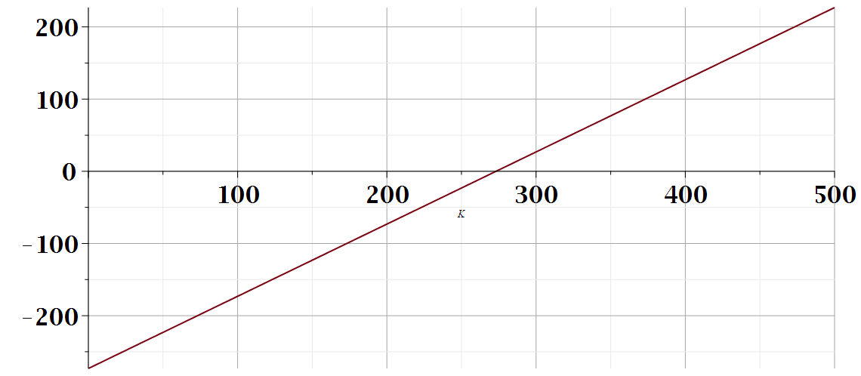
Temperature scales
Water boils
T (Celsius)
Water freezes
T (Kelvin)
273.15

Slide 9
History of ideal gas equation of state – short article from department of energy --
https://www.energy.gov/ne/articles/empirical-math-model-ideal-gas-law-0
Multiple scientists over ~ 200 years starting in 1663
Boyle
Charles
Guy-Lussac
Avogadro

Slide 10
Limitations of ideal gas equation of state
Assume gas particles are points (do not account for particle size) which particularly limits validity at high density
Assume gas particles do not interact with each other
Other?
Your homework problem for this and Monday’s lecture will explore some of these issues.

Slide 11
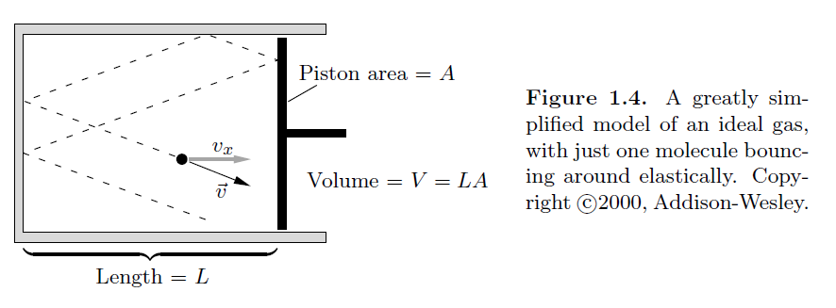
Microscopic analysis of ideal gas equation of state.
Figure from your textbook:
Collision of atom with piston exerts pressure
Notes:
Slide from lecture 1.

Slide 12
From Lecture 1 analysis:
Some questions about these equations
The time interval estimate 2L/v_{x} does not take into account particles near the boundary which may not travel a distance of 2L. Comment, in general boundary effects are much smaller than the bulk contributions.
Why are we only considering pressure due to x direction motion? Comment, this is special to our setup, but it is assumed that the gas motion is isotropic.

Slide 13
Note that v denotes the magnitude of the translational velocity and the average is over all gas particles in the sample.
This should work reasonably for mono atomic ideal gases.
Notes:
This was roughly the conclusion of Monday’s lecture.

Slide 14
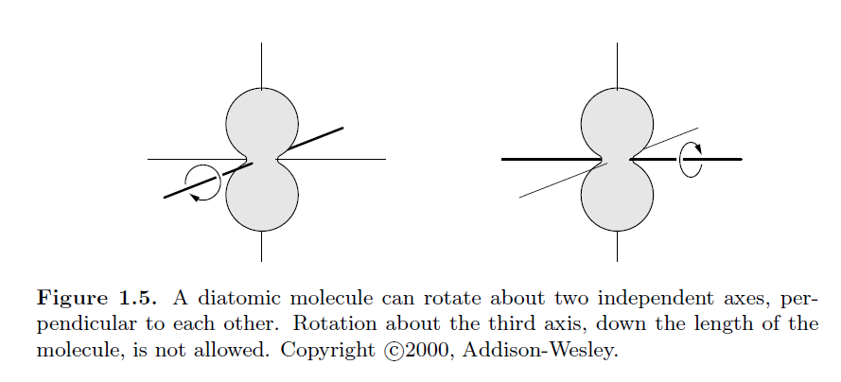
What about more complicated ideal gases composed of diatomic molecules such as O₂ or N₂?
2
1
Zero in this case.
In this case, there is non-trivial energy associated with rotational motion in the two axes perpendicular to the molecular bond while rotation about the bond axis involves a trivial expenditure of energy.

Slide 15
Having established that temperature is related to the translational kinetic energy of a monoatomic particle, what can we expect for the temperature relation to a diatomic or more complex molecule?
Introduce the notion of “degrees of freedom” f
f= 3 + rotations
Here 3 represents the 3 translational degrees of freedom and “rotations” mean the number of nontrivial moments of inertial for the molecule (2 for a diatomic, 3 for CH₄, for example.
Note that the translational and rotational kinetic energies can be very small, but vibrations typically take more energy. Therefore, in counting the “degrees of freedom” only translations and rotations are considered.

Slide 16
Equipartition theorem –
At temperature T each degree of freedom of the molecule on average takes the amount of energy ½ k_{B}T.
What do you think about the equipartition theorem
Totally believable
Somewhat skeptical
Totally unconvinced ⬅➔ should ask for your money back!!
**Make sure that you get this question answered**
On the basis of the equipartition theorem, we can then deduce that the motional energy of an ideal gas containing N particles can be written
Note the f is temperature dependent; operationally it can be measured by experiment.

Slide 17
Continued discussion --

Slide 18
From:
https://www.engineeringtoolbox.com/specific-heat-capacity-gases-d_159.html
Values at room temperature and pressure
Molecule | Formula | γ
Benzene | C₆H₆ | 1.21
Carbon dioxide | CO₂ | 1.289
Carbon monoxide | CO | 1.4
Oxygen | O₂ | 1.395
Nitrogen | N₂ | 1.400
Argon | Ar | 1.667

Slide 19
More questions –-
Parker -- Is heat a good rule of thumb to distinguish the transfer of energy from work as to that of transfer of energy from heat, as both are energy in transit?
Nick -- 1) I have a question about the set up and in particular the role that L plays. Why do we calculate over the round trip (2L) and not half the journey?
2) Also, when on slide 13 does the caption say we cannot rotate about the bond axis, but your comment says that it requires trivial every to do so?
Michael -- I am still not exactly clear on why the degrees of freedom for a diatomic gas like oxygen is 5, while this number is increased to 6 for atoms within a solid?
Annelise -- About degrees of freedom. I am confused on what that means exactly. I am also confused about why vibration counts as 2 degrees of freedom?

Slide 20
Your questions continued –
Kristen -- From what I understand from my reading, both heat and work are energy in transit, but that they are two separate entities, and while they can both increase the temperature of something, the nature of this transit is what defines them separately. I was hoping you could confirm/expand this idea.
Leon -- I suggest the class discussion can involve how the idea of the degree of freedom integrates with the Equipartition theorem.
Noah -- What are examples of temperature-dependent forms of energy that are not quadratic?
ZeZhong -- For the figure 1.6 bed spring model, does the three dimensions of kinetic energy correspond to the W and three dimensions of potential energy correspond to the Q of Chapter 1.4?

Slide 21
Notions of heat and work
Initial system
work
heat
Final system

Slide 22
Heat: Q Heat added to the system is defined as positive if it flows from a higher temperature to a lower temperature
Work: W Work done on the system defined as positive if the system contracts.
Internal energy U of the system is its average motional energy

Slide 23
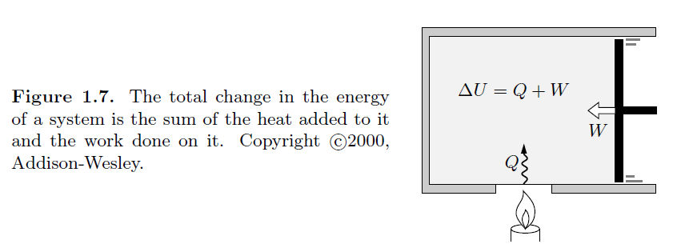
Notes:
We will study this law for our ideal gas system.

