Slide 1
PHY 341/641 Thermodynamics and Statistical Mechanics
MWF: Online at 12 PM & FTF at 2 PM
Plan for Lecture 3:
Reading: Chapters 1.5-1.6
Evaluation of work for various processes on an ideal gas
Evaluation of heat for various processes on an ideal gas
Internal energy and enthalpy
Notes:
In this lecture we will discuss the concepts and values of heat and work for various processes on ideal gases.

Slide 2
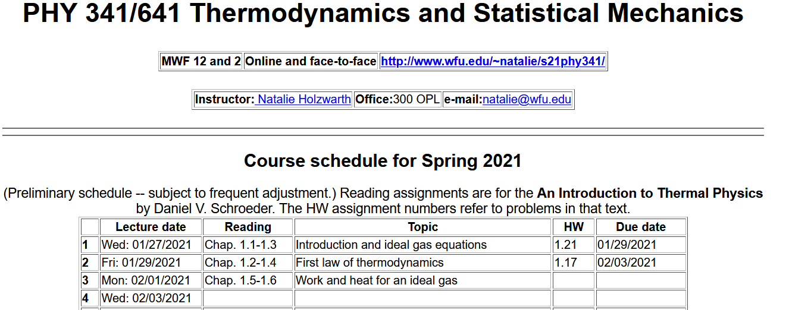
http://users.wfu.edu/natalie/s21phy341/homework/
Notes:
There is no new homework for this lecture.

Slide 3
Basic equations
General principle – expected of all systems
Follows from notion that we can/should account for all energy
Special for an ideal gas system –
Equation of state
Internal energy
Notes:
Review of basic equations needed here.

Slide 4
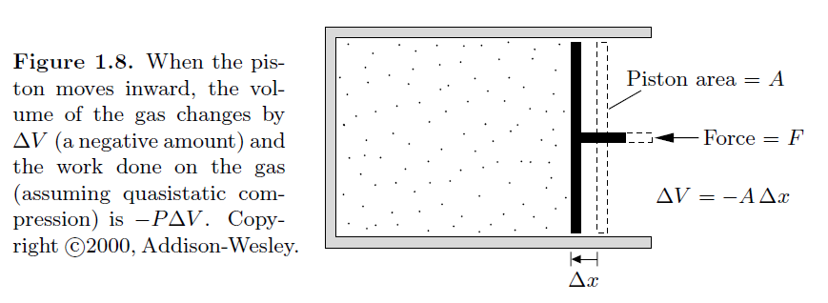
Calculation of work for various processes
Note that in our definition of work, the system contracts.
Notes:
Expression for work.

Slide 5
Work for various processes for an ideal gas
 | Initial | Final | W
Constant V | P₁ V₁ | P₂ V₁ | 0
Constant P | P₁ V₁ | P₁ V₂ | -P₁(V₂-V₁)
Notes:
Summary of results for simple cases.

Slide 6
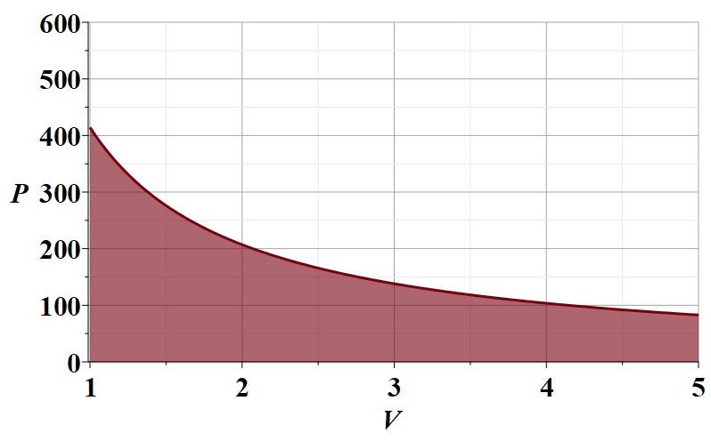
Work for various processes for an ideal gas
Now consider an isothermal process
In order to evaluate W, it is useful to consider a plot of P versus V
N=10²³
T=300 K
P (Pa)
V (m³ )
Notes:
Work for an isothermal process.

Slide 7
Work for an isothermal process in an ideal gas
N=10²³
T=300 K
Notes:
Performing the integral to evaluate work for an isothermal process.

Slide 8
Summary of results
 | Initial | Final | W
Constant V | P₁ V₁ | P₂ V₁ | 0
Constant P | P₁ V₁ | P₁ V₂ | -P₁(V₂-V₁)
Constant T | P₁ V₁ | P₁V₁/V₂ V₂ | -P₁V₁ ln(V₂/V₁)
Notes:
Updating the summary of results.

Slide 9
Now consider the effects of heat on the system
Special for an ideal gas system –
Equation of state
Internal energy
Notes:
Now consider heat for these and other processes.

Slide 10
Consider the ideal gas processes that we have just discussed:
Con. | Initial | Final | W | ΔU | Q
V | P₁ V₁ | P₂ V₁ | 0 |  | ΔU
P | P₁ V₁ | P₁ V₂ | -P₁(V₂-V₁) |  | ΔU-W
T | P₁ V₁ | P₁V₁/V₂ V₂ | -P₁V₁ ln(V₂/V₁) | 0 | -W
Notes:
Combining work and heat results while considering change in internal energy for the same processes.

Slide 11
Now consider the case where Q=0, termed an “adiabatic” process for a system described by an ideal gas equation of state.
Notes:
Now consider the situation when there is no heat added to the system. For the ideal gas, this leads to a modified equation of state in this case.

Slide 12
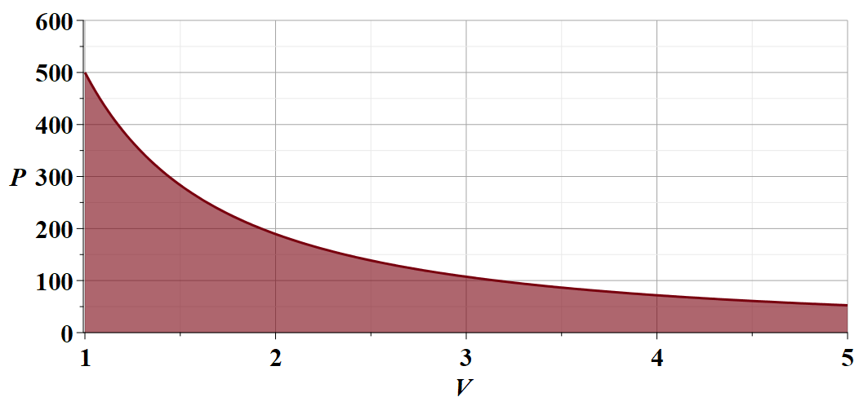
Notes:
Graph of adiabatic ideal gas equation of state and work integral.

Slide 13
The notion of heat capacity
The rate of heat increment per increment of temperature
Constant volume process
Note that g is temperature dependent, but it that contribution is generally a small correction.
Notes:
Specific heat.

Slide 14
Constant pressure process
Notes:
Specific heat at constant pressure.

Slide 15
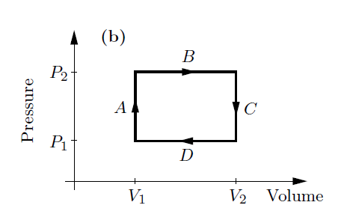
Net work done in a cyclic process
Consider the following 4 step cycle
A ➔ no work
B ➔ negative work
C ➔ no work
D ➔ positive work
net work
Notes:
Consider a set of processes that return the system to its beginning conditions – a complete cycle.

Slide 16
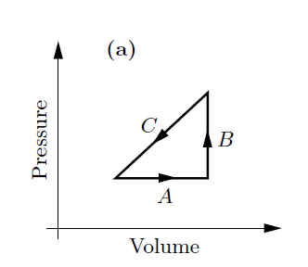
Net work done in a cyclic process -- continued
Consider the following 3 step cycle:
P₂
P₁
net work
V₁
V₂
Notes:
Another example of a complete cycle.

Slide 17
Question – What is ΔU for full cycle process?
Notes:
We saw examples of complete cycles with net work and net heat. What about the net change in internal energy?

