Slide 1
PHY 341/641 Thermodynamics and Statistical Mechanics
MWF: Online at 12 PM & FTF at 2 PM
Discussion for Lecture 30:
Quantum effects in statistical mechanics
Reading: Chapter 7 (mostly 7.5)
Statistical mechanics of lattice vibrations
Other Bose systems
Bose condensate
Record!!!

Slide 2
4 PM

Slide 3
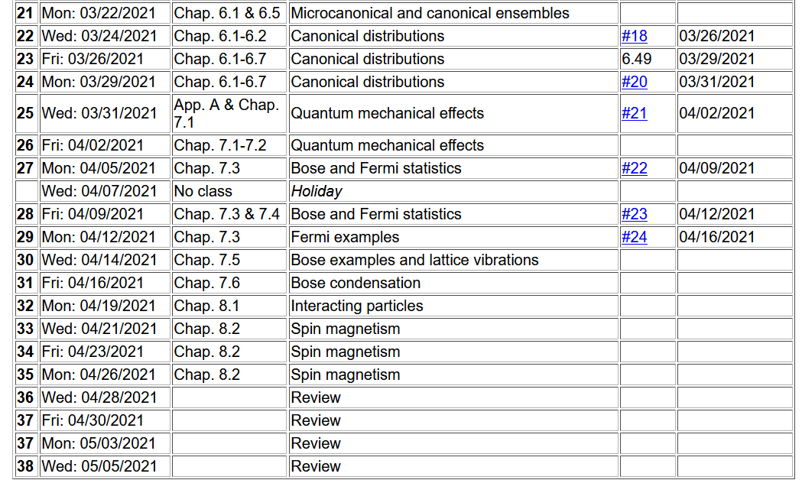

Slide 4
Your questions –
From Kristen -- 1. Could you highlight the difference between high frequency and low frequency modes?
2. Do we approximate the cube using a whole sphere or simply a quarter of a sphere as shown in figure 7.27?
3. What does the Debye temperature represent physically?
From Noah -- Can you explain the actual meaning of n and n_max? I am having trouble understanding it's physical meaning in crystals and the waves shown in Figure 7.26.
Comment – We will analyze the equations in a somewhat different way by first introducing the notion of density of states for the phonon modes, similar to the treatment of ideal gasses as we did previously.

Slide 5
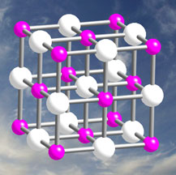
What do vibrations have to do with Bose statistical mechanics?
Nothing.
Similar mathematics.
Physicists never are will to let a beautiful equation go unused.
Image of equilibrium geometry of crystal:

Slide 6
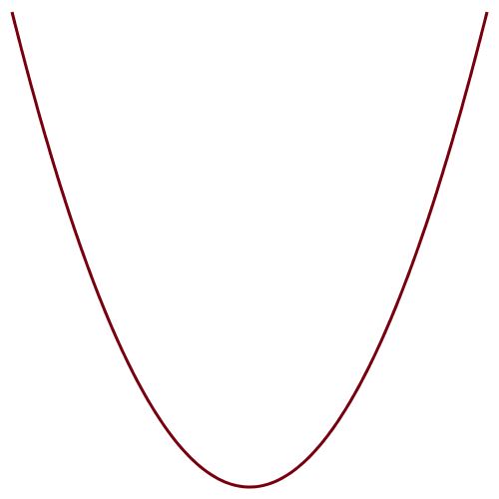
In practice, each of the 3N atoms in the crystal oscillates about its equilibrium position with various characteristic
frequencies ω^{ν}(k) depending on wavevector k mode number ν.

Slide 7
In this case, the quantum numbers for each mode
n=0,1,2… are not constrained so that the canonical partition function can be evaluated and it is a good approximation to assume that mode ν at each wave vector k is independent --
Note that even at T=0, vibrations contribute to the Helmholtz free energy. This is called zero point motion.

Slide 8
Thermodynamic functions for vibrations

Slide 9
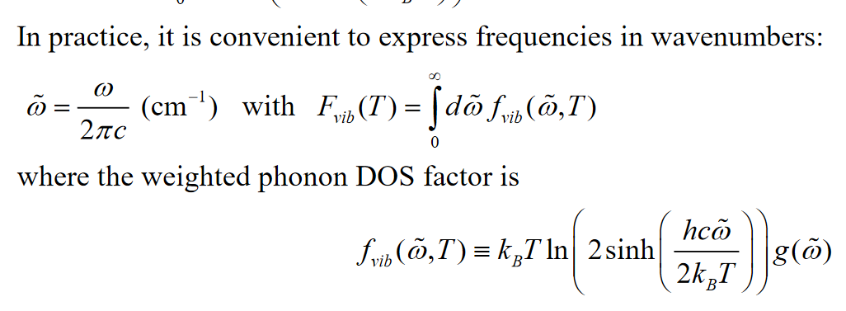
How can we evaluate these quantities? Again, it is convenient to calculate the density of states for the vibrational modes. For this various units can be used for the vibrational frequencies such as the following --

Slide 10
Plot of lattice vibration modes for diamond plotted for various wavevectors https://th.fhi-berlin.mpg.de/th/Meetings/DFT-workshop-Berlin2009/Talks/OnlinePublication/0630-4T_20090630-1_FH_-_phonon_tutorial_talk_web.pdf

Slide 11
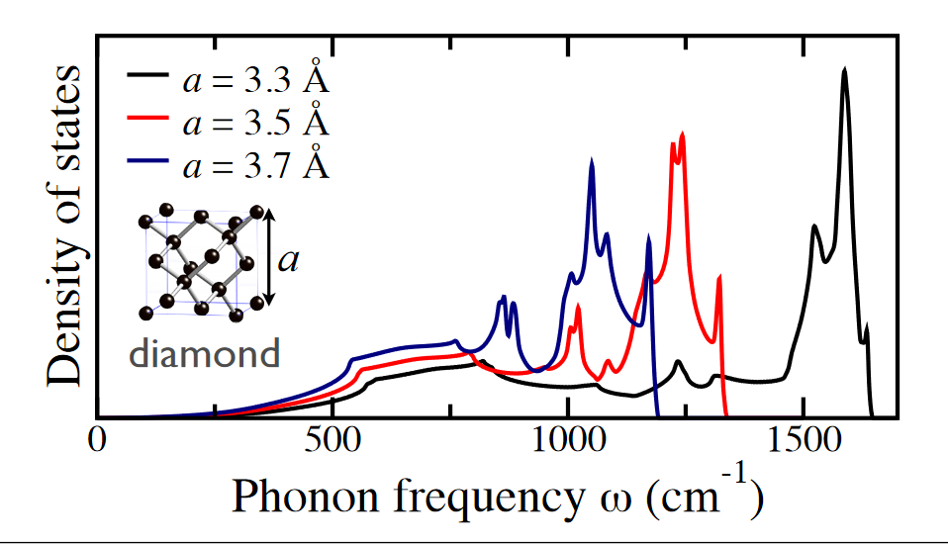
g(ε) plots from previously cited presentation showing how the density of states is very sensitive to volume (lattice constant)

Slide 12
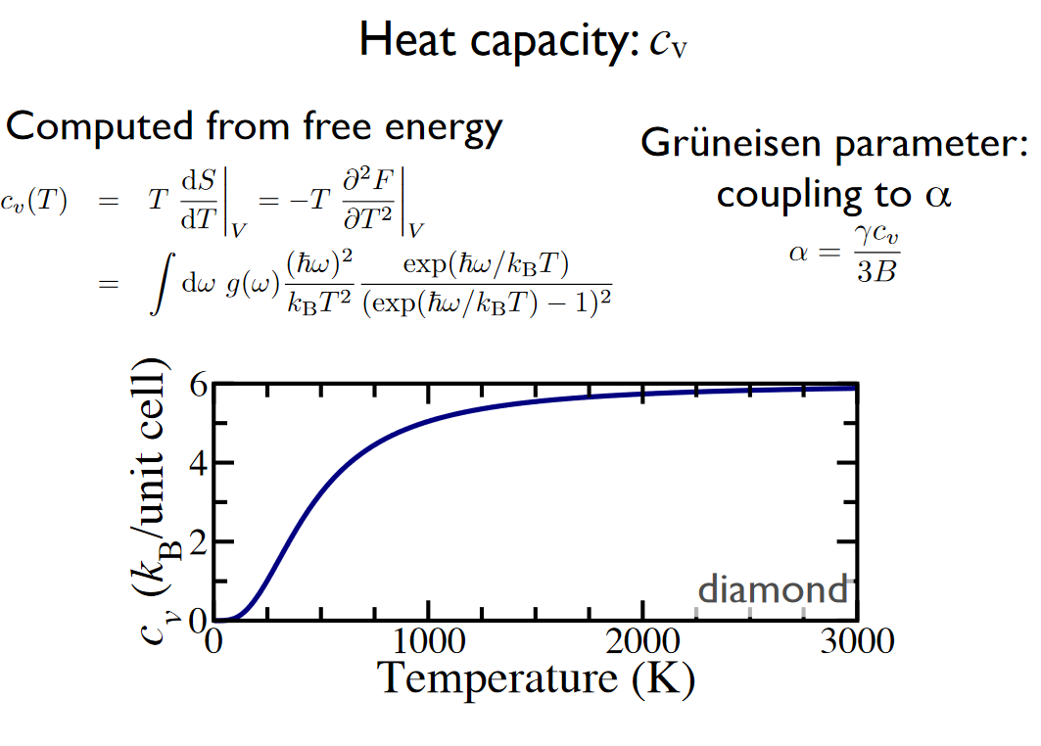
From Hanke & Fuckes (continued)

Slide 13
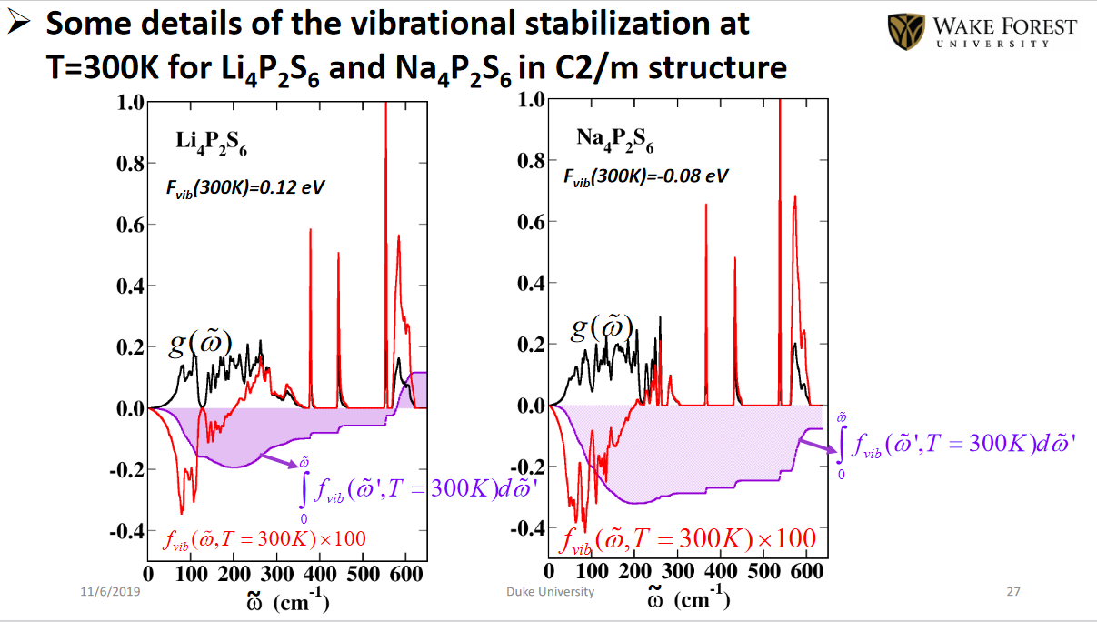
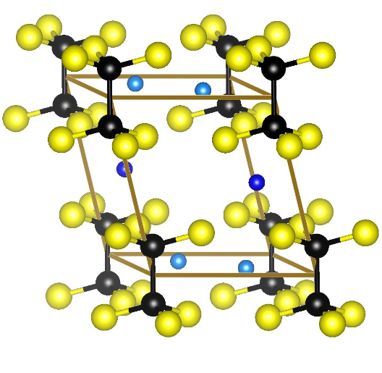
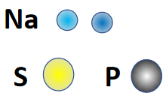
Example from a recent paper by graduate student Yan Li

Slide 14
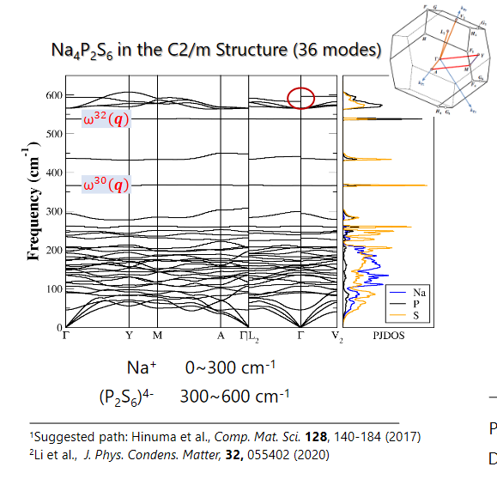
Representation of the phonon modes

Slide 15
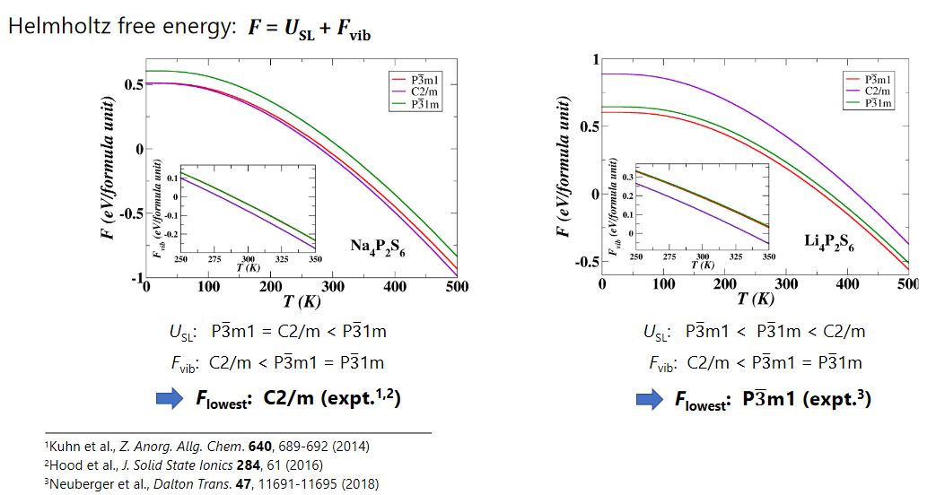
In this study, the estimate of the phonon contributions to the Helmholtz free energy helped explain why the two similar materials take different structural forms at room temperature.

Slide 16
Back to the general equations

Slide 17
Debye model to approximate g(ε)
Based on the notion that at low frequency (ε) the vibrations behave like sound waves through the material with a characteristic speed c. (Note that this is the speed of sound not light!!!) In more detail sound waves in different directions of the material can have different speeds, but we will characterize the average by c.

Slide 18
Evaluation of heat capacity in the Debye model

Slide 19
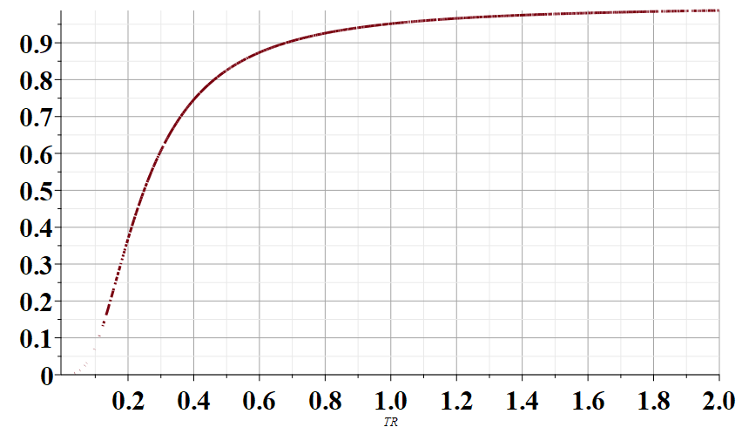
C_{V}/(3Nk)
T/T_{D}

Slide 20
Some typical values of T_{D}
Material | T_{D} (K)
Na (metal) | 150
C (diamond) | 1860
Fe (metal) | 420

