Slide 1
PHY 341/641 Thermodynamics and Statistical Mechanics
MWF: Online at 12 PM & FTF at 2 PM
Discussion for Lecture 31:
Quantum effects in statistical mechanics
Reading: Chapter 7 (mostly 7.5)
Statistical mechanics of Bose systems
Liquid ⁴He
Bose condensate
Record!!!

Slide 2
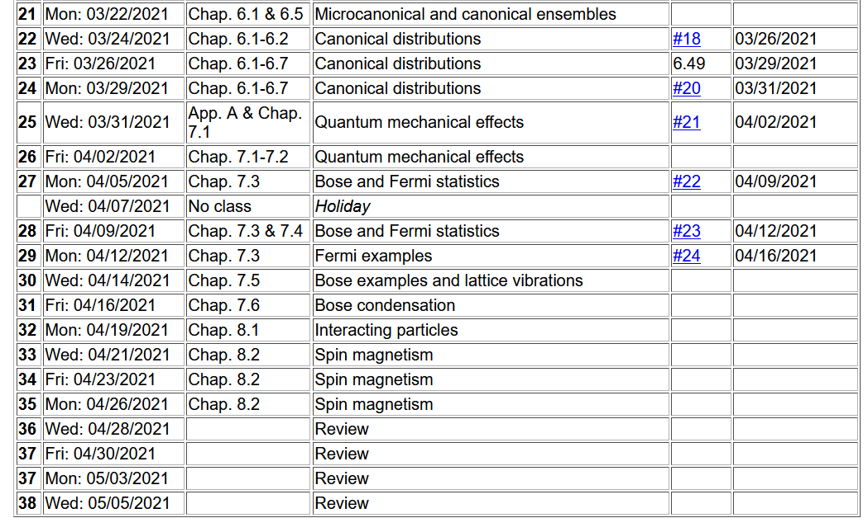

Slide 3
Your questions –
From Kristen -- 1. Why must the ground state of the energy be equal to the chemical potential at T=0, wouldn't this make the denominator of equation 7.121 be zero? 2. At temperatures higher than Tc, why is it that the chemical potential is negative? 3. Could you reinforce why Bose-Einstein Condensation doesn't happen in all systems?
From Mike -- Can you further elaborate on how the ground state for bose particles is more favorable if they are indistinguishable rather than distinguishable?
From Chao -- how is the factor Pi included in the formula below?
.

Slide 5
Grand canonical partition function and Grand potential for non interacting Bose particles:

Slide 7
Integral to evaluate:
Note that for ε < μ, the integrand is unphysical (negative)
Deduce that μ ≤ 0.
➔ negative value
➔ As T→0 and quantum effects dominate, we expect μ to increase to its limiting value of 0.

Slide 8
Back to our integral
Now assume that as T is lowered, there may be a critical temperature T_{c} at which μ=0 so that
Riemann zeta function

Slide 9
Significance of this result --
➔It is possible for a macroscopic number of Bose particles to occupy the lowest energy state of the system.

Slide 10
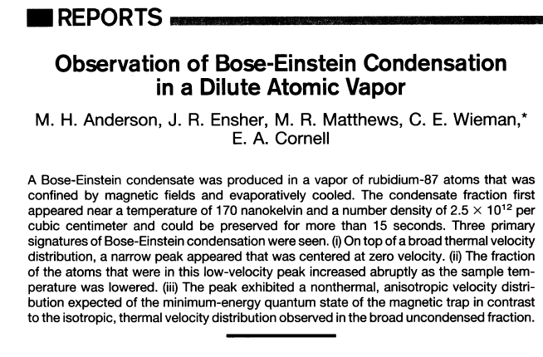
Physical realization of Bose condensation
⁴He has a phase transition at 2 K to a “superfluid” state as discovered in 1937. While it is intriguing to associate this phenomenon with Bose condensation, interactions of the He atoms in the superfluid state, modify the thermodynamics and statistical mechanics.
1995
T_{c}=1.7x10⁻⁷K
⁸⁷Rb atoms

Slide 12
Additional reading –
Proceedings of the National Academy of Sciences 2017
www.pnas.org/cgi/doi/10.1073/pnas.1707804114

Slide 13
https://www.pnas.org/content/pnas/114/23/5766.full.pdf
⁸⁷Rb atoms (~2000 atoms in condensate)

Slide 15
The problem is that as z→1, the equations become poorly defined and we need to use more careful analysis.

Slide 17
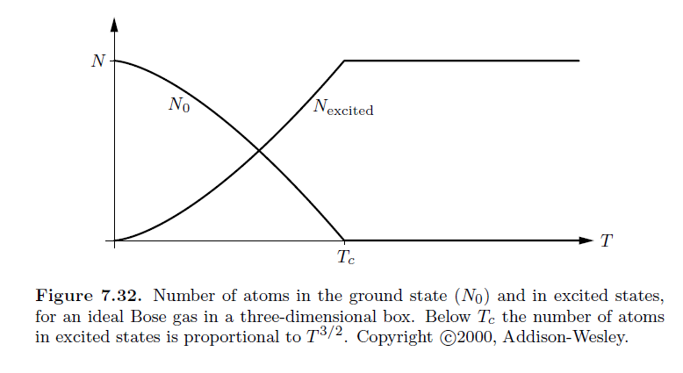

Slide 18
