Slide 1
PHY 341/641 Thermodynamics and Statistical Mechanics
MWF: Online at 12 PM & FTF at 2 PM
Discussion for Lecture 32:
Recap of Bose condensation; Treatment of particle interactions in statistical mechanics
Reading: Sections 7.6 and 8.1
Recap of Bose condensate
Treatment and effects of interparticle interactions in statistical mechanics
Record!!!

Slide 2
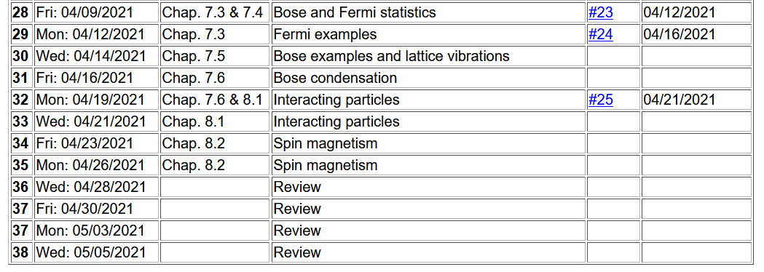

Slide 4
Some review of Bose condensate -- Bose particles are characterized by integer intrinsic spin. In the following we will assume s=0. They have the property that there are no restrictions on the occupancy of each single particle state. Therefore, there is the possibility that there can be a macroscopic number of particles occupying the ground state (in our case at ε₀=0)

Slide 5
At the critical temperature T_{c}, N₀=0 and z=1 for 0 ≤T ≤ T_{c}

Slide 7
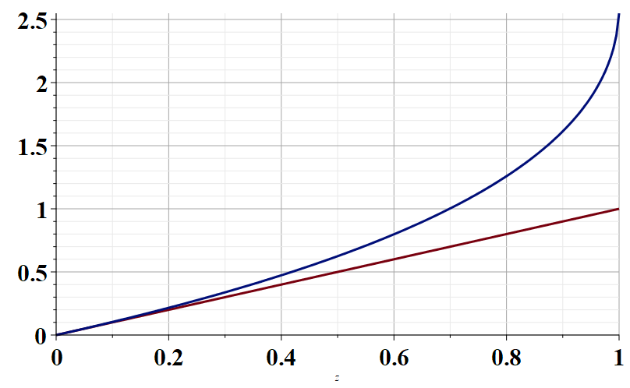
g_{3/2}(z)
z
z

Slide 8
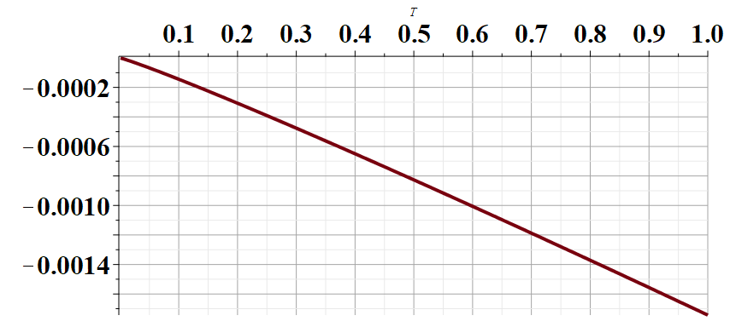
Result for classical monoatomic ideal gas!
T (K)
For ⁸⁷Rb at N/V=2.5x10²⁰m⁻³
μ (eV)

Slide 9
Your questions on Chap. 8
From Kristen -- 1. Why does the momentum (p) not appear in the first term of equations 8.2 and 8.4? 2. What is the Mayer f-function explicitly? 3. I understand where B(T) comes from mathematically, but does it have any physical representation outside of the formula?
From Rich -- What are the u0 and r0 constraints used in the equation 8.37?
From Michael --Our book mentions a symmetry factor, I was wondering if you could please expand on this a little bit, about what exactly it is and how we find it?

Slide 10
Up to now, we have focused on systems that can be well described as independent (non-interacting) particles. More realistically, particles do interact. Typically this interaction can be described in terms an interacting potential energy term. As an example, we will consider a gas of N monoatomic atoms of mass m treated using classical mechanics .
We have been ignoring this term

Slide 11
Some typical potential interactions
r₁-r₂
1
2
In practice, potential interactions can involve more than 2 particles and can be angularly dependent.

Slide 12
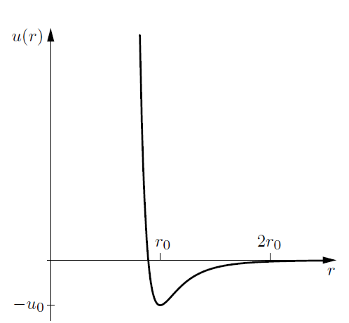
The Lennard-Jones pair potential does a good job of describing the interaction between rare gas atoms.
Repulsive interaction
at short range
Dipole-dipole attraction at long range

Slide 13
Measured Lennard-Jones parameters for some rare gas atoms (Ref. Ashcroft and Mermin, Solid State Physics)
 | Ne | Ar | Kr | Xe
U₀ (eV) | 0.0031 | 0.0104 | 0.0140 | 0.0200
r₀ (Angstroms) | 3.08 | 3.82 | 4.10 | 4.47

Slide 14
Classical canonical partition function for gas of particles of mass m in the presence of an interaction potential

Slide 16
Evaluation of potential terms continued --

