Slide 1
PHY 341/641 Thermodynamics and Statistical Mechanics
MWF: Online at 12 PM & FTF at 2 PM
Discussion for Lecture 33:
Treatment of particle interactions in statistical mechanics
Reading: Sections 8.1
Treatment and effects of interparticle interactions in statistical mechanics
Corrections to the ideal gas law; virial coefficient
Record!!!

Slide 2
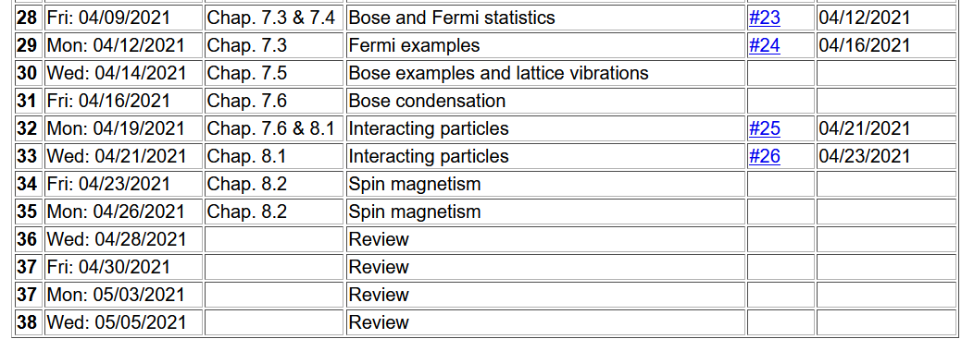

Slide 4
4 PM

Slide 5
Up to now, we have focused on systems that can be well described as independent (non-interacting) particles. More realistically, particles do interact. Typically this interaction can be described in terms an interacting potential energy term. As an example, we will consider a gas of N monoatomic atoms of mass m treated using classical mechanics .
We have been ignoring this term

Slide 6
Some typical potential interactions
r₁-r₂
1
2
In practice, potential interactions can involve more than 2 particles and can be angularly dependent.

Slide 7
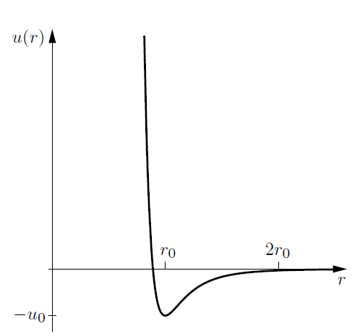
The Lennard-Jones pair potential does a good job of describing the interaction between rare gas atoms.
Repulsive interaction
at short range
Dipole-dipole attraction at long range

Slide 8
Measured Lennard-Jones parameters for some rare gas atoms (Ref. Ashcroft and Mermin, Solid State Physics)
 | Ne | Ar | Kr | Xe
U₀ (eV) | 0.0031 | 0.0104 | 0.0140 | 0.0200
r₀ (Angstroms) | 3.08 | 3.82 | 4.10 | 4.47

Slide 9
Classical canonical partition function for gas of particles of mass m in the presence of an interaction potential

Slide 11
Comment --

Slide 12
Evaluation of potential terms continued --

Slide 13
Evaluation of the pair contribution --

Slide 14
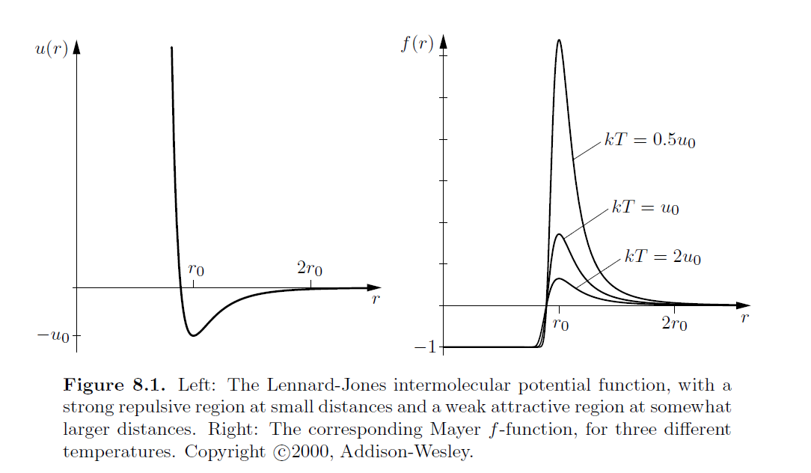

Slide 15
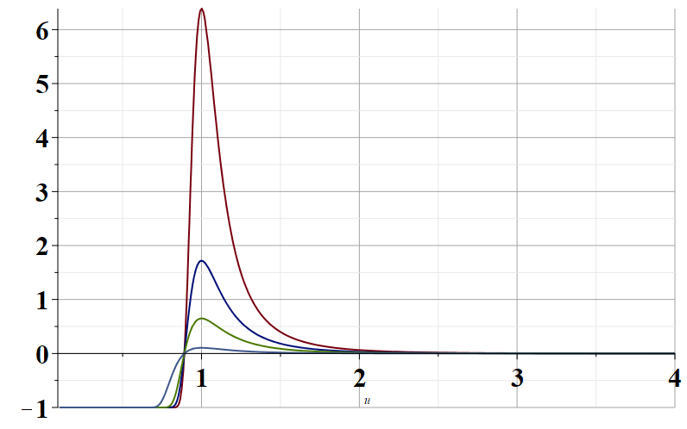
u→

Slide 16
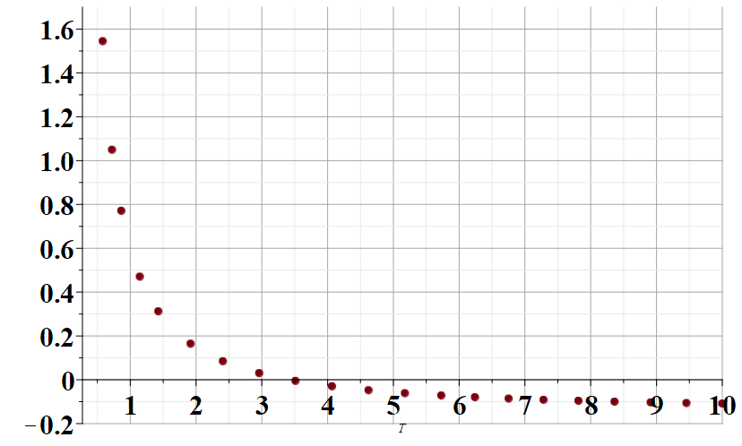
I_{pair}
kT/Φ₀

Slide 17
Evaluating the partition function for this case

Slide 19
Virial expansion up to second order

Slide 20
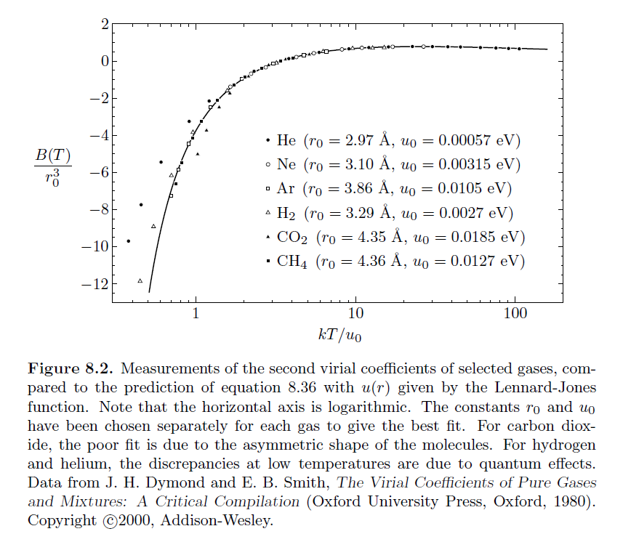
Plot of second virial coefficients from Schroeder --

